Slide 1
Pass-through Entity’s Oversight Responsibilities for Subrecipients
TRAINING
Office of the Chief Financial Officer
Office of Justice Programs

Slide 2
Topics Slide Number
Definitions . . . . . . . . . . . . . . . . . . . . . . . . . . . . . . . . 5
What is a Pass-through Entity? . . . . . . . . . . . . . . . . . . . . 6
What is a Subaward/Subrecipient? . . . . . . . . . . . . . . . . . 7-8
What is a Contract/Contractor? . . . . . . . . . . . . . . . . . . . 9-10
Determination . . . . . . . . . . . . . . . . . . . . . . . . . . . . . 11
Subrecipient vs. Contract Determination . . . . . . . . . . . . . 12-14
Characteristics of a Subrecipient vs. a Contractor . . . . . . . . . . 15
Responsibilities . . . . . . . . . . . . . . . . . . . . . . . . . . . . 16
Pass-through Entity’s Responsibilities . . . . . . . . . . . . . . 17-18
Caution! . . . . . . . . . . . . . . . . . . . . . . . . . . . . . . . . 19

Slide 3
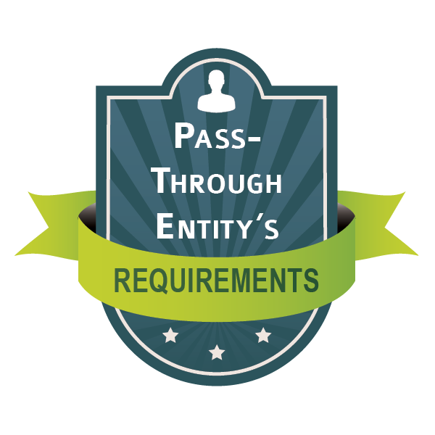
Topics Slide Number
Requirements for Pass-through Entities
Pre-Award Process . . . . . . . . . . . . . . . . . . . . . . . . . 20
Policies and Procedures . . . . . . . . . . . . . . . . . . . . . 21
Risk Assessment . . . . . . . . . . . . . . . . . . . . . . . . . 24
Post-Award Process . . . . . . . . . . . . . . . . . . . . . . . . 25
Risk Assessment . . . . . . . . . . . . . . . . . . . . . . . . . 26
Subrecipient Monitoring . . . . . . . . . . . . . . . . . . . . 30
Remedies for Subrecipient Noncompliance . . . . . . . . . . . . . 42
Closeout Process . . . . . . . . . . . . . . . . . . . . . . . . 45

Slide 4
Topics Slide Number
Recurring OIG/DOJ Findings . . . . . . . . . . . . . . . . . . . . 48
Resources . . . . . . . . . . . . . . . . . . . . . . . . . . . . . . . 51
Contact Information . . . . . . . . . . . . . . . . . . . . . . . . . 57
OJP OCFO . . . . . . . . . . . . . . . . . . . . . . . . . . . . . . 57

Slide 5
Definitions
Pass-through Entity
Subaward / Subrecipient
Contract / Contractor

Slide 6
Pass-through Entity
What is a Pass-through Entity?
A non-federal entity that provides a subaward to a subrecipient to carry out part of a Federal program (Title 2 CFR 200.1).

Slide 7
Subaward
What is a Subaward?
An award provided by a pass-through entity to a subrecipient, for the subrecipient to carry out part of a federal award received by the pass-through entity (Title 2 CFR 200.1).
Note: Subaward does not include payments to a contractor or to an individual that is a beneficiary of the federal program.

Slide 8
Subrecipient
What is a Subrecipient?
A non-federal entity that receives a subaward from a pass-through entity to carry out part of a federal program (Title 2 CFR 200.1).

Slide 9
Contract
What is a Contract?
A legal instrument by which a non-federal entity purchases property or services needed to carry out the project or program under a federal award. The term as used in this part does not include a legal instrument, even if the non-federal entity considers it a contract, when the substance of the transaction meets the definition of a Federal award or subaward (Title 2 CFR 200.1).

Slide 10
Contractor
What is a Contractor?
An entity that receives a contract as defined in Contract on previous slide (Title 2 CFR 200.1).

Slide 11
Subrecipient vs. Contractor Determination

Slide 12
Subrecipient vs. Contractor Determination
The determination on whether an entity receiving federal funds is a subrecipient or contractor is not always straightforward.
No one single factor alone will dictate one type of relationship over the other.
In fact, an entity may possess characteristics from both sides making the determination process much more challenging.

Slide 13
Subrecipient vs. Contractor Determination
The “form” (i.e. MOU, contract, etc.) is less important to the examination of a relationship than its “substance.”
“Substance” refers to the characteristics of the arrangement and whether it cast the party receiving the funds in the role of a subrecipient or a contractor.

Slide 14
Subrecipient vs. Contractor Determination
Labeling an organization as a subrecipient or contractor does not dictate how the DOJ will treat that relationship for federal grants administrative purposes.
Title
2 CFR Part 200.331
OR

Slide 15
Characteristics of a Subrecipient vs. Contractor
For additional information, please refer to: Checklist to Determine Subrecipient or Contractor Classification
SUBRECIPIENT | CONTRACTOR
Determines who is eligible to receive what Federal assistance under the program guidelines. | Provides the goods and services within normal business operations.
Has its performance measured in relation to whether objectives of a Federal program were met. | Provides similar goods or services to many different purchasers.
Has responsibility for programmatic decision making. | Normally operates in a competitive environment.
Is responsible for adherence to applicable program requirements specified in the federal award. | Provides goods or services that are ancillary to the operation of the Federal program.
In accordance with its agreement, uses the Federal funds to carry out a program for a public purpose specified in authorizing statute, as opposed to providing goods or services for the benefit of the pass-through entity. | Is not subject to compliance requirements of the federal program as a result of the agreement, though similar requirements may apply for other reasons.

Slide 16
Pass-through Entity’s Responsibilities

Slide 17
Pass-through Entity’s Responsibilities
(Title 2 CFR 200.332)
Ensure subrecipients use grant funds in accordance with all federal and program guidelines.
Oversee the day-to-day operations of subrecipients to ensure they achieve performance objectives on schedule and within budget.
-
- - - - - - - - - - - - - - - - - - -
- - -
- - -
- - -
- - -
- -
- -
- -

Slide 18
Pass-through Entity’s Responsibilities
(Title 2 CFR 200.332)
Ensure subrecipients’ timely submission of all documents necessary to meet all reporting requirements of the awarding agency (financial and performance reports).
Take the appropriate actions to get the subrecipient back on track, if problems arise.
- - - - - - - -
- - - - - - - - - - - - - - - -
- -
- - - - - - - -

Slide 19
Pass-through Entity’s Responsibilities
The use of subrecipients does not relieve the pass-through entity of its responsibilities.

Slide 20
Pre-award Process
Pass-through Entity’s Requirements

Slide 21
Pre-award Process
A pass-through entity must have established policies and procedures on how subawards will be made and subrecipients managed.
Policies and procedures must be in writing and clearly describe the pass-through entity’s responsibility for managing subrecipient’s activities throughout the award lifecycle.

Slide 22
Pre-award Process
A pass-through entity must:
Decide upon the appropriate instrument for the services needed (i.e., subaward, contract, etc.) (Title 2 CFR 200.201)
Have a method for announcing the specific funding opportunities, eligibility requirements and the allotted timeframe to apply.
Have a process for reviewing each subrecipient’s eligibility for federal funding.
Include the criteria to be used to evaluate each application.

Slide 23
Pre-award Process
A pass-through entity must:
Ensure that subrecipients are not suspended or debarred by the federal government prior to making the award.
Clearly identify the federal award information, compliance requirements, applicable terms and conditions, and any supplemental requirements imposed by the pass-through entity.
Include specific award identification data elements such as subrecipient name and entity identifier, federal award identification number, and federal award date.
(Title 2 CFR 200.332(a))

Slide 24
Pre-award Risk Assessment
A pass-through entity should:
Perform a risk-assessment of applicants prior to awarding funds – highly recommended.
Evaluate the risk posed by applicants before they receive an award. Consider such elements as:
Applicant’s eligibility or the quality of its application;
Financial stability and quality of management system;
History of performance; and
Audit findings.
The results of the risk assessment can assist the pass-through entity in determining whether additional terms and conditions should be imposed on the award.

Slide 25
Post-award Process Risk Assessment
Pass-through Entity’s Requirements

Slide 26
Post-award Process Risk Assessment
The pass-through entity must perform a risk assessment of each subrecipient for noncompliance with federal statutes, regulations, and the terms and conditions of the subaward.
To determine the appropriate level of monitoring needed.
Program requirements should be taken into consideration when determining the attributes to use in evaluating the overall risk.
There are a number of different attributes to consider when assessing risk. The final score should clearly identify the risk level (e.g., high, medium, or low).

Slide 27
Post-award Process Risk Assessment
Pass-through entity should develop a methodology to determine risk levels and the reason for assigning each subrecipient into risk categories.
The overall level of risk identified should support the frequency and depth of the monitoring practices to include ways to mitigate risk.
Subrecipient Risk Factors: | 1 | 2 | 3
Confidential Funds/Petty Cash |  |  | X
Subaward Amount $25K < | X
Delinquent Reports |  | X

Slide 28
Post-award Process Risk Assessment
Some additional items a pass-through entity should also consider when performing a risk assessment include, but are not limited to:
GENERAL ASSESSMENT | LEGAL ASSESSMENT | FINANCIAL ASSESSMENT
Award amount Matching funds New subrecipient Budget modification requests | Past suspension or debarment (must be considered) Federal debt owed | Delinquent reports Recent audit opinion Received financial reviews from other agencies

Slide 29
Post-award Process Risk Assessment
The assessment of these attributes should provide the basis for developing a monitoring plan and a strategy for monitoring subrecipients.
While this process is not all inclusive, it should give pass-through entities a starting point for assessing risk and developing a monitoring plan.
(Title 2 CFR 200.332)

Slide 30
Post-award Process Subrecipient Monitoring
Pass-through Entity’s Requirements

Slide 31
Post-award Process Subrecipient Monitoring
The pass-through entity’s annual monitoring plan should include:
All subrecipients that will be monitored
Subrecipients from each risk level should be monitored (i.e., high, medium, and low)
Type of monitoring
On-site or in-house review
Effective implementation of the monitoring plan may also result in the identification of potential areas for training and technical assistance.

Slide 32
Post-award Process Subrecipient Monitoring
Pass-through entities should develop monitoring objectives to ensure subrecipients:
Carry out program activities as stipulated in the subaward;
Have adequate internal controls to protect federal funds;
Claim reimbursement for costs that are allowable, reasonable, allocable, and necessary under program guidelines;
Identify any conflicts of interest that exist; and
Maintain required supporting documentation/records.

Slide 33
Post-award Process Subrecipient Monitoring
In preparation for an on-site visit, the pass-through entity should review all documentation, such as:
Subrecipient’s application for funding;
Written agreement with the subrecipient;
Financial and progress reports;
Drawdown history (payments made to the subrecipient); and
Copies of recent audit reports.
The result of this review may inform the pass-through entity about the subrecipient’s operations and identify potential problem areas to examine during the on-site visit.
(Title 2 CFR 200.332)

Slide 34
Post-award Process Subrecipient Monitoring
BEST PRACTICES
Notification
Entrance conference
Supporting documentation, data gathering and analysis
Exit conference
Follow-up
Corrective action plan (if applicable)
Closure of site visit

Slide 35
Post-award Process Subrecipient Monitoring
BEST PRACTICES
Notification—Send a formal notification letter at least several weeks before the visit (if possible) to:
Confirm dates and scope of review
Provide details of documentation needed for the review
Specify expected timeframe for the review
Ensure key officials are available during the review
1

Slide 36
Post-award Process Subrecipient Monitoring
BEST PRACTICES
Entrance Conference—Hold on-site meeting with the appropriate subrecipient staff (i.e. financial, program, director) prior to starting any monitoring activities.
Subrecipient staff should have a clear understanding of the purpose, scope, and schedule for the monitoring visit.
2

Slide 37
Post-award Process Subrecipient Monitoring
BEST PRACTICES
Documentation, Data Gathering and Analysis— Track each step followed during the review process, document conversations with subrecipient staff, and inspect the progress of the actual project/program.
3

Slide 38
Post-award Process Subrecipient Monitoring
BEST PRACTICES
Exit Conference—Meet with key officials to present the preliminary findings noted from the financial review.
The exit conference should cover the following objectives:
Present preliminary results of the financial/program review
Provide an opportunity for subrecipient to resolve any disputed findings
Obtain additional documentation from subrecipient to clarify or support their position
For all deficiencies not resolved at the end of the exit conference, there should be a clear understanding of any remaining finding(s).
4

Slide 39
Post-award Process Subrecipient Monitoring
BEST PRACTICES
Follow-up Letter—Use to create a permanent record of those findings not resolved during the exit conference.
Recognizes subrecipient’s success, if performing well.
Clearly describes deficiencies and recommendations, if the subrecipient is experiencing problems or failing to comply with federal requirements or program guidelines.
Includes deadlines informing subrecipients when a written response describing their proposed resolutions to any findings is due.
Send to the subrecipient within an established timeframe after conference.
Develop the follow-up letter using standardized language for the opening paragraphs and for the sections on findings, corrective action, concerns and recommendations.
5

Slide 40
Post-award Process Subrecipient Monitoring
BEST PRACTICES
Corrective Action Plan—Subrecipient must submit a plan identifying deficiencies resolved and any remaining action needed.
If any findings were not corrected or partially corrected, the reason and timeframe for each resolution must be included.
6

Slide 41
Post-award Process Subrecipient Monitoring
BEST PRACTICES
Closure of Site Visit—If adequate documentation is received to resolve each finding, send a closure letter to close the site visit.
7

Slide 42
Post-award Process Remedies for Subrecipient Noncompliance
Pass-through Entity’s Requirements

Slide 43
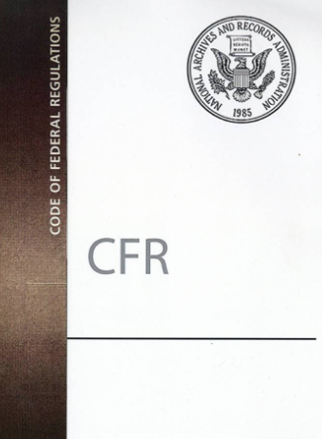
Post-award Remedies for Noncompliance
If a subrecipient doesn’t comply with federal statutes, regulations or the terms and conditions of the subaward, the pass-through entity may impose additional conditions (2 CFR 200.339).

Slide 44
Post-award Remedies for Noncompliance
If noncompliance cannot be remedied by imposing additional conditions one or more of the following actions may be taken:
Temporarily withhold funds pending correction of the deficiency;
Disallow all or part of the activity not in compliance;
Wholly or partly suspend or terminate the subaward;
Initiate suspension or debarment;
Withhold future subawards; or
Other legal remedies that may be available.

Slide 45
Post-award Process Close-out Requirements
Pass-through Entity’s Requirements

Slide 46
Post-award Closeout Process
The pass-through entity may approve an extension of the performance period only within their own performance period.
The pass-through entity must:
Close out the subaward when all applicable administrative actions and all grant related work have been completed.
Closeouts should be completed in time to meet the federal agency’s closeout timeline.
Require the subrecipient to submit all financial, performance, and other reports to the pass-through entity within 90-days after the end date of the subaward’s performance period.
(Title 2 CFR 200.344)

Slide 47
Post-award Closeout Process
The pass-through entity must:
Make prompt payments to subrecipients for allowable and authorized reimbursable costs charged to the federal award (Title 2 CFR 200.344(c)).
Establish procedures for the closeout process that address refunding excess cash and accounting for any real or personal property acquired with federal funds (Title 2 CFR 200.344(d) and (f)).
- - -
- -
- - -

Slide 48
Recurring OIG Findings

Slide 49
Recurring OIG Findings
Pass-through entities are not:
Establishing policies and procedures on how subawards will be made and subrecipients managed.
Ensuring subrecipient monitoring procedures are adequate and implemented effectively.
Adequately monitoring subrecipients to provide reasonable assurance that they comply with the terms and conditions of the award.
Ensuring resources are available to provide adequate monitoring.

Slide 50
Recurring OIG Findings
Pass-through entities are not:
Providing training and technical assistance to staff involved with the oversight of subrecipients.
Establishing procedures to ensure subrecipients comply with Single Audit Act requirements and take appropriate action on relevant findings in subrecipient’s audit reports.
Meeting Federal Funding Accountability and Transparency Act (FFATA) reporting requirements.

Slide 51
REST ASSURED
THERE ARE
RESOURCES

Slide 52
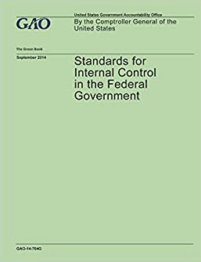
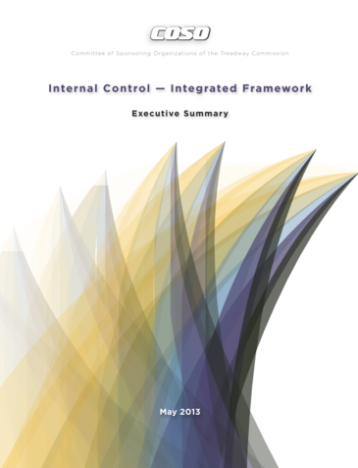
Resources
CFR 200
The Uniform Administrative Requirements, Cost Principles, and Audit Requirements in 2 C.F.R. Part 200, as adopted and supplemented by the Department of Justice (DOJ) in 2 C.F.R. Part 2800.
DOJ Grants Financial Guide
Subawards and Procurement Contracts under OJP Awards
Standards for Internal Control in the Federal Government (Comptroller General)
Internal Control Integrated Framework (COSO)

Slide 53
Specific OJP Resources
Subawards under OJP Awards and Procurement Contracts under Awards/A Toolkit for OJP Recipients
Purpose and Scope
This Office of Justice Programs “toolkit” provides guidance designed to help recipients of OJP grants and cooperative agreements (as well as prospective applicants for such OJP awards) understand:
Which (if any) of the recipient’s proposed actions OJP will consider “subawards” for purposes of federal grants administrative requirements.
Which (if any) of the recipient’s proposed actions OJP will consider “procurement contracts under an OJP award” for purposes of those federal requirements.

Slide 54
Specific OJP Resources
Common federal administrative requirements that apply to all (or virtually all) subawards of OJP awards.
Common federal administrative requirements that apply to all (or virtually all) procurement contracts under OJP awards.
OJP resources on related topics and for additional information please refer to:
https://ojp.gov/training/pdfs/Subaward-Procure-Toolkit-D.pdf

Slide 55
Specific OJP Resources
Noncompetitive Procurement
What is “noncompetitive/sole source” procurement?
Procurement by noncompetitive proposals
Must adhere to the standards set forth in Title 2 CFR 200.320(c)
When is sole source approval required by OJP?
A recipient determines that the award of a contract through a competitive process is infeasible.
Simplified Acquisition Threshold > $250K
What documentation must be submitted to OJP for sole source approval?
Noncompetitive/Sole Source Approval Grant Award Modification (GAM) in the Office of Justice Programs (OJP) JustGrants System

Slide 56
Specific OJP Resources
What is sole source review checklist?
A tool to assess the merits of a sole source approval request
For additional information, please refer to the Sole Source Justification Fact Sheet:
https://ojp.gov/training/pdfs/Sole-Source-FactSheet-C.pdf

Slide 57
Contact Information
Michael Williams - OJP/OCFO
(202) 305-2584
Michael.Williams4@usdoj.gov or DOJFinancialTraining@usdoj.gov
OCFO Customer Service Center
Monday through Friday
8:30 a.m.–6:00 p.m. (EST)
1 (800) 458-0786 or (202) 305-9988
FAX (202) 353-9279
OCFO email Address: Ask.ocfo@usdoj.gov
For program specific questions, contact your program manager.

Slide 58
No Question
?
?
?
?
?
?
is a Dumb Question

