Slide 1
Financial Management Seminar
Basic Training
Angela Wade and Trevon Tillman
Grants Financial Management Division
October 20-21, 2026

Slide 2
Opening Remarks and Overview of the Course

Slide 3





Financial Life Cycle of Grants
Application
Budget
Review
Award
Grant Administration
Closeout

Slide 4

No
Question
Is a dumb Question

Slide 5
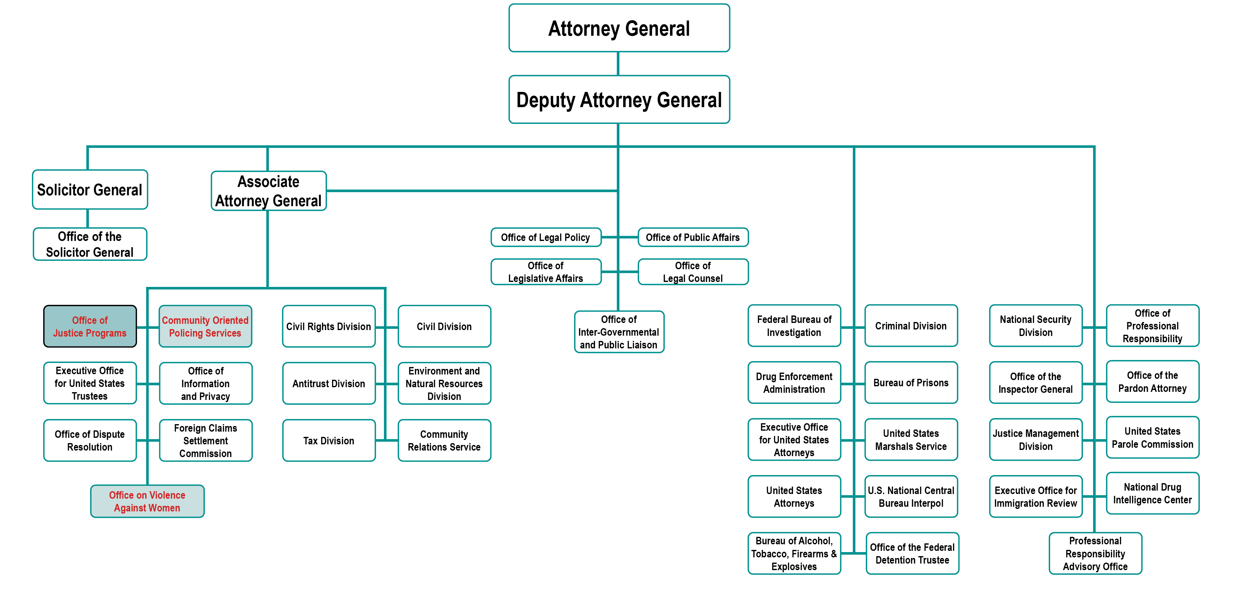
U.S. Department of Justice

Slide 6
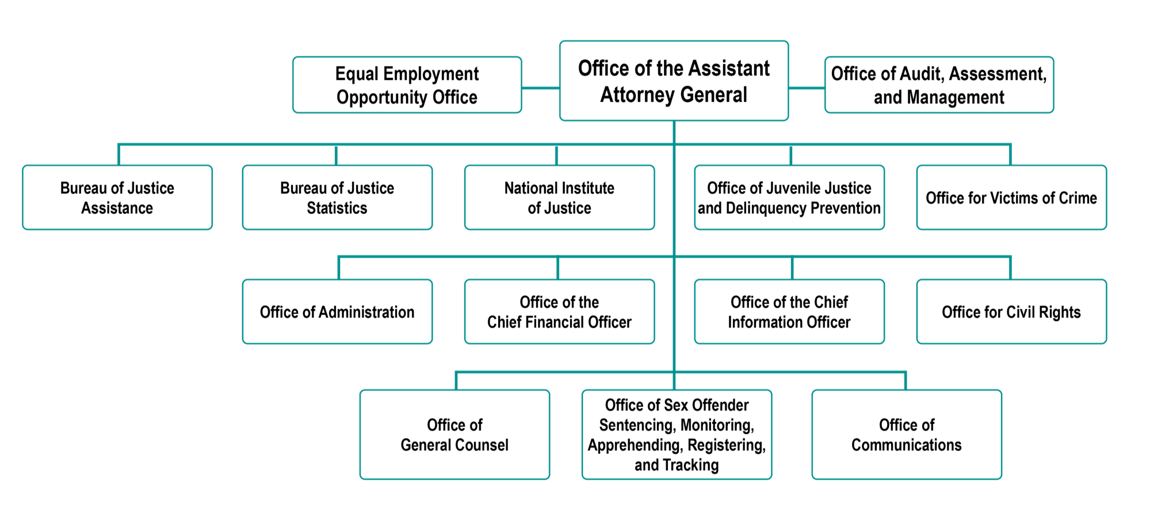
Office of Justice Programs

Slide 7
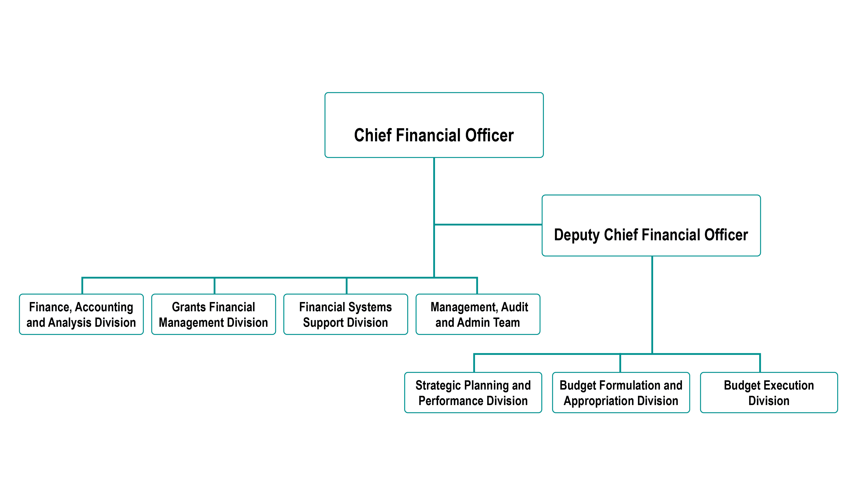
Office of the Chief Financial Officer
Rachel Johnson
Brian Horn

Slide 8
Where Do Federal Grants Come From?

Slide 9

Federal Budget Process (1 of 7)
Authorization

Slide 10

Federal Budget Process (2 of 7)
Authorization
Appropriation

Slide 11

Federal Budget Process (3 of 7)
Authorization
Apportionment
Appropriation
$
$

Slide 12

Federal Budget Process (4 of 7)
Authorization
Apportionment
Appropriation
Allotment
$
$

Slide 13

Federal Budget Process (5 of 7)
Authorization
Apportionment
Obligation
Appropriation
Allotment
$
$
$

Slide 14

Federal Budget Process (6 of 7)
Authorization
Apportionment
Obligation
Allotment
Expenditures
Appropriation
$
$
$
$

Slide 15

Federal Budget Process (7 of 7)
Authorization
Apportionment
Obligation
Disbursements
Allotment
Expenditures
Appropriation
$
$
$

Slide 16
Agency Requirements When Applying for Federal Grant Funds

Slide 17


Financial Management Systems
All recipients are required to:
Establish/maintain auditable accounting records
Accurately account for funds awarded
Funds for each award must be accounted for
separately from other grants and other funding sources

Slide 18
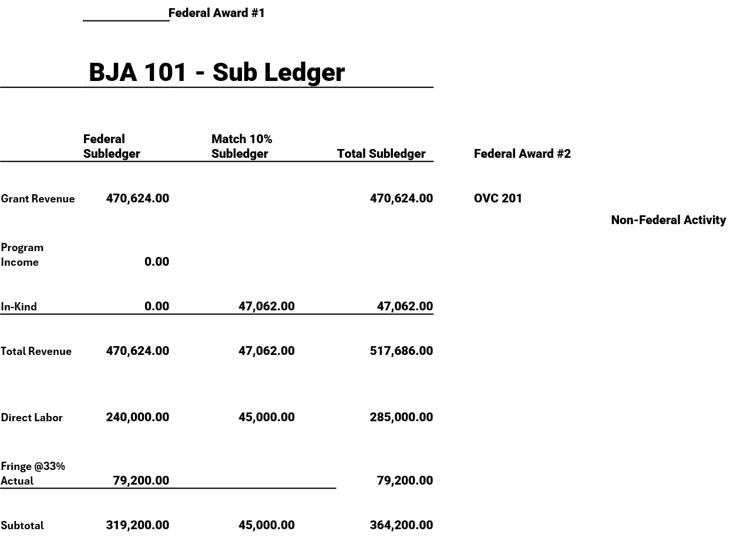
Segregation of Awards and Activities

Slide 19
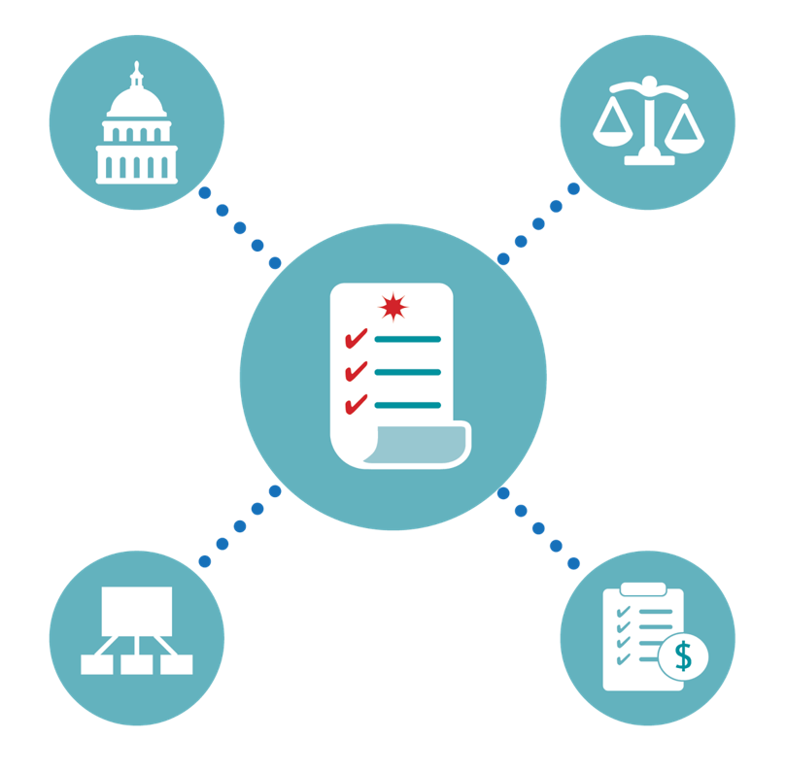
Policies and Procedures
States, Indian Tribes, and recipients or subrecipients must expend/account for grant funds per their own policies and procedures, applicable Federal statutes, regulations, and terms and conditions of the award. (whichever are more restrictive)

Slide 20

Accounting and Internal Controls
Proper stewardship of federal resources is an essential responsibility of the grantee organization.
Grantees must ensure that Federal programs and resources are used efficiently and effectively to achieve desired objectives.

Slide 21

Internal Controls and Segregation of Duties
Strong internal controls allow for effective and efficient operations, reliable financial reporting, and compliance with applicable laws and regulations.
Proper segregation of duties should ensure that no individual has the ability to either conceal or misdirect funds within the agency.

Slide 22
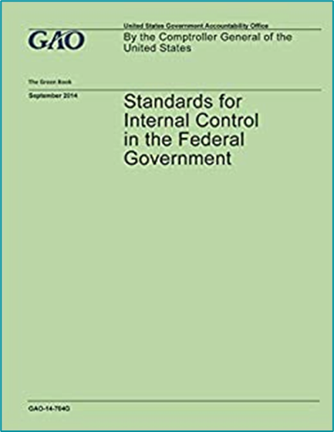
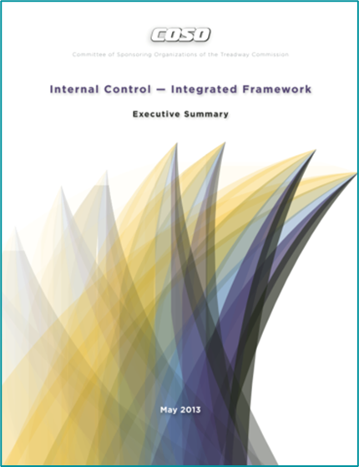
Internal Controls
Standards for Internal Controls in the Federal Government – (Green Book).
Internal Control Integrated Framework / (Committee
of Sponsoring Organizations
of the Treadway
Commission – COSO).

Slide 23


Adequate Accounting System (1 of 3)
Grantee must maintain an adequate system of accounting and internal controls and ensure that an adequate system exists for each of its subrecipients.

Slide 24

Adequate Accounting System (2 of 3)
Provides cost and property control to ensure optimal use of funds.
Present and classifies costs,
as required for budgetary and evaluation purposes.
Controls funds/resources to assure conformance with general or special conditions.

Slide 25

Adequate Accounting System (3 of 3)
Provides financial data for planning, control, measurement, and evaluation of direct and indirect costs. general or special conditions.
Meets requirements for periodic reporting.

Slide 26
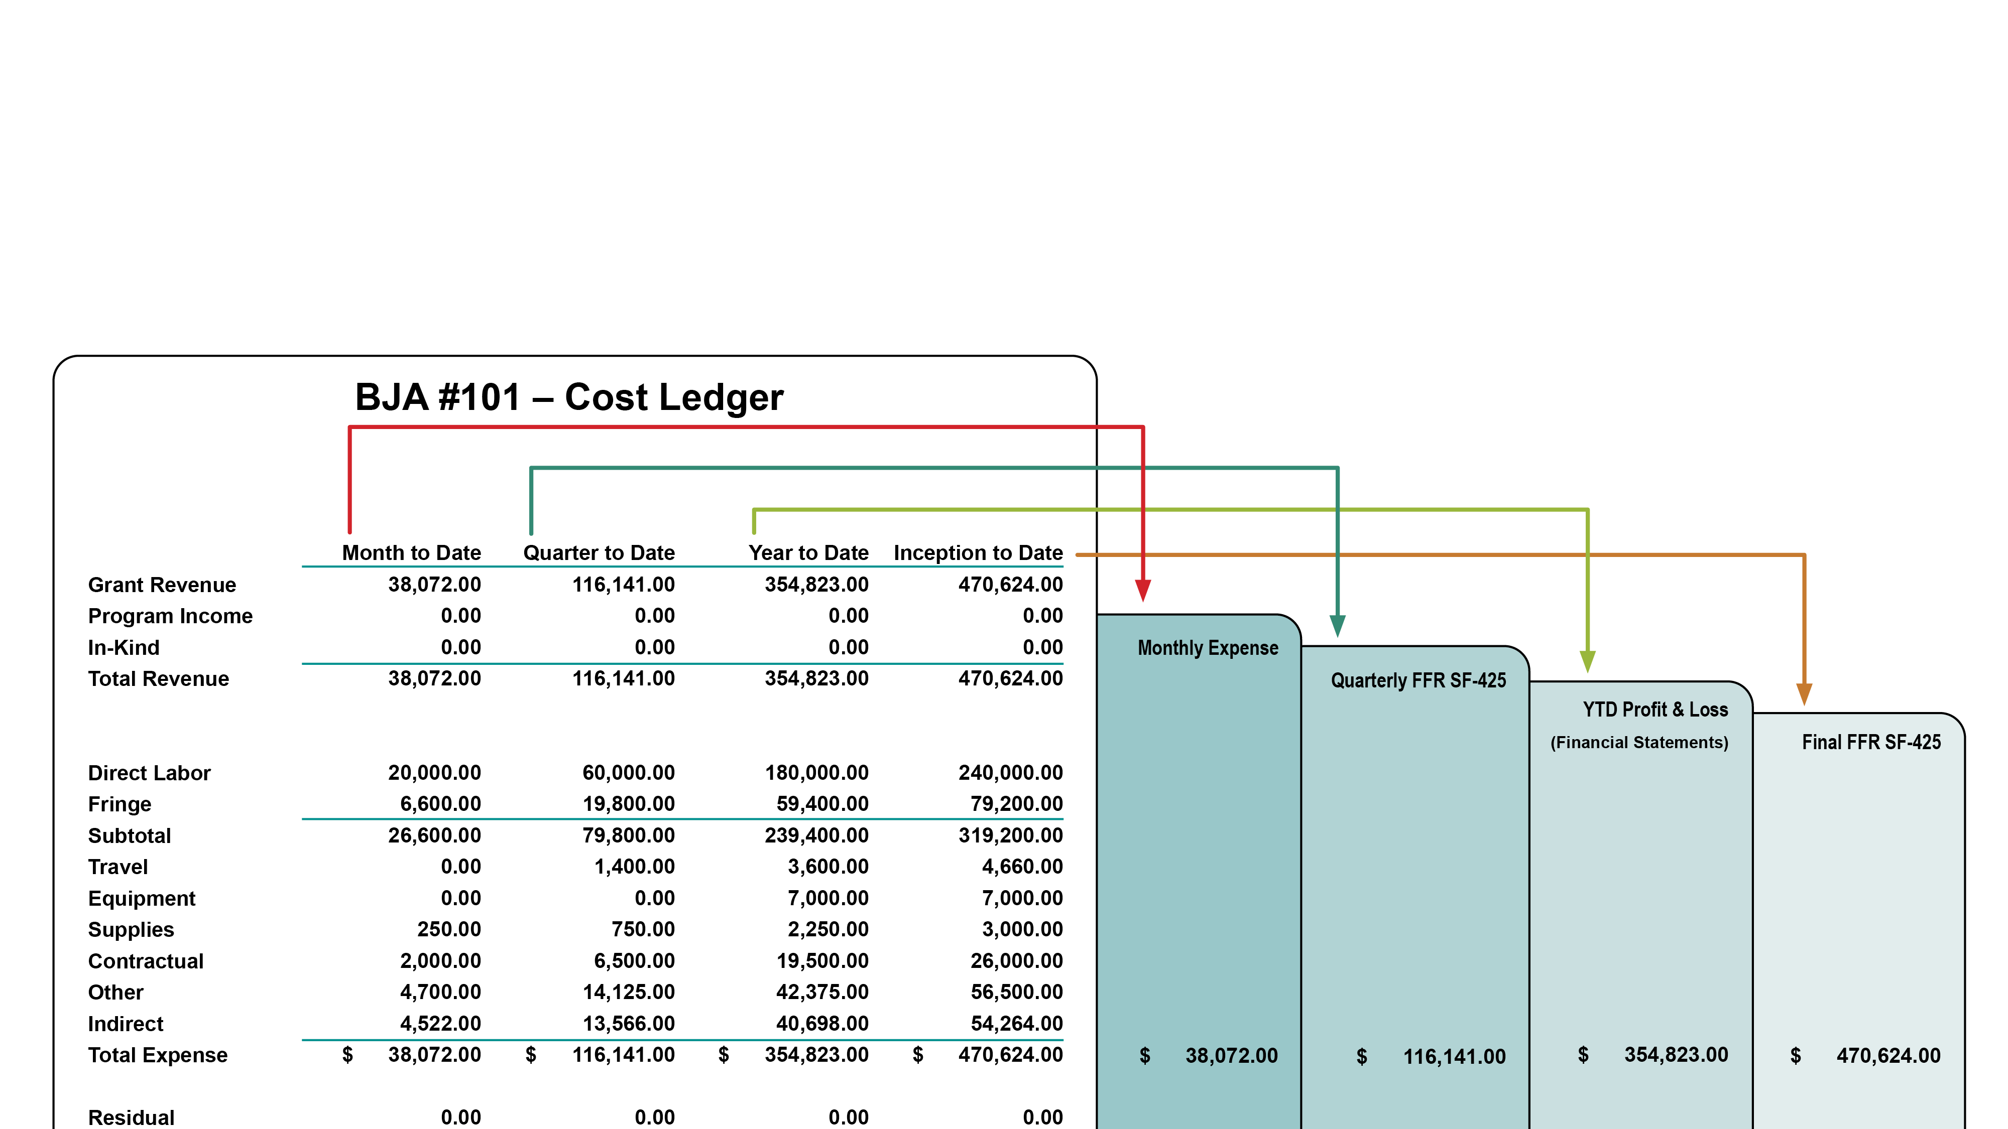
Requirements of Periodic Reports

Slide 27
Financial Management Systems-Summary
Record and Report on:
Receipt Obligation Expenditure
of Grant Funds

Slide 28
Knowledge Check #1
Under the standards for an adequate accounting system, recipients are required to have a separate bank account for each award.
True
False

Slide 29
Applicable Laws and Regulations Affecting Federal Grant Funds

Slide 30




Order of Precedence
AUTHORIZING LEGISLATION
  Congress
FEDERAL AGENCY REGULATION
  Code of Federal Regulations
TERMS AND CONDITIONS OF THE AWARD
  Grant Award Document
FEDERAL AGENCY POLICIES
  DOJ Grants Financial Guide

Slide 31
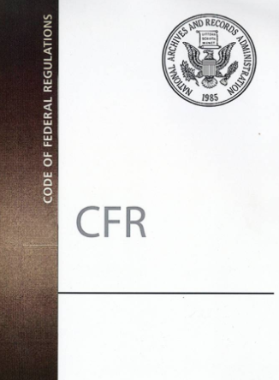
The Code of Regulations (CFR)
The codification of the general and permanent rules published in the Federal Register by the executive departments and agencies of the Federal Government.

Slide 32
2 CFR Part 200
Applies To
OMB
Administrative Requirements
State and Local Units of Government
OMB 2 CFR Part 200 Uniform Administrative Requirements, Cost Principles, and Audit Requirements for Federal Awards
Cost Principles
Non and For -Profit Organizations
Audit Requirements
Educational Institutions

Slide 33

Break Time
See you in 15 minutes

Slide 34
Government-wide Common Rules (1 of 2)
Common Rules:
Committee of
Federal
agency
representatives
“Uniform”
requirements
Signed by
Federal
agencies
Limited
Exceptions
granted by OMB

Slide 35

Government-wide Common Rules (2 of 2)
2 CFR Part 200
Suspension & Debarment
Drug-free Workplace
Lobbying

Slide 36





Lobbying Restrictions
Applicable to:
State & Local Units of Government
Non-Profit Organizations
Indian Tribes and Tribal Organizations
Commercial Entities
Individuals
(direct or indirect)

Slide 37
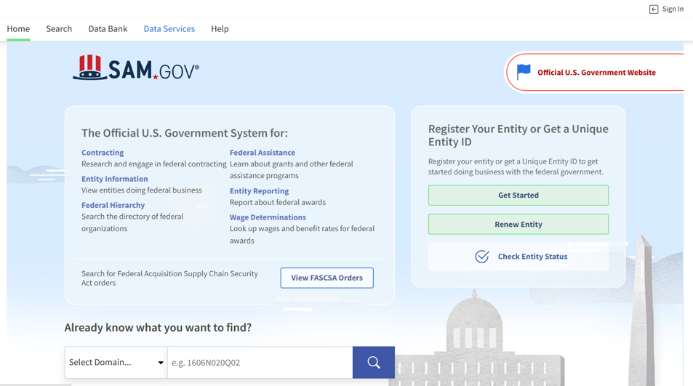
How to Search for See if a Vendor is Debarred or Suspended
Go to www.sam.gov.
You do not need to enter a username or password.
Suspension and Debarment (Exclude List of Parties –ELPS)

Slide 38
Code of Federal Regulations (2 CFR/Part-200) Cost Standards
Uniform Administrative Requirements, Cost Principles and Audit Requirements for Federal Awards
Standards for Costs Requires:
Allowable
Necessary to the performance of a project
Reasonable
Allocable to the project and consistently treated
Non-profitable
Claimed against only on award, and
Permissible under State and Federal laws and regulations

Slide 39
Classification of Costs –Direct Costs
Direct Costs are costs identified specifically with an activity
Salaries and wages (including holidays, sick leave, etc.) for direct labor employees
Other employee fringe benefits allocable
to direct labor employees
Consultant services contracted to
accomplish specific project objectives
Travel of direct labor employees
Materials/supplies purchased directly
for use on a specific project

Slide 40
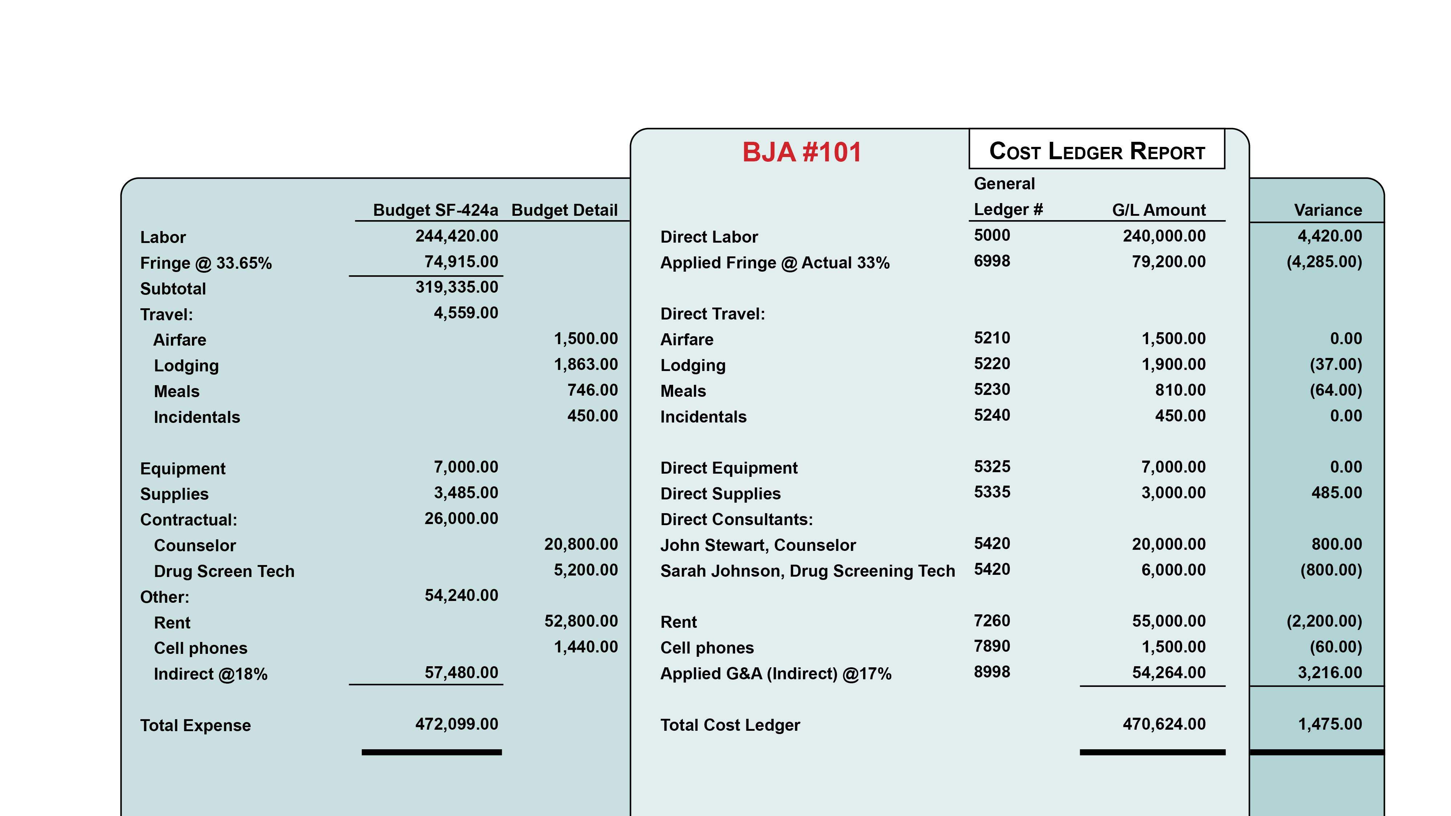
Classification of Costs – Example #1

Slide 41
Classification of Costs – Indirect Costs
Indirect costs generally are not readily identifiable with a particular activity or cost objective.
Maintenance of buildings
Telephone expense
Supplies
Depreciation
Rental Expense

Slide 42
Indirect Cost Rates
Provisional indirect costs rates adjusted
to actual (retroactive adjustment)
Predetermined rates (not normally
subject to adjustment)
Fixed rates (with roll or carry forward
adjustment in future period)
Implements cognizant Federal
agency concept

Slide 43
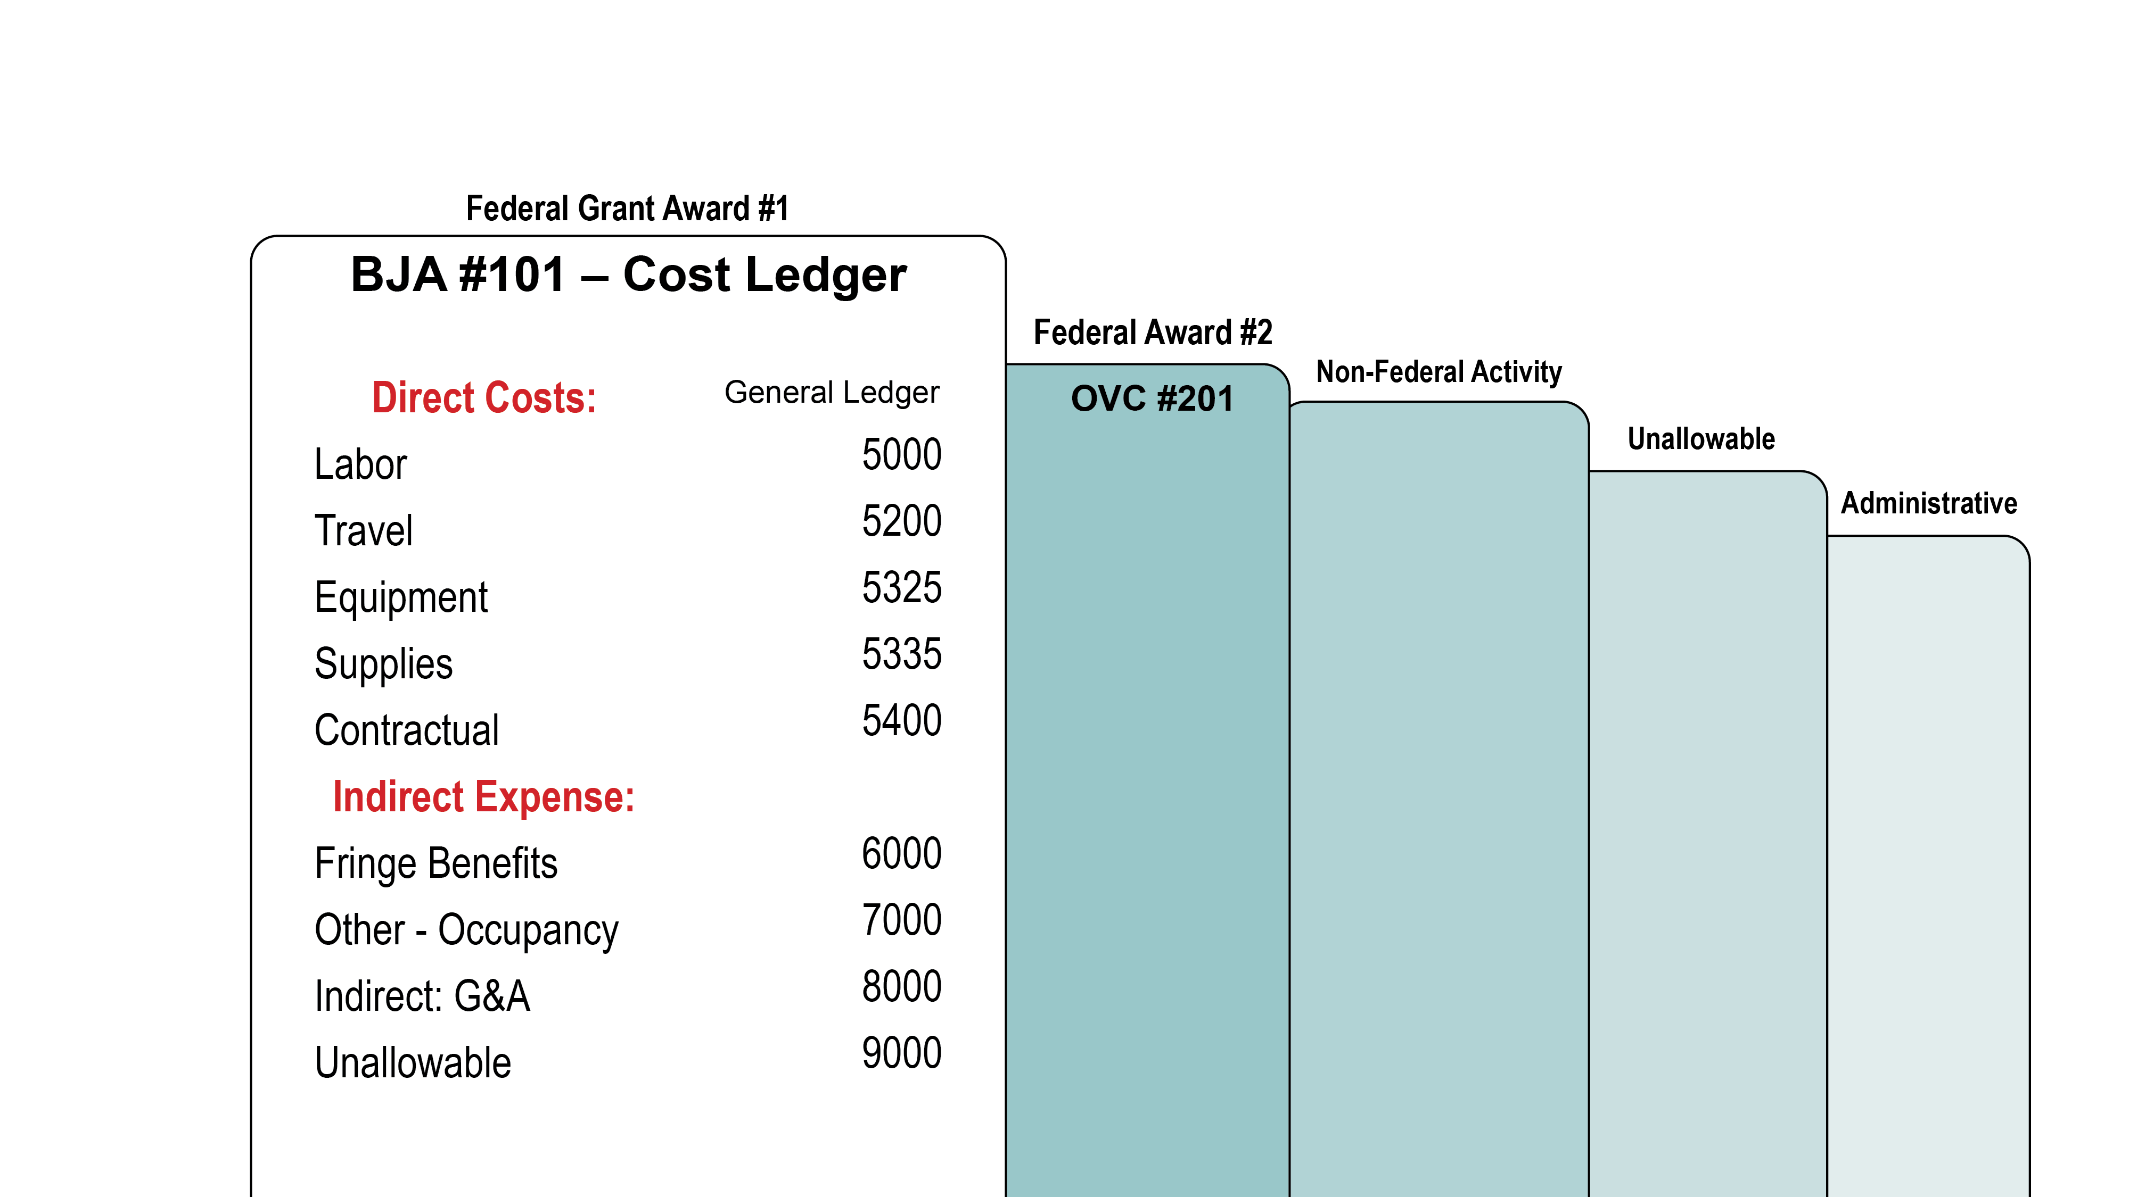
Classification of Costs – Example #2

Slide 44
Classification of Costs –De Minimis Rate
Any Non-Federal entity that does not have a negotiated indirect cost rate may elect to charge a de minimis rate of up to 15% of modified total direct costs (MTDC)
Rate may be used indefinitely or until entity elect to negotiate for a rate
Costs must be consistently charged
as either indirect or direct – (not both)
Subrecipients use the same guidelines
as recipients.

Slide 45
Code of Federal Regulations Does Not:
Supersede limitation imposed by law
Dictate extent of Federal funds
Provide additional Federal funds for indirect costs
Dictate how a government should use funds
Relieve State & local governments of stewardship
responsibilities for Federal funds

Slide 46
Selective Items of Costs
Accounting
Advertising
Alcoholic Beverages
Audit Services
Bad Debts
Contingencies
Contributions & Donations
Entertainment
Fines/Penalties
Fundraising
Rental Costs

Slide 47
Knowledge Check #2
Which item is first in the order of precedence?
DOJ Grants Financial Guide
Terms and Conditions of Awards
Authorizing Legislation
2 CFR 200

Slide 48
Knowledge Check #3
All grant recipients are required to establish and maintain accounting systems and financial records that accurately account for grant funds.
True
False

Slide 49
Supplanting
DOJ funds must be used to supplement existing funds for program activities and may not replace (supplant) non-federal funds that have been appropriated for the same purpose.

Slide 50
Program Requirements
Applicable to Some Federal Grants

Slide 51


Cost Sharing (Match) Requirements (1 of 3)
Cash Match
VS
In Kind
Cash Spent for project related costs.
Value of non-cash or donated contributions

Slide 52
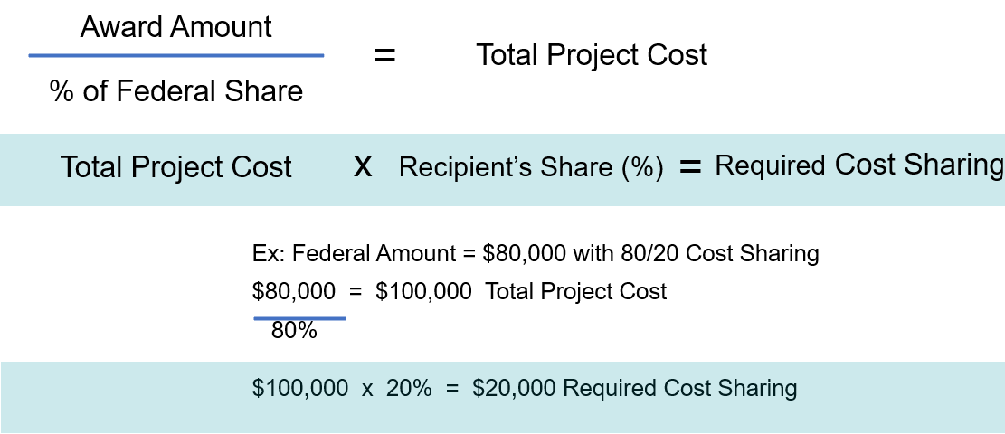
Cost Sharing (Match) Requirements (2 of 3)
How to Calculate Cost Sharing

Slide 53
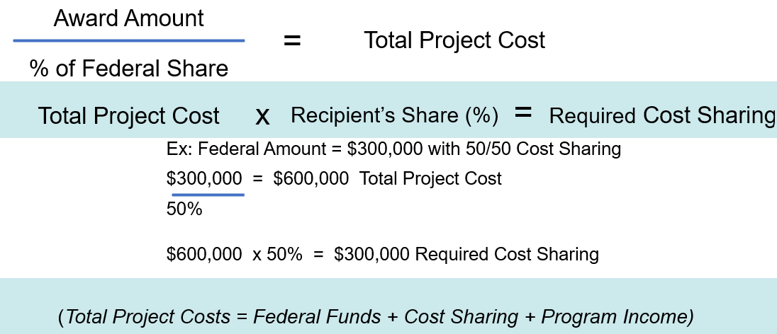
Cost Sharing (Match) Requirements (3 of 3)
How to Calculate Cost Sharing

Slide 54
Procurement

Slide 55

Procurement Procedures and General Guidance
States and Indian Tribes must follow the same policies and procedures it uses for procurements with non-Federal funds.
All other recipients and subrecipients must follow 2 CFR 200.318 – 200.327.
Documentation is very important!
Contract files must establish an audit trail.
Documentation should be sufficient enough
to stand on its own.

Slide 56

General Guidance and Competition
2 CFR 200.319 requires all procurement transactions be conducted in a manner that provides full and open competition.
Examples of situations that may restrict competition include, but are not limited to:
  Unreasonable requirements
  Unnecessary experience
  Conflicts of interest
  Specifying only a “brand name” product
Bidders’ lists should be continually updated.
Newspaper/other advertising of contract requirement is very important.

Slide 57
Sole Source Contract
Federal awarding agency’s approval of sole source is required for procurements over $350K.
Use when:
The item or service is available only from a single source.
A true public exigency or emergency exists.
After competitive solicitation, competition is considered inadequate.
A for-profit entity not eligible to be a direct recipient may not be awarded a sole source contract.

Slide 58
Sole Source Justification/Sample Outline (1 of 3)
Paragraph | Content
1 | Brief description of program and what product or service is being contracted for:
2 | Explanation of why it is necessary to contract non-competitively, to include: Organizational expertise Management Knowledge of the program Responsiveness Expertise of personnel

Slide 59
Sole Source Justification/Sample Outline (2 of 3)
Paragraph | Content
3 | Description of and the results of any market survey or research conducted. If no survey or research conducted, explain why not.
4 | Statement of when contractual coverage is required and if dates are not met, what impact on the program. Example: how long it would take another contractor to reach the same level of competence (equate in $$).

Slide 60
Sole Source Justification/Sample Outline (3 of 3)
Paragraph | Content
5 | Other points to “sell the case.”
6 | A declaration that this action is in the “best interest” of the grantor agency and/or the Federal government.
7 Note: | Conflict of Interest review. Time constraints will not be considered a factor if the grantee has not sought competitive bids in a timely manner thereby creating a time constraint situation.

Slide 61
Contracting Dos & Don’ts
DO’s
DON’Ts
Compete
Prepare IFB/RFP
Maintain bidders list
Conduct interviews
Obtain prior approval
Make documentation available
Place unreasonable requirements
Require unnecessary experience
Engage in noncompetitive pricing
Engage in organizational conflicts of interest
Require unreasonable timeframe
Require only “brand name” products

Slide 62

Excluded List of Parties
Excluded From Federal Procurement or Non-Procurement Programs
Frequently Asked Questions:
Electronic List of Parties/Suspension & Debarment
https://www.sam.gov/
Federal Service Desk:
1-866-606-8220

Slide 63
Indirect Costs Presentation

Slide 64


Lunch Break

Slide 65
Breakout Sessions

Slide 66
Breakout Session Descriptions
Sub Recipient Monitoring - This session will emphasize the basic requirements that the pass-through entity must impose on the subrecipient to ensure that the Federal award is used in accordance with Federal statutes, regulations and the terms and conditions of the Federal award.
Just Grants Training Team - Roles, Federal Financial Reports (FFRs), Monitoring, Closeout, Resources
Chat with the Experts – Financial and Programmatic representatives - Question and Answer session
Networking - A networking session allowing grantees the opportunity to share best practices, share knowledge and gain insight on award management from similar grantee types. This session will be facilitated by an OJP representative

Slide 67
Application Process and Budget Review

Slide 68
Application Process (1 of 2)
Unique Entity Identifier (UEI)
  Universal identifier for Federal recipients and their direct subrecipients.
  System for Award Management (SAM)
  Federal Service Desk
  https://www.sam.gov

Slide 69

Application Process (2 of 2)
Financial Integrity
Type of Applicant
Financial Management and Internal Controls Questionnaire – (All OJP applicants)
Grantee Audits
Applicants Federal Debt
Accuracy of Taxpayer ID

Slide 70
High Risk Grantees
Have a history of unsatisfactory performance
Are not financially stable
Have a management system which does not meet the management standards set forth in 2 CFR Part 200.302 (Financial Management)
Have not conformed to the terms and conditions of previous awards
Have open Single Audit or Office of Inspector General (OIG) audit report recommendations
Have significant non-compliance issues
Are otherwise not responsible (e.g., open site visit,
requests for information from DOJ program manager, etc.)

Slide 71










Budget Categories
PERSONNEL
FRINGE BENEFITS
TRAVEL
EQUIPMENT
SUPPLIES
CONSTRUCTION
SUBAWARDS
PROCUREMENT
OTHER
INDIRECT

Slide 72
Personnel Category (1 of 5)
Position – (i.e.,) grant coordinator
Title – (i.e.,) director, sheriff, secretary
Percentage of time – (i.e.,) 50%, 100%
Compensation – (i.e., show annual) $60,000
Increases – (i.e.,) raise, cost of living allowance (COLA)

Slide 73
Personnel Category (2 of 5)
Important Things to Know-Personnel
Only the salaries of direct employees should be in the personnel category
Non-employee salaries should be in procurement contracts category
Excessive annual salary limits require a signed waiver (DOJ Financial Guide Pg. 60)
For 2026, the maximum salary limit is 110% of the SES salary: $228,000 x 110% = $250,800.

Slide 74
Personnel Category (3 of 5)
John Smith, Project Director ($60,000 x 100% x 1yr) $60,000
Peter Mayes, Program Manager ($45,000 x 100% x 1yr) 45,000
Mary Jones, Assistant Solicitor ($32,000 x 50% x 1yr) 16,000
$121,000
Cost of living increase on second year
John Smith, Project Director ($60,000 x 2%) $1,200
Peter Mayes, Program Manager ($45,000 x 2%) 900
Mary Jones, Assistant Solicitor ($16,000 x 2%) 320
$2,420

Slide 75
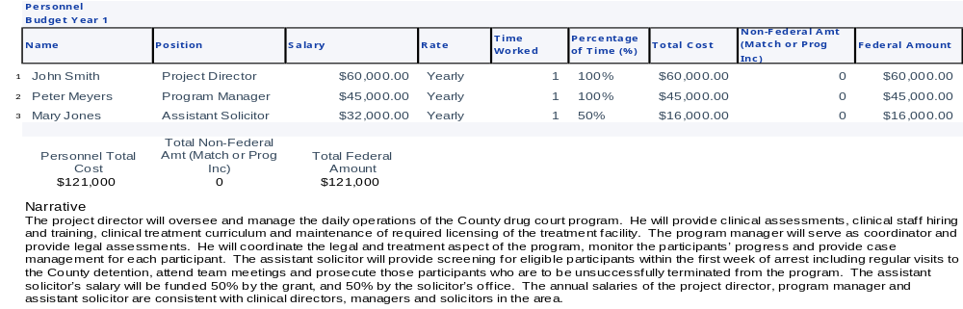
Personnel Category (4 of 5)

Slide 76
Personnel Category (5 of 5)

Slide 77

Fringe Benefits Category
What’s included – (i.e., FICA, health, retirement, workman’s comp)
Unallowable – (i.e., excessive fringe for executives)
Fringe benefits should be calculated on the actual salary of personnel versus the total costs (unless they are the same)
Fringe benefits should be itemized

Slide 78
Fringe Benefits (1 of 3)
Important Things to Know-Fringe Benefits
Non-federal fringe benefits cannot be based on Federal personnel salaries.​
Ensure fringe benefits are reasonable and not excessive. Excessive fringe benefits for executives are generally unallowable.
Consultants/contractors should not be included in fringe benefits.

Slide 79
Fringe Benefits (2 of 3)
FICA 6.75%
Retirement 9.20%
Workman’s Comp 3.70%
Health Insurance 11.0%
Fringe Benefit Rate 30.65%
The fringe benefit for each staff member is estimated at 30.65% of the salaries which is the current cost of fringe benefits for current full-time employees of the Third Judicial Circuit.
John Smith, Project Director (30.65% x $121,200) $37,148
Peter Mayes, Program Manager (30.65% x $90.900) $27,861
Assistant Solicitor (30.65% x $32,320) $ 9,907
Total Fringe $74,916

Slide 80

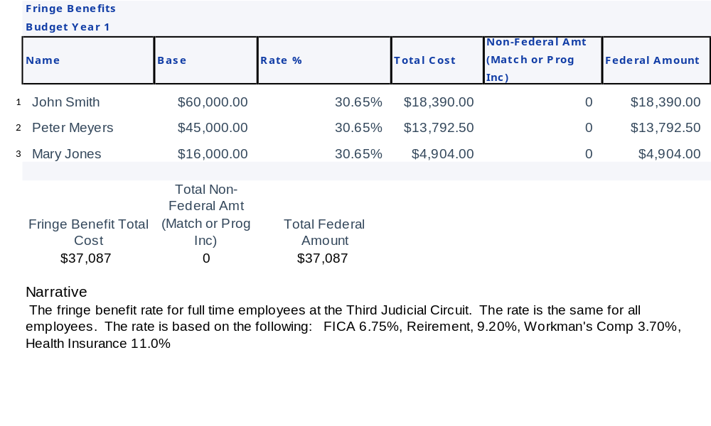
Fringe Benefits (3 of 3)

Slide 81

Travel Category
Travel Policy
Computation – number of travelers x cost
Purpose – grant/program requirements
Per Diem – use agency policy and, if no policy, must follow Federal Travel Regulations
Transportation – air, taxi (show each separately)
Other – parking, tolls, baggage fees
Local Travel – mileage, use agency policy and,
if no policy, must follow Federal policy

Slide 82

Travel (1 of 2)
Important Things to Know-Travel
Registration/Conference fees should be in the “Other Category”
Please include applicable taxes and fees with lodging rates
If using Air travel, include a line item for baggage fees
If the lodging rate per night is more than the GSA rate, the grantees need a justification and state travel policy used

Slide 83
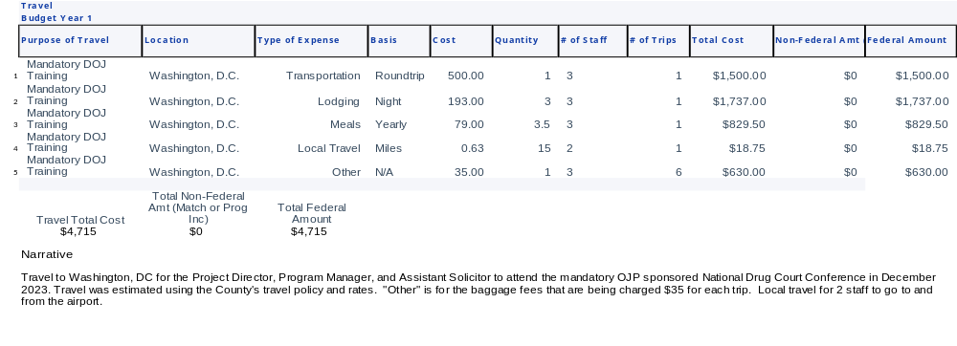
Travel (2 of 2)

Slide 84
Lodging Rates at Per Diem
All OJP funded contracts for events that include 30 or more participants (both Federal and non-Federal) lodging costs for any number of attendees requiring lodging must not exceed Federal per diem rate for lodging.
Conferences that include less than 30 people are exempt from this requirement.
The web-site address for obtaining the current rates is https://www.gsa.gov
DOJ Grants Financial Guide provides further clarification of this
requirement at https://www.ojp.gov/funding/financialguidedoj/overview

Slide 85
Knowledge Check #4
Non-employee or contract salaries should go in the Personnel category.
True
False

Slide 86
Knowledge Check #5
Which of the following items would not go in the Travel Category.
Lodging Taxes
Baggage Fees
Registration Fees
All the above items should go in the Travel Category

Slide 87

Equipment (1 of 4)
Policy – Recipients should follow their own capitalization policy for equipment.
If no policy exists, must follow Federal policy
Unit & cost – (i.e., 1 computer @ $2,000)
Purpose – (i.e., grant/program requirement)

Slide 88

Equipment (2 of 4)
Federal Definition – useful life of more than one year with a fair market value (FMV) of $10,000 or more.
Disposition – when equipment is no longer needed for criminal justice purposes, and its FMV is less than $10,000, the equipment can be retained with no further obligation to the awarding agency.
If the FMV is $10,000 or more, the equipment can be retained
or sold; however, the proceeds (Federal participation)
must be returned to the awarding agency.

Slide 89
Equipment (3 of 4)
Important Things to Know-Equipment
Items that do not fit in the guidelines for capitalization, should be in the Supplies category
Rented or leased equipment should be in the Procurements Contracts category

Slide 90
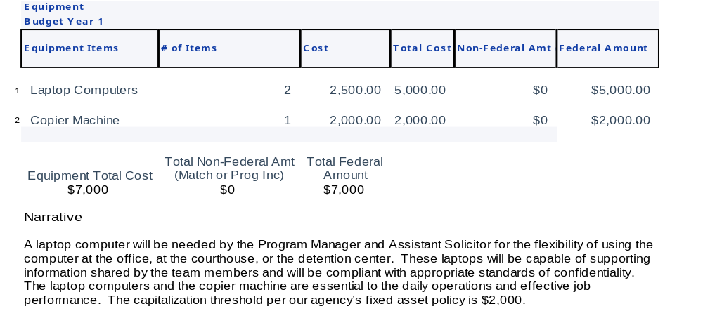
Equipment (4 of 4)

Slide 91

Supplies (1 of 3)
Major types – (i.e., office, training, postage)
Project benefits – (i.e., how supplies will support efforts)
Supplies should be itemized in detail
Miscellaneous expense needs to be itemized

Slide 92

Supplies (2 of 3)
Important Things to Know-Supplies
Cell phone – device cost without the monthly service cost can be categorized as Supplies. However, if the cell phone cost has a monthly service fee, like internet or telephone service then it should be categorized in Other Costs category.
Items that do not fit in the guidelines for capitalization, should be in the Supplies category.

Slide 93
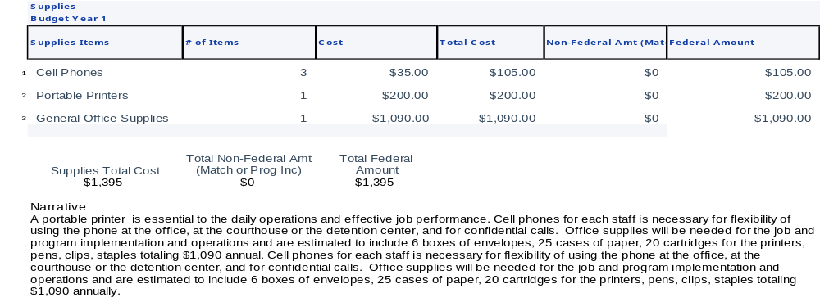
Supplies (3 of 3)

Slide 94

Construction (1 of 3)
As a rule, construction costs are generally not allowable.
Minor repairs or renovations may be allowable
Consult with the program office before budgeting funds in this category.

Slide 95
Construction (2 of 3)
Important Things to Know-Construction
If construction costs are allowed, a description of the construction project and an estimate of the costs should be provided in the budget narrative.
The total cost of a construction project includes the cost of site preparation and demolition of existing structures.

Slide 96
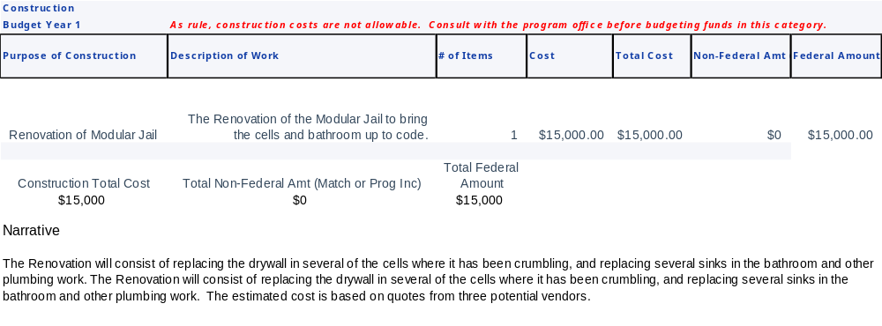
Construction (3 of 3)

Slide 97
Knowledge Check #6
The federal threshold for supplies is less than $10,000 per item.
True
False

Slide 98

Subawards (Subgrants) Category
A description of the activities to be carried out by subrecipients.
Describe the purpose of the subaward (subgrant)
Contracts or consultants that are not considered as subaward should be under procurement contracts category
Grantees must ensure correct calculation when using the de minimis rate
  It should be calculated on the first $50,000 and not $50,000 per year for the subaward category

Slide 99

Subawards (1 of 2)
Important Things to Know-Subawards
The name of each sub-awardee should be listed, if known. A description of the purpose should be explained in detail.
Subrecipients must follow award terms and special conditions same as the grantee.

Slide 100
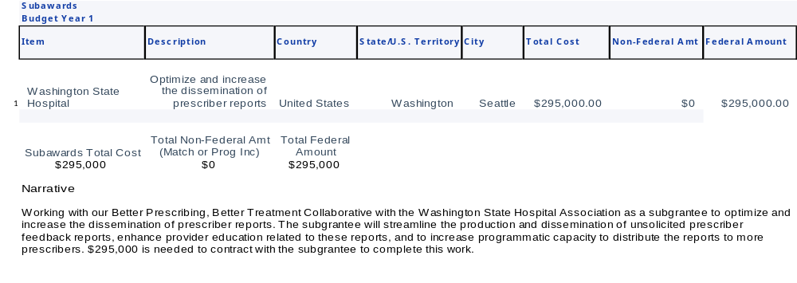
Subawards (2 of 2)

Slide 101

Procurement Contracts Category
Procurement for goods or services
Consultant rates – (i.e., $650 threshold)
Sole Source – over $350K
Procurement Standards—General Guidance for Open Competition (Uniform Guidance at 2 C.F.R. § 200.317 through 2 C.F.R. § 200.327)
Please describe services being provided
Indicate whether the applicant’s formal written procurement policy or federal acquisition regulations is followed

Slide 102

Procurement Contracts (1 of 3)
Important Things to Know-Procurement
Indicate whether the applicant’s formal written procurement policy or federal acquisition regulations is followed
Sole Source Contracts over $350k requires approval from the Program Manager and OCFO. See -Procurement Standards—General Guidance for Open Competition (Uniform Guidance at 2 C.F.R. § 200.317 through 2 C.F.R. § 200.327)

Slide 103
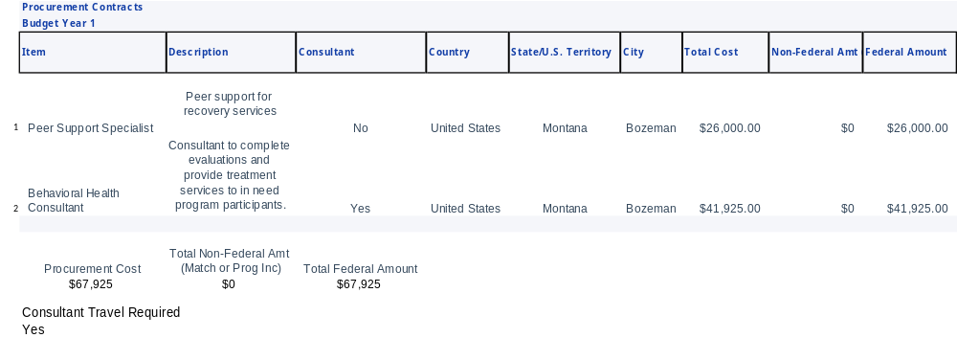
Procurement Contracts (2 of 3)

Slide 104
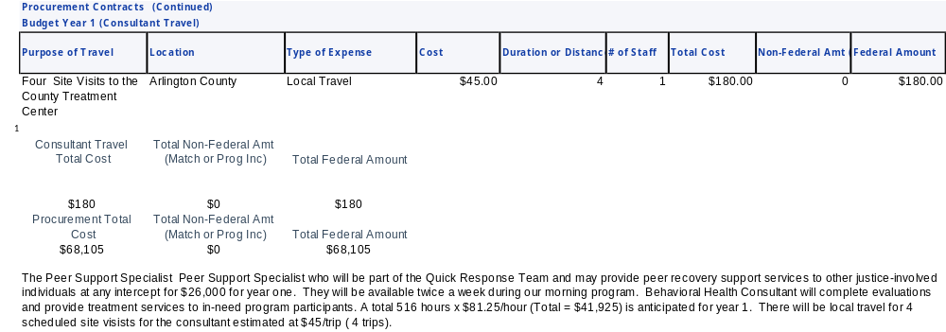
Procurement Contracts (3 of 3)

Slide 105

Other Category
Major types – (i.e., rent, utilities)
Basis – (i.e., 1200 sq ft @ $22 per sq ft)
Please list out each item type
Examples of Other: registration fees, rent, software, etc

Slide 106

Other (1 of 2)
Important Things to Know-Other
Other costs generally includes registration fees, rent, software, subscriptions, etc.
Each item must be detailed and listed separately, and an explanation should be included in the narrative.
Food and beverage for meetings (generally unallowable). There are exceptions for some programs. Prior approval is required.

Slide 107
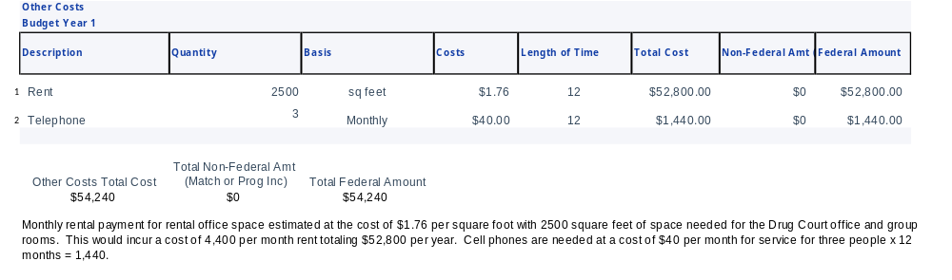
Other (2 of 2)

Slide 108

Indirect Costs Category
Approved rate – (i.e., by cognizant Federal agency)
Current negotiated agreement – (i.e., provisional, fixed, final)
De Minimis rate – must specify in application the amount to be claimed
Grantee should calculate indirect costs on federal share only
The correct indirect cost base should be used
If using MTDC as your base, please show what you have included in your base for the calculation.

Slide 109

Indirect Costs (1 of 2)
Important Things to Know-Indirect Costs
A current negotiated agreement should be attached if the De Minimis rate is not being use.
Grantee can opt to use the De Minimis rate of 15% when applicable. No agreement or certificate is required. However, it should be stated in the budget narrative.
If an IDC agreement has expired, that portion of funds will be held until a new agreement is received.

Slide 110
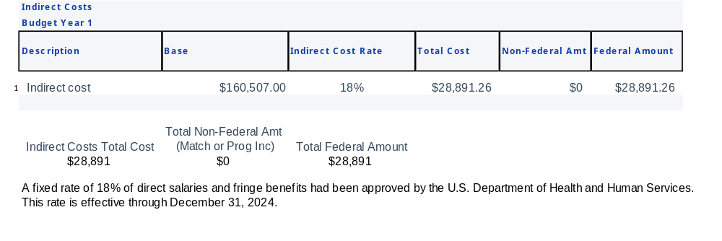
Indirect Costs (2 of 2)

Slide 111

Budget Summary
Budget Categories Amount
Personnel $121,000
Fringe Benefits $37,087
Travel $4,715
Equipment $7,000
Supplies $1,395
Construction $15,000
Subawards (Subgrants)/ $450,000
Procurement Contracts
Other Costs $54,240
Total Direct Costs $690,437
Indirect Costs $28,891
Total Project Costs $719,328

Slide 112

Top Ten Reasons Budgets Don’t Clear (1 of 3)
The budget detail narrative amounts and descriptions do not match the budget line item.
Costs are allocated to the wrong category (i.e. fringe benefits in personnel; registration in travel; contracts listed in other, etc.)
The required match percentage has not been met or source identified, and/or the match is calculated incorrectly.
Unallowable costs are included in the budget detail.
Incomplete Budget – budget narrative is missing.

Slide 113

Top Ten Reasons Budgets Don’t Clear (2 of 3)
IDC rate used in computation is calculated incorrectly.
Prior budget did not clear, or pending budget modification not approved (applies to supplemental awards).
Fringe Benefits Base is different from the calculated salaries in Personnel category.
Responses to the initial budget financial review memo were insufficient.
Total Project Costs do not equal the Federal Funds and Match amount.

Slide 114
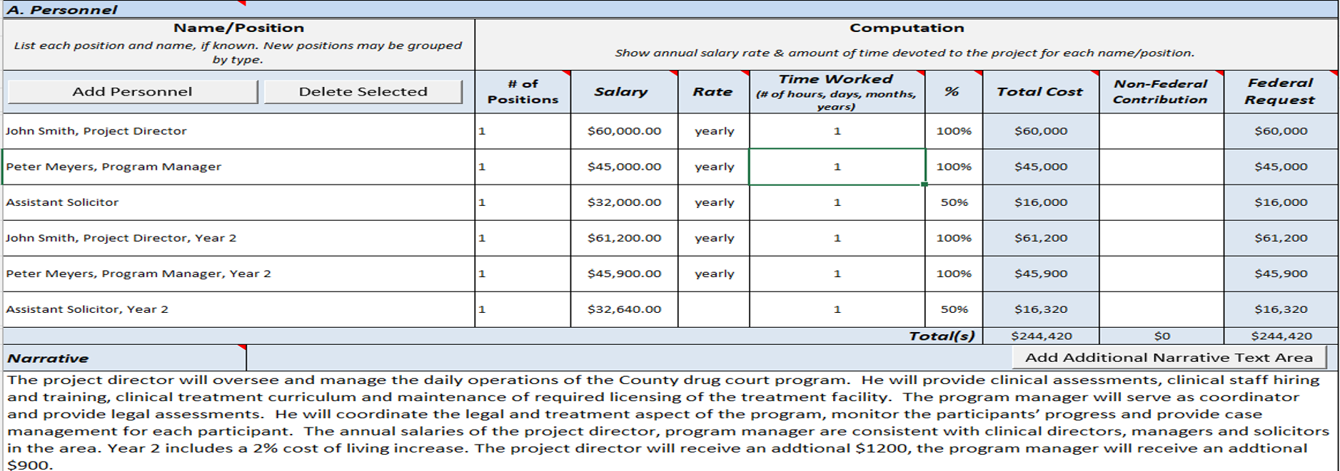

Top Ten Reasons Budgets Don’t Clear (3 of 3)
Example: The budget detail narrative amounts and descriptions do not match the budget line item.

Slide 115
Budget Exercise-Group Activity
For the Budget Exercise- Please refer to the zip file you received by email.

Slide 116
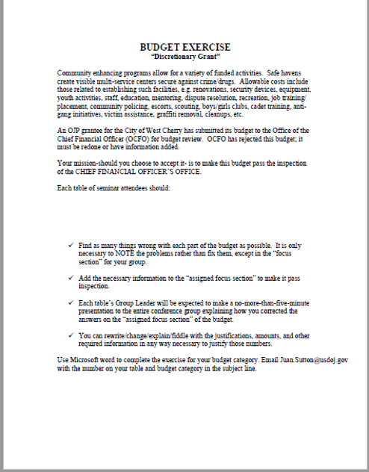
In Zip File

Slide 117
To Be Continued:
See you tomorrow ☺

