Slide 1
Financial Management Seminar
Basic Training
Angela Wade and Trevon Tillman
Grants Financial Management Division
October 20-21, 2026

Slide 2
Pre-award Exercise

Slide 3
Pre-award exercise 1
1. Strong internal controls can ensure effective and efficient operations, reliable financial reporting, and compliance with applicable laws and regulations.
  True
  False

Slide 4
Pre-award exercise 2
2. An adequate accounting system:
  Meets requirements for periodic reporting.
  Provides financial data for planning, control, measurement, and evaluation of direct and indirect costs.
  Presents and classifies costs, as required for budgetary and evaluation purposes.
  All of the above
  None of the above

Slide 5
Pre-award exercise 3
3. Per 2 CFR/Part 200 (Uniform Administrative Requirements, Cost Principles, and Audit Requirements) accounting, advertising, rental costs, and audit services:
  are allowable costs
  are unallowable costs
  can be allowable costs

Slide 6
Pre-award exercise 4
4. OJP funding can be used to purchase food and/or beverages
for any meeting, conference, training or other event.
  True
  False

Slide 7
Pre-award exercise 5
5. The value of something received or provided that does not have a cost associated with it.
  Cash match
  In-kind match

Slide 8
Pre-award exercise 6
6. Which of the following is first in the order of precedence?
  Terms and Conditions of the Award
  Authorizing Legislation
  Federal Agency Regulation
  Federal Agency Policies

Slide 9
Pre-award exercise 7
7. Indirect costs are:
  costs identified specifically with an activity
  costs not readily identifiable with a particular grant or contract
  costs that generally include employee fringe benefits allocable to direct labor employees

Slide 10
Pre-award exercise 8
Under Government wide common rules, Indian Tribal Governments are exempt from lobbying.
  True
  False

Slide 11
Pre-award exercise 9
9. To deliberately reduce State or local funds because of the existence of Federal funds.
  Indirect Costs
  Supplanting
  Supplement

Slide 12
Pre-award exercise 10
Federal awarding agency’s approval of sole source is required for procurements over
  $ 20,000
  $ 350,000
  $ 50,000

Slide 13

Recap

Slide 14
Memorable Moments-Day One (1 of 3)
Financial Management System must meet the requirements for receipt, obligation and expenditure of all grant funds
  Federal cost share & local cost share (match)
    Calculate correctly
    All subject to the same rules
  Planning & property control and periodic reporting
Internal controls
Segregation of duties

Slide 15
Memorable Moments-Day One (2 of 3)
Internal agency policies, procedures
  Procurement, personnel, travel, accounting, etc.
  Current email, username, passwords, schedule password/log changes and SAM updates
Supplementing-Good/Supplanting-BAD!
Approved budget categories & items
Prior approval Items
  Consultant rate ($650) prior approval threshold
  Sole source (non-competitive ^ $350K)
  DOCUMENTATION

Slide 16
Memorable Moments-Day One (3 of 3)
External rules of the game –
  Order of precedence
  Be sure you follow the guidance for the particular grant, program, and agency awarding the grant
  DOJ Grants Financial Guide – “Current Edition” is 2024
  Budget details & “Flexibility”

Slide 17
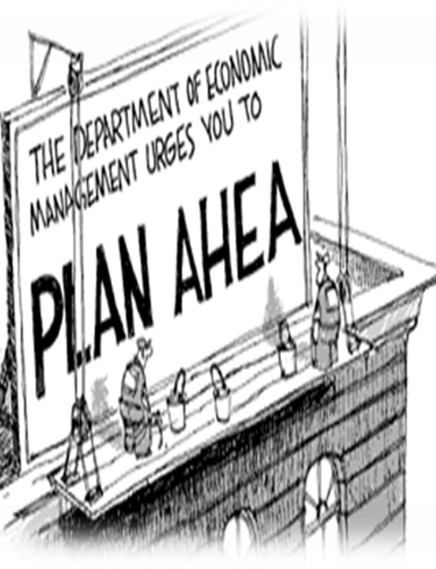
Yogi Berra
Prediction is very difficult,
especially if it's about the future.

Slide 18

Evaluation and sign in
Evaluation & Sign In

Slide 19
Post Award Activities

Slide 20
Award Notification and Acceptance

Slide 21
Award Notification and Acceptance (1 of 3)
Award notifications are issued electronically in Just Grants
An email notification will be sent to the Application Submitter, the Authorized Representative(s), and the Entity Administrator with detailed instructions on how to access and accept the award in Just Grants.

Slide 22



Award Notification and Acceptance (2 of 3)
Prior to accepting the award the Recipient/Entity Administrator should:
Make sure they have set up their Just Grants account and are enrolled in the Automated Standard Application for Payments (ASAP)
Assign a Financial Manager, a Grant Award Administrator, and an Authorized Representative to the award
*The Authorized Representative has the legal authority to enter into contracts, grants, and cooperative agreements with the federal government on behalf of the Entity.

Slide 23


Award Notification and Acceptance (3 of 3)
To accept the award, the Authorized Representative should:
Review all award conditions. Check each section’s checkbox indicating they have read and understood all information presented in that section.
Once all acceptance boxes in each section have been checked and the Declaration and Certification has been checked, they can choose to Accept or Decline the Award.
Read each section of the award package and certify that they have read and understood the information.

Slide 24
Conditions of Award

Slide 25

Conditions of Award 1
The recipient agrees to comply with the requirements set forth in 2 CFR Part 200 Uniform Administrative Requirements, Cost Principles, and Audit Requirements for Federal Awards.

Slide 26

Conditions of Award 2
The recipient agrees to comply with the financial and administrative requirements set forth in the current edition of the “DOJ Grants Financial Guide."

Slide 27
Conditions of Award 3
Comply with the training requirement for the Grant Award Administrator and all Financial Managers to successfully complete an OJP financial management and grant administrative training by 120 days after the date the recipient accepts the award.

Slide 28
Conditions of Award 4
Conditions of Award
A recipient that is eligible to use the “de minimis” indirect cost rate and elects to use the “de minimis” indirect cost rate, must advise OJP in writing of both its eligibility and its election and must comply with all associated requirements in the Part 200 Uniform Requirements.

Slide 29
Conditions of Award 5
Conditions of Award
All subawards (“subgrants”) at any tier, must have specific federal authorization.

Slide 30
Conditions of Award 6
Conditions of Award
Recipients and any subrecipients at any tier, must obtain specific post-award approval to use a noncompetitive approach in any procurement contract that would exceed the Simplified Acquisition Threshold (currently $350,000).

Slide 31
Conditions of Award 7
The recipient agrees that DOJ may withhold award funds or impose other requirements if the recipients does not promptly address outstanding issues related to an audit.

Slide 32
Availability of Funds

Slide 33

Availability of Funds (1 of 2)
Funds will be frozen 120 days after the end of the award.
Obligation Period (Grantee’s books)
  EX: 10/1/2023 - 09/30/2026
Award date = 12/1/2023 (Federal books)
Expenditure Period
  EX: 10/1/2023 - 01/28/2027
Liquidation Period (120 days after end of award)
  Ex: 10/01/2026 - 01/28/2027

Slide 34
Availability of Funds (2 of 2)
Pre-agreement Costs
Costs incurred prior to the project start date
Written prior approval

Slide 35
Program Income

Slide 36
Program Income (1 of 2)
Gross income earned by the recipient or subrecipient during the funding period as a direct result of a supported activity or earned as a result of the Federal award.

Slide 37
Program Income (2 of 2)
Spend prior to requesting additional grant funds
Supplement Project with $$
Reduce Project with $$
Send Back $$

Slide 38
Knowledge Check #1
Completing the Advanced training satisfies the training requirement for your Grant Award Administrator and all the Financial Managers.
True or False?

Slide 39
Knowledge Check #2
How long is the liquidation period after your award ends?
90 days
160 days
120 days
180 days

Slide 40
Grant Award Modification
(GAM)

Slide 41

Grant Award Modification (Overview 1)
The purpose of a Grant Award Modification (GAM) is to update/modify key facts or details about the award.
There are three types of award changes that can be performed in the GAM system:
  Financial;
  Project Period Extension; and
  Programmatic.

Slide 42
Grant Award Modification (Overview 2)
Financial GAMs have four subtypes:
  Budget Modification;
  Budget Reduction;
  Sole Source Approval; and
  Budget Clearance (Financial Grants Management Initiator only).
Project Period Extension GAM is used to extend the length of the funded award.
Programmatic GAMs have two subtypes:
  Programmatic Costs; and
  Scope Change.

Slide 43
Grant Award Modification – Financial (1 of 7)
Budget Modification GAM is initiated to modify an approved budget when:
A proposed budget change affects a category that was not in the original budget
The Indirect cost category is increased or decreased.
Cumulative change is greater than 10% of the Total Award. This does not apply to awards less than $250,000

Slide 44
Grant Award Modification – Financial (2 of 7)
Budget Modification (Cumulative Change)
ABC Company has a total award amount of $500,000. 10% of the total award amount = $50,000
Categories | Current Budget | Modification | Revised Budget
Personnel | $ 120,000.00 | $ - | $ 120,000.00
Fringe Benefits | $ 30,000.00 | $ - | $ 30,000.00
Travel | $ 2,500.00 | $ 15,000.00 | $ 17,500.00
Equipment | $ 200,000.00 | $ (15,000.00) | $ 185,000.00
Supplies | $ 10,000.00 | $ - | $ 10,000.00
Constructions | $ - | $ - | $ -
SubAward | $ - | $ - | $ -
Procurement Contracts | $ 130,000.00 | $ - | $ 130,000.00
Other Costs | $ 7,500.00 | $ - | $ 7,500.00
Total Direct Costs | $ 500,000.00 | $ - | $ 500,000.00
Indirect Costs | $ - | $ - | $ -
Total Projects Costs | $ 500,000.00 | $ - | $ 500,000.00
Grantee is adding $15,000 to the Travel category. The cumulative change amount is $15,000. A Budget Modification is not required.

Slide 45
Grant Award Modification – Financial (3 of 7)
Budget Modification (Cumulative Change)
ABC Company has a total award amount of $500,000. 10% of the total award amount = $50,000
Categories | Current Budget | Modification | Revised Budget
Personnel | $ 120,000.00 | $ 30,000.00 | $ 150,000.00
Fringe Benefits | $ 30,000.00 | $ 2,700.00 | $ 32,700.00
Travel | $ 2,500.00 | $ - | $ 2,500.00
Equipment | $ 200,000.00 | $ - | $ 200,000.00
Supplies | $ 10,000.00 | $ - | $ 10,000.00
Constructions | $ - | $ - | $ -
SubAward | $ - | $ - | $ -
Procurement Contracts | $ 130,000.00 | $ (36,700.00) | $ 93,300.00
Other Costs | $ 7,500.00 | $ 4,000.00 | $ 11,500.00
Total Direct Costs | $ 500,000.00 |  | $ 500,000.00
Indirect Costs | $ - |  | $ -
Total Projects Costs | $ 500,000.00 |  | $ 500,000.00
Grantee is making a second budget modification. They are adding $30,000 to the Personnel category, $2,700 to the Fringe Benefits category, and $4,000 to the “Other” Category. The cumulative change amount is $36,700. A Budget Modification GAM is now required.

Slide 46
Grant Award Modification – Financial (4 of 7)
Budget Modification Reminders
Federal Funds Amount + Match Amount + Program Income Amount must equal Total Project Costs.
For manual budgets, an updated budget detail worksheet should be attached to JustGrants and should total the original Total Project Costs and Federal Award Amount. The manual budget should include all details from prior years.
Changes to your budget may affect your indirect cost calculation.

Slide 47
Grant Award Modification – Financial (5 of 7)
Sole Source
Sole Source GAM is required for noncompetitive procurement contracts over $350K.
Use when:
The item or service is available only from a single source.
A true public exigency or emergency exists.
After competitive solicitation, competition is considered inadequate.
A justification is required when requesting a prior approval for Sole Source.

Slide 48
Grant Award Modification – Financial (6 of 7)
Budget Clearance
Budget Clearance GAM is initiated by OCFO after the grantee has been an approved for an award that has received a conditional clearance.
Once the GAM has been created, OCFO will begin reviewing the budget.
If they have questions during the review they will change request it to the grantee in Just Grants.

Slide 49
Grant Award Modification – Financial (7 of 7)
Project Period Extension
A Project Period Extension (PPE) Grant Award Modification (GAM) is used to extend the length of the period of performance that does not require the obligation of additional Federal funds.
Extension request does not exceed 12 months (individually).
Extension request is not made after the period of performance has expired.
Extension request does not extend the period of performance beyond 5 years/60 months

Slide 50
Grant Award Modification – Programmatic
Programmatic GAM
Programmatic Cost GAM is used to gain prior approval for changes with programmatic costs and activities.
Some of these costs include:
Consultant Rates
Pre-award Costs
Proposal Costs
Other Costs that may require prior approval

Slide 51

BREAK TIME #1

Slide 52

BREAK TIME #1 (Timer)
15 Minutes
Notes:
52
52
Using this PowerPoint break timer
This PowerPoint slide uses images, custom animation, and timing to provide a countdown timer that you can use in any presentation. When you open the template, you’ll notice that the timer is set at 00:00. However, when you start the slide show, the timer will start at the correct time and count down by 1-minute intervals until it gets to 1 minute. At that point, it will count down in two 30-seconds intervals to 00:00.
To insert this slide into your presentation
Save this template as a presentation (.ppt file) on your computer.
Open the presentation that will contain the timer.
On the Slides tab, place your insertion point after the slide that will precede the timer. (Make sure you don't select a slide. Your insertion point should be between the slides.)
On the Insert menu, click Slides from Files.
In the Slide Finder dialog box, click the Find Presentation tab.
Click Browse, locate and select the timer presentation, and then click Open.
In the Slides from Files dialog box, select the timer slide.
Select the Keep source formatting check box. If you do not select this check box, the copied slide will inherit the design of the slide that precedes it in the presentation.
Click Insert.
Click Close.

Slide 53
Payment of Grant Funds

Slide 54
Payment of Grant Funds (continued)
For the ASAP slides-
Please refer to the zip file you received by email.

Slide 55
Reporting Requirements

Slide 56
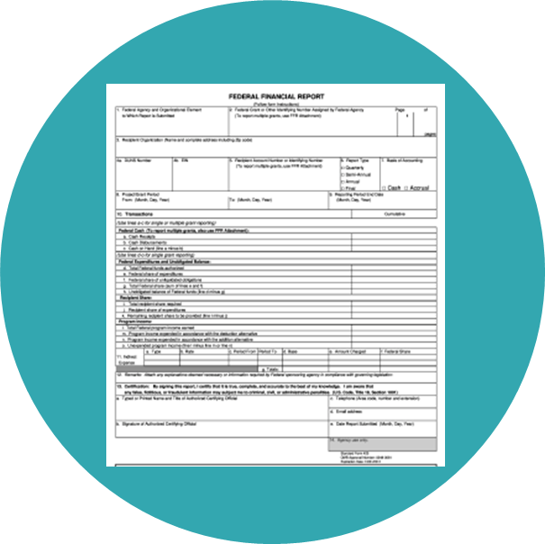


Reporting Requirements Introduction
Federal Financial Report (SF–425)
Submitted Quarterly
Performance Reports – Programmatic Reports Submitted Annually, Semi-annually or Quarterly

Slide 57

Federal Financial Reports (SF425) (1 of 3)

Slide 58
Federal Financial Reports (SF425) (2 of 3)
Quarterly Federal Financial Reports are submitted through the Just Grants system at https://justicegrants.usdoj.gov
Grant recipients will be required to report grant expenditures utilizing the web based Federal Financial Report Form (SF-425) in Just Grants.
The SF-425 quarterly report may be submitted ten (10) calendar days or less from a reporting end date until the due date.

Slide 59
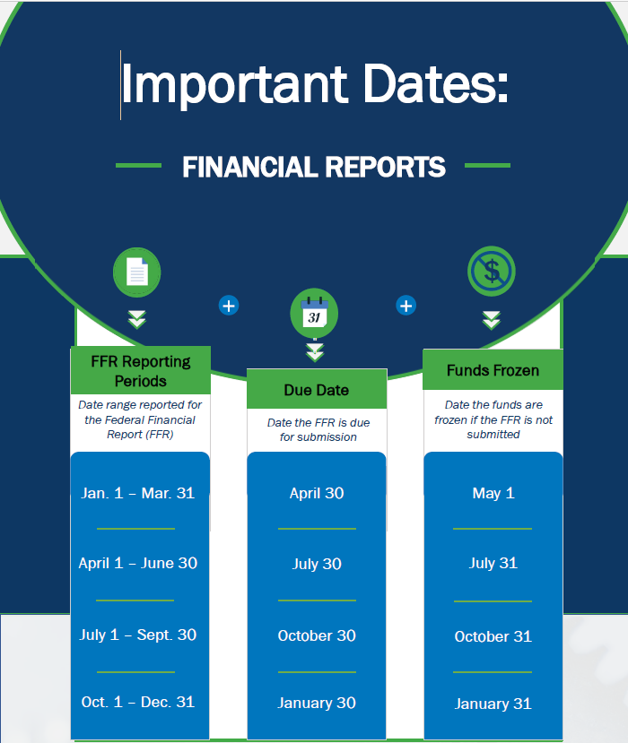
Federal Financial Reports (SF425) (3 of 3)

Slide 60
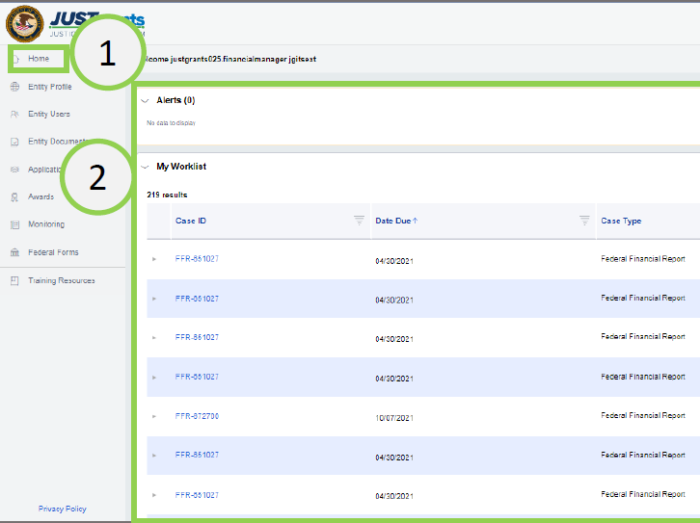
Submitting a Federal Financial Report (SF425) (1 of 10)
Navigate to the Home link on the left side of the screen.
Go to the user’s Worklist.
Open the FFR to be edited/submitted.

Slide 61
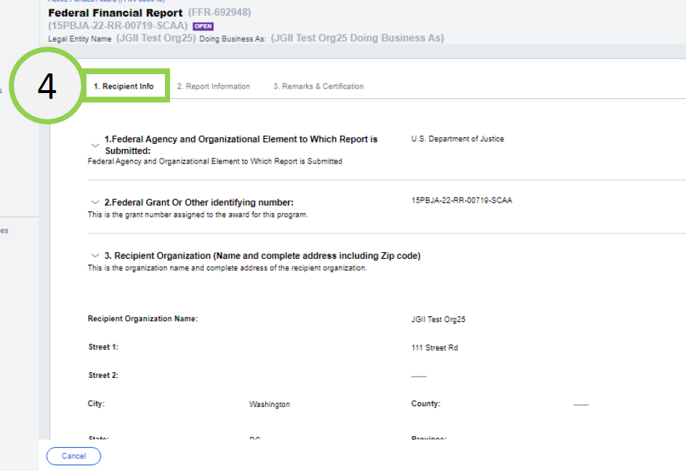
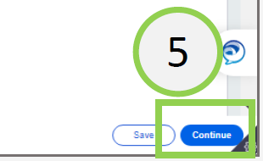
Submitting a Federal Financial Report (SF425) (2 of 10)
Once the FFR opens, the Recipient Information appears.
Select Continue to proceed to the next screen
* Note: The data on this page is prepopulated using information from the award document and the entity profile.

Slide 62
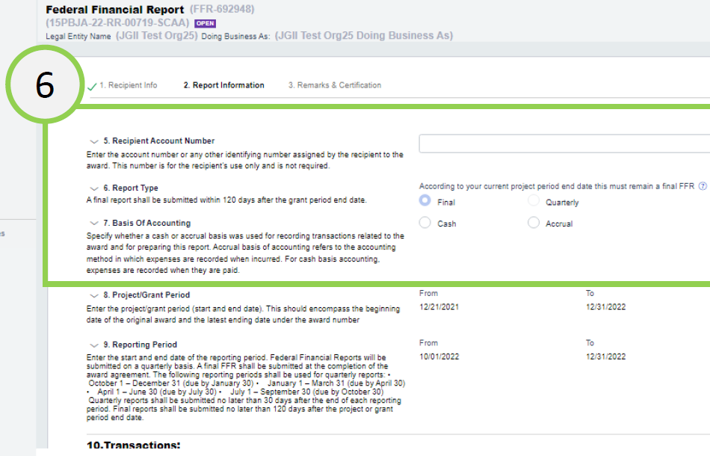
Submitting a Federal Financial Report (SF425) (3 of 10)
The Report Information screen contains several required fields.
  Recipient Account Number
  Report Type
  Basis of Accounting
Scroll down to the Transactions section.

Slide 63
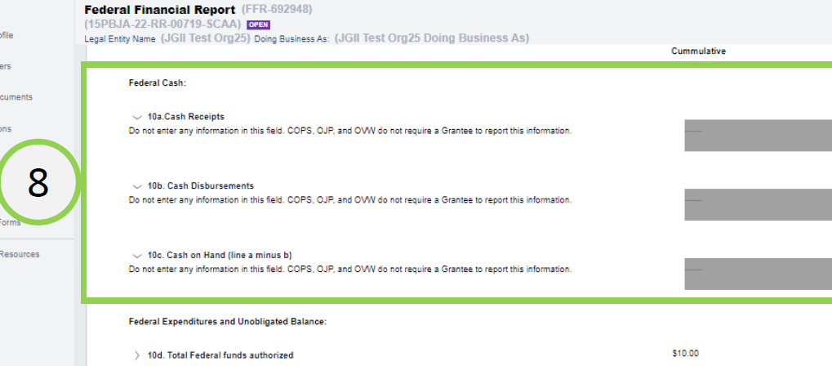
Submitting a Federal Financial Report (SF425) (4 of 10)
The following fields are not editable because they are not required by DOJ:
  10a. Cash Receipts
  10b. Cash Disbursements
  10c. Cash on Hand

Slide 64
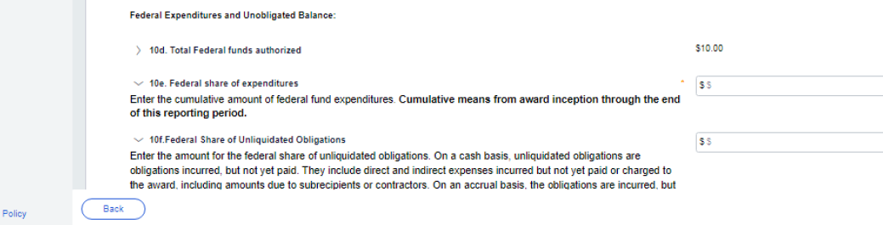
Submitting a Federal Financial Report (SF425) (5 of 10)
9
Enter information in the following fields as appropriate:
  10d. Total Federal funds authorized. (Prepopulated from the Award Document)
  10e. Federal share of expenditures. (Enter the cumulative amount of federal fund expenditures)
  10f. Federal Share of Unliquidated Obligation. (Insert as appropriate)

Slide 65
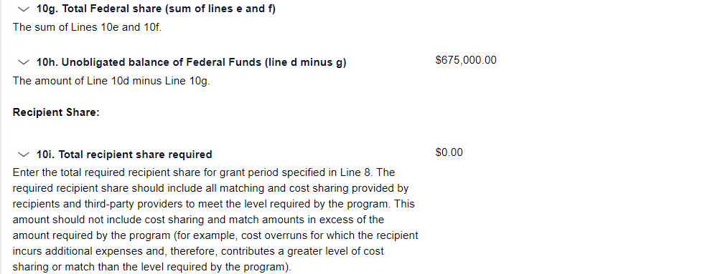
Submitting a Federal Financial Report (SF425) (6 of 10)
9
Enter information in the following fields as appropriate:
  10g. Total Federal share (sum of lines e and f; System calculated)
  10h. Unobligated balance of Federal Funds (line d minus g)
  10i. Total recipient share required.

Slide 66
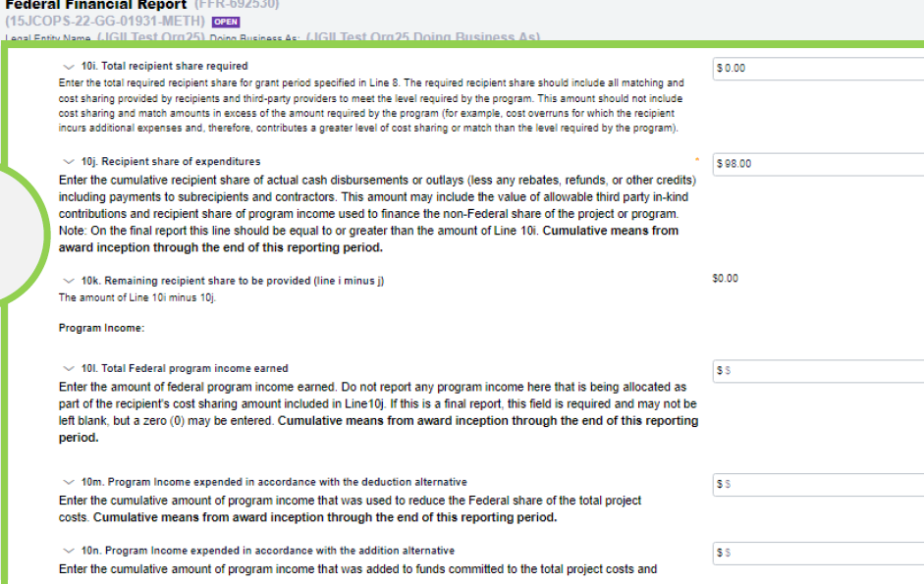

Submitting a Federal Financial Report (SF425) (7 of 10)
Enter information in the following fields as appropriate:
  10j. Recipient share of expenditures
  10k.Remaining recipient share to be provided (line i minus j)
  10l. Total Federal program income earned
  10m. Program income expended in accordance with the deduction method
  10n. Program income expended in accordance with the addition method
  10o. Unexpended program income
* Note: OJP uses the deduction method
10

Slide 67
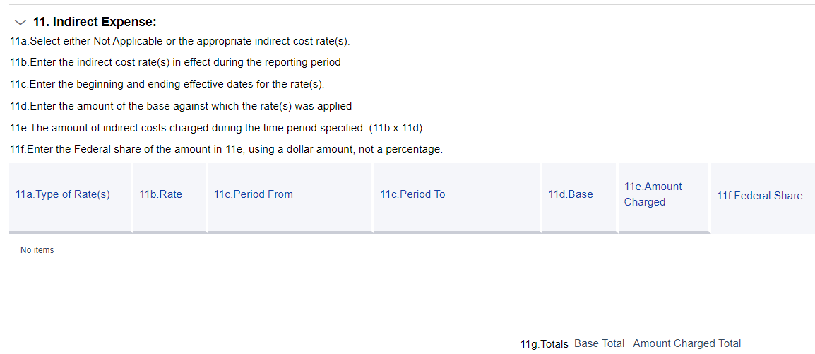
Submitting a Federal Financial Report (SF425) (8 of 10)
Enter Indirect Expenses. Depending on the Type of Rate, the user will be presented with different fields to complete.
* Note: Indirect expenses are NOT cumulative. Indirect expenses are entered with a Start Date and End Date, and the totals are applied based on those dates, rather than the Project Period Start Date and Project Period End Date, as are all other expenses.

Slide 68
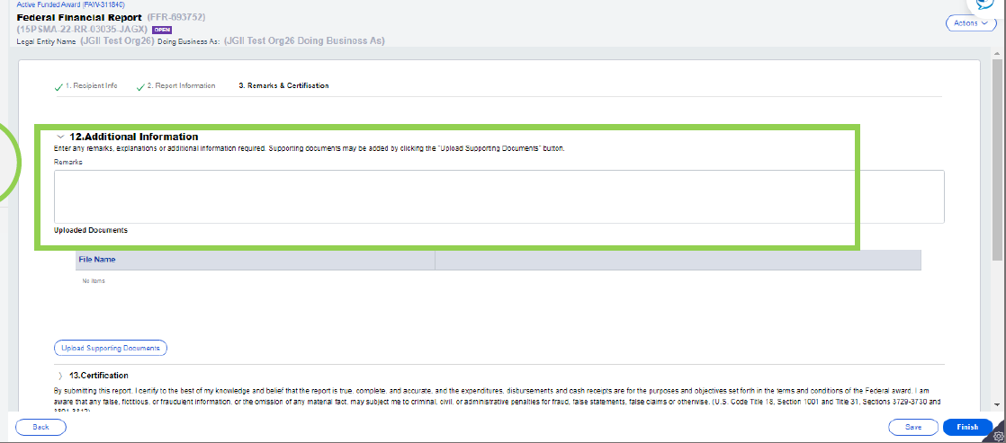
Submitting a Federal Financial Report (SF425) (9 of 10)
In the Remarks and Certification screen, enter text in box 12: Additional Information, any remarks, explanations or additional information required. Supporting documents may be added by clicking the “Upload Supporting Documents” button. Remarks

Slide 69
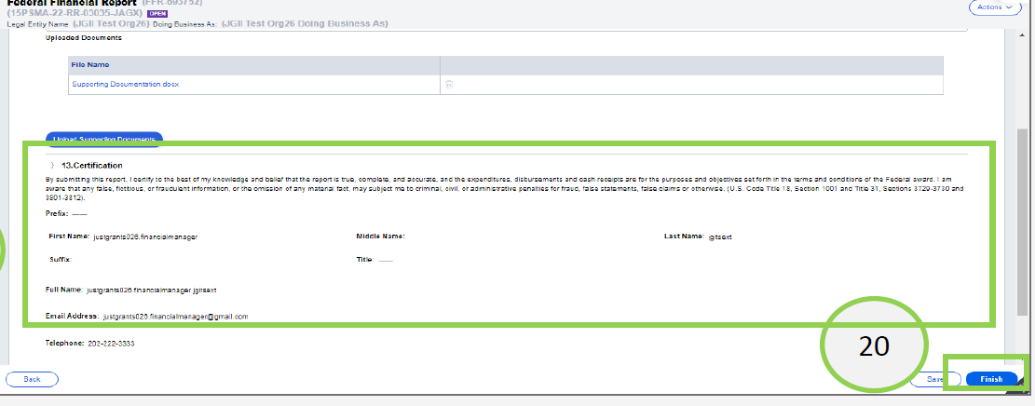
Submitting a Federal Financial Report (SF425) (10 of 10)
Review the certification section then select the Finish button.

Slide 70

Editing a Federal Financial Report (SF425) (1 of 2)
The Financial Manager can edit a submitted FFR only if it is the most recently submitted FFR and the next FFR has not been generated.
Example A: It is February 26, 2023, and the Financial Manager wants to edit the FFR which includes information from 10/1/22-12/31/22 reporting period.
FFR-1
FFR-2
FFR-3
Reporting Period:
7/1/22 to 9/30/22
Due Date of Report:
10/30/22 (previous FFR)
Reporting Period:
10/1/22 to 12/31/22
Due Date of Report:
1/30/23 (direct previous FFR)
Reporting Period:
1/1/23 to 3/31/23
Due Date of Report:
4/30/23 (current FFR)
The Financial Manager can edit and resubmit FFR-2 because it is:
The directly previous FFR, AND
The next FFR has not been generated.
FFR-2 can be edited until March 31,2023, the final day of the next reporting period, when the next report is generated.

Slide 71
Editing a Federal Financial Report (SF425) (2 of 2)
The Financial Manager can edit a submitted FFR only if it is the most recently submitted FFR and the next FFR has not been generated.
Example B: It is April 1, 2023, and the Financial Manager wants to edit the FFR which includes information from 10/1/22-12/31/22 reporting period.
FFR-1
FFR-2
FFR-3
FFR-4
Reporting Period:
7/1/22 to 9/30/22
Due Date of Report:
10/30/22 (previous FFR)
Reporting Period:
10/1/22 to 12/31/22
Due Date of Report:
1/30/23 (direct previous FFR)
Reporting Period:
1/1/23 to 3/31/23
Due Date of Report:
4/30/23 (current FFR)
Reporting Period:
4/1/23 to 6/30/23
Due Date of Report:
7/30/23 (current FFR)
The Financial Manager will not be able to reopen and edit FFR-2 because FFR-4 has already been generated. The Financial Manager will be able to reopen and edit FFR-3 until June 30 since that is the most recently submitted FFR.

Slide 72
Knowledge Check #3
All of the expenditures on the Federal Financial Report are cumulative except for:
Federal Expenditures
Cost Sharing (Match)
Indirect Expenses
Program Income

Slide 73
Federal Financial Reports (SF425)
FFR Helpful Tips
Report actual expenditures not disbursements from Federal Government.
Report correct indirect cost type, rate, and base.
Financial Manager can revise submitted reports prior to the due date.
Funds will be frozen in ASAP if the FFR is delinquent.
The Final FFR is due 120 days after the end of the grant period.

Slide 74
Performance Reports (1 of 2)
Performance Reports
Performance Reports, formerly called Progress reports are submitted in Just Grants
Describes the status of a project and its accomplishments.
Report requirements are determined by the program/program office.
Check the special conditions on your Award Document or the Solicitation, to determine due dates for Performance Reports.

Slide 75
Performance Reports ( 2 of 2)
Performance Reports are reviewed and approved by the OJP program manager
If the Performance Report is delinquent, grants funds will be frozen.
The Final Performance Report is due 120 days after the end of the grant period.

Slide 76

FFR Exercise

Slide 77
2 CFR Part 200/Subpart F
Audit of Non-Federal Entities
Expending Federal Awards

Slide 78
Audit Requirements
Thresholds $1 million
or more expended during
the FY –
Single Audit required
2 CFR
Subpart F applicable
to all
non-federal entities
Audit Report due nine (9) months after end of FY
Submit
online to Federal Audit Clearinghouse
(FAC)
$25,000
or more in questioned costs must
be included
in the Single
Audit report
Due
9 Months after end
of FY
Submit online to FAC
$25K
Questioned Costs
2 CFR Subpart F
$1 million
Thresholds
Notes:
2 CFR Subpart F applicable to all non-federal entities
Thresholds $1 million or more expended during the FY - Single Audit required
Audit Report - due nine (9) months after end of FY
Submit online to Federal Audit Clearinghouse (FAC)
$25,000 or more in questioned costs must be included in the Single Audit report

Slide 79
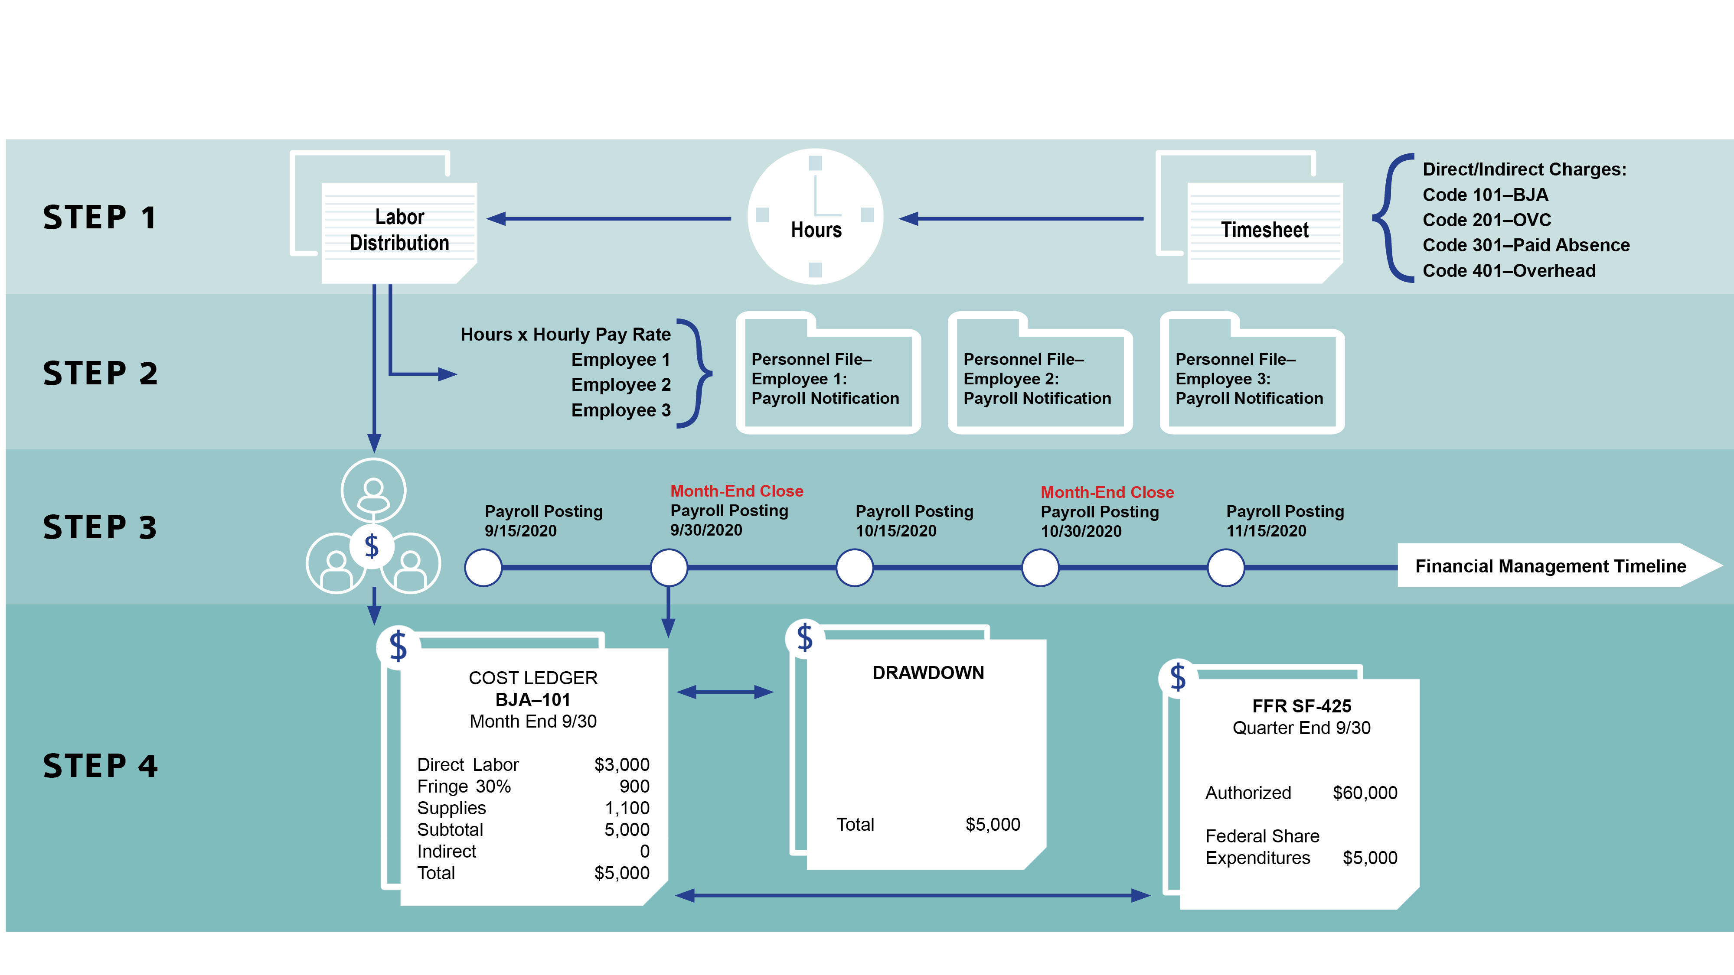
Audit Trail

Slide 80



Single Audit
Federal Audit Clearinghouse (FAC) Requirement
  All grant recipients to submit online via Internet Data Entry System (IDES):
form
SF SAC
Single Audit Report package
IF AUDIT REPORT IS DELINQUENT, FUNDS MAY BE WITHHELD.

Slide 81



Resolution of Audit Reports (1 of 2)
Office of Audit, Assessment, and Management
Establish working file for the audit report.
Review and analyze the audit report.
If there are any findings, a letter must be generated to the audited recipient. This letter should include a request for a Corrective Action Plan (CAP).

Slide 82
Resolution of Audit Reports (2 of 2)
The corrective action plan (CAP) should include:
Description of each finding.
Specific steps to implement the recommendation.
Timetable for performance of each corrective action.
Description of monitoring to be performed.

Slide 83

Top 10 Auditing Findings (FY 2024) (1 of 2)
1
Procedures not documented or need improvement.
Questioned costs – unsupported/unallowable.
Subgrantee monitoring not being conducted.
Financial and Program Reports not accurately prepared.
Special Conditions not met by grantee.
2
3
4
5

Slide 84
Top 10 Auditing Findings (FY 2024) (2 of 2)
6
Financial and/or Program Reports inaccurate, and/or not submitted timely.
Drawdowns not adequately supported and/or Excess cash-on-hand identified.
Suspension and Debarment - verification not performed or not properly documented.
Indirect Costs charged improperly
Accounting system inadequate or not effectively utilized.
7
8
9
10

Slide 85
Federal Funding Accountability and Transparency Act of 2006 (FFATA)

Slide 86

FFATA - Subaward and Executive Compensation (1 of 4)
Requires prime recipients to report on first-tier subawards of $30K or more.
  Requires prime recipients to report executive compensation for prime or subawards if:
The organization received 80% or more of its annual gross revenues in Federal awards and those revenues are greater than $25 million; and
The public does not have access to information about executive compensation through periodic reporting.

Slide 87


FFATA - Subaward and Executive Compensation (2 of 4)
When to Report
For Federal awards of $30K or more the prime recipient must report first-tier and executive compensation data.
Data must be reported in FSRS the following month after the obligation is made.
Example: Awards made during October will have until November 30th to report.

Slide 88

FFATA - Subaward and Executive Compensation (3 of 4)
Prime recipients must report FFATA requirements in the System for Award Management (SAM) https://www.sam.gov/fsrs.

Slide 89
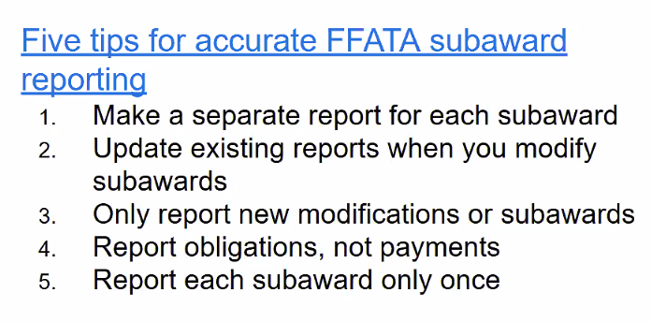
FFATA - Subaward and Executive Compensation (4 of 4)

Slide 90



Lunch Break

Slide 91
Break Out Sessions

Slide 92
BREAK TIME #2

Slide 93
15 minute break
15 Minutes
Notes:
93
93
Using this PowerPoint break timer
This PowerPoint slide uses images, custom animation, and timing to provide a countdown timer that you can use in any presentation. When you open the template, you’ll notice that the timer is set at 00:00. However, when you start the slide show, the timer will start at the correct time and count down by 1-minute intervals until it gets to 1 minute. At that point, it will count down in two 30-seconds intervals to 00:00.
To insert this slide into your presentation
Save this template as a presentation (.ppt file) on your computer.
Open the presentation that will contain the timer.
On the Slides tab, place your insertion point after the slide that will precede the timer. (Make sure you don't select a slide. Your insertion point should be between the slides.)
On the Insert menu, click Slides from Files.
In the Slide Finder dialog box, click the Find Presentation tab.
Click Browse, locate and select the timer presentation, and then click Open.
In the Slides from Files dialog box, select the timer slide.
Select the Keep source formatting check box. If you do not select this check box, the copied slide will inherit the design of the slide that precedes it in the presentation.
Click Insert.
Click Close.

Slide 94
Monitoring Discussion

Slide 95
Grants Financial Management Division’s Mission
To ensure stewardship over Federal funds
awarded by:
Conducting On-Site Financial Reviews
Conducting OCFO-Desk Based Financial Reviews
Providing Technical Assistance to Grantees

Slide 96

Monitoring Discussion (1 of 6)
How are grants selected for on site review?
Grantee’s Request for Technical Assistance
Random Sample
Risk Assessment
New Grant or
Grantee
Problems Identified from OCFO Desk Review
Dollar Amount of
Award
Program Office Request

Slide 97
Monitoring Discussion (2 of 6)
What will be reviewed during the on-site visit?
Internal Controls
Accounting System
Accounting procedures including cash management procedures
Federal Financial Reports (SF-425s)
Test and Analyze expenditures
Provide technical assistance

Slide 98
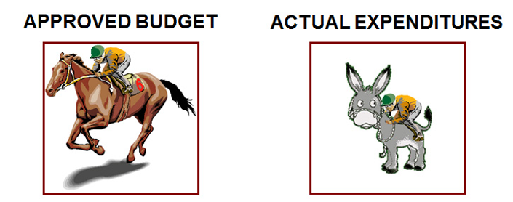
Monitoring Discussion (3 of 6)
Compare your actual expenditures with your grant objectives and approved budget
Are you spending the money according to the purpose of the award?

Slide 99
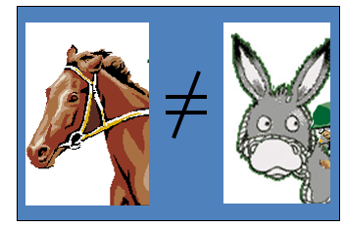
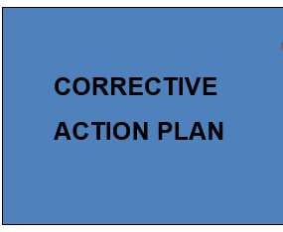
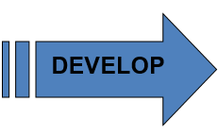
Monitoring Discussion (4 of 6)
Compare your actual expenditures with your grant objectives and approved budget
OCFO will help you get back on track

Slide 100
Monitoring Discussion (5 of 6)
What are the objectives of the OCFO based desk review?
Conduct an analysis of grant activity to date
Analyze Federal Financial Reports (SF-425s)
Determine compliance with audit report submission requirements
Evaluate payments -- determine excess cash
Identify grantees who need on-site financial review

Slide 101
Monitoring Discussion (6 of 6)
Primary Grantee’s Responsibility
The primary grant recipient is responsible for monitoring the subrecipient and ascertaining that all fiscal and programmatic responsibilities are fulfilled, including compliance with Federal rules and regulations (e.g., 2 CFR Part 200, EEO compliance).

Slide 102
Top 10 Monitoring Findings (FY 2025) (1 of 3)
Procedures not documented or need improvement
All Financial Managers and Grants Award Administrators should take the Financial Management Training Course
Federal Funding Accountability and Transparency (FFATA) reporting requirement not met
Internal Control Weakness - Procedures Not Followed
1
2
3
4

Slide 103
Top 10 Monitoring Findings (FY 2025) (2 of 3)
5
Federal Financial Report (FFR) do not reconcile with Grantee's Accounting Records
Inadequate Subrecipient Files/Documentation
Indirect Costs not properly reported on the Federal Financial Reports (FFR)
Excess Cash-On Hand Identified
6
7
8

Slide 104
Top 10 Monitoring Findings (FY 2025) (3 of 3)
9
Budget Modification – Addition of an unauthorized budget category
Subrecipient monitoring not being conducted
10

Slide 105
Closeout

Slide 106
Closeout (1 of 4)
Cash Reconciliation and Final Drawdown
Award recipients must conduct a financial reconciliation of their accounting records to the final Federal Financial Report (FFR/SF-425) at closeout. Recipients must:
Report final Federal share of cumulative expenditures and recipient share, if required, on the final FFR.
Liquidate obligations incurred prior to end of the period of performance no more than 120 days after the project period end date.
Request final draw down of Federal expenditures made within the approved period of performance in conjunction with the final SF-425. This request must be submitted prior to the end of the liquidation period.
Funds will be frozen after 120 days.

Slide 107
Closeout (2 of 4)
Closeout Requirements
Within 120 days of the end of the award period, the recipient must submit the following:
Final Federal Financial Report
Final Performance Report
Refund of Excess Cash
Funds will be frozen after 120 days.

Slide 108
Closeout (3 of 4)
Refund Excess Cash
Make check payable to DOJ/Office of Justice Programs
Cover letter or voucher containing the grant number for the refund, itemization of funds and the unobligated balance
Printout of the final SF-425 report which supports the amount of the refund
Failure to remit payment to OJP will be referred to the U.S. Department of the Treasury for collection.
Funds will be frozen after 120 days.

Slide 109
Closeout (4 of 4)
For The OIG Grant Fraud slides-
Please refer to the zip file you received by email.

Slide 110
U.S. Department of Justice
Home Stretch

Slide 111
Resources

Slide 112
Resources (1 of 6)
Webinar Recordings
  Open your web browser and go to:
  https://www.ojp.gov/
  Click on “Training”
  Click on "Training" again (This will open the OJP Training section.)
  Click on + sign next to “Grants and Financial Training” (the window will expand).
  From the expanded list, click on “OJP Financial Management Training Webinars.”
This should open the page dedicated to those webinars, where you can view, or access recordings of financial management webinars offered by OJP.

Slide 113

Resources (2 of 6)
General Information
Pre-award Requirements
Post Award Requirements
Organization Structure
Appendices
DOJ Grants Financial Guide 2024 | Welcome to the DOJ Grants Financial Guide | Office of Justice Programs (ojp.gov)

Slide 114
Resources (3 of 6)
OCFO Financial Questions via Telephone/Internet
OCFO Customer Service Center
Monday through Friday
8:30 a.m. - 6:00 p.m. est.
1-(800) 458-0786 or (202) 305-9988
FAX (202) 353-9279
OCFO e-mail Address:
ask.ocfo@usdoj.gov

Slide 115
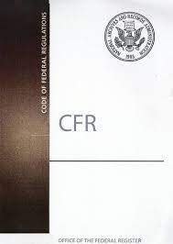
Resources (4 of 6)
eCFR :: 2 CFR Part 200 -- Uniform Administrative Requirements, Cost Principles, and Audit Requirements for Federal Awards
Previous Webinar Recordings and PowerPoints ​​
https://www.ojp.gov/training/financial-management-training-webinars

Slide 116
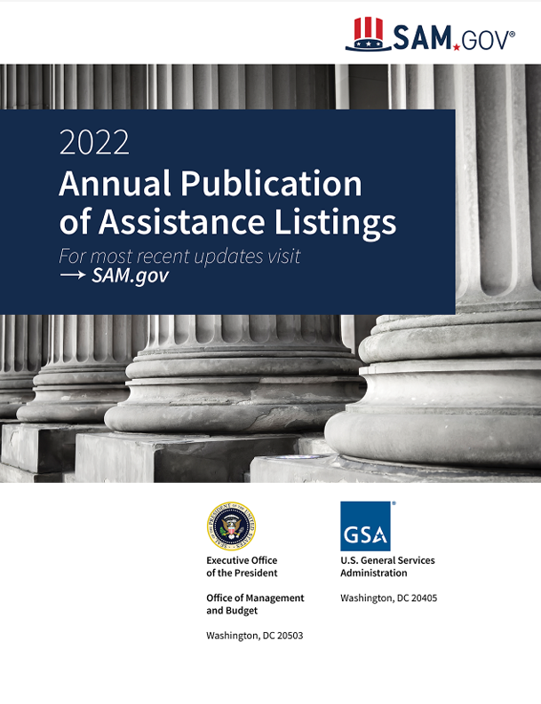
Resources (5 of 6)
How to Access Grant $$
Assistance Listings (formerly Catalogue of Federal Domestic Assistance CFDA)
Over 2,500 Programs
Available at www.sam.gov

Slide 117

Resources (6 of 6)
In The End…
Some Things to Remember!
Get through the Maze!

Slide 118
Memorable Moments
Dates:
  Award
  Obligation
  Expenditure
  Budget modifications, no cost extensions & other GANs
  Drawdown
  Reporting (Financial & Performance)
  Documentation!

Slide 119




Wrap Up
Last thoughts
Evaluations
Certifications
Thanks for coming!

Slide 120
The End

