Slide 2


Financial Life Cycle of Grants
APPLICATION
BUDGET REVIEW
AWARD
GRANT ADMINITRATION
CLOSEOUT

Slide 3
Welcome and Introductions
Name
Jurisdiction/Organization represented
Years in grants
Type of grants

Slide 4

No
Question
?
?
?
?
?
?
is a Dumb
Question

Slide 5
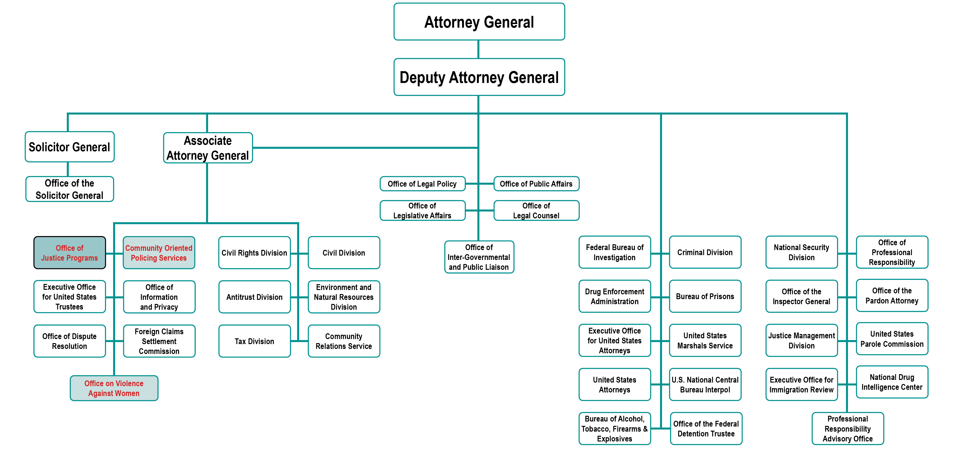
U.S. Department of Justice

Slide 6
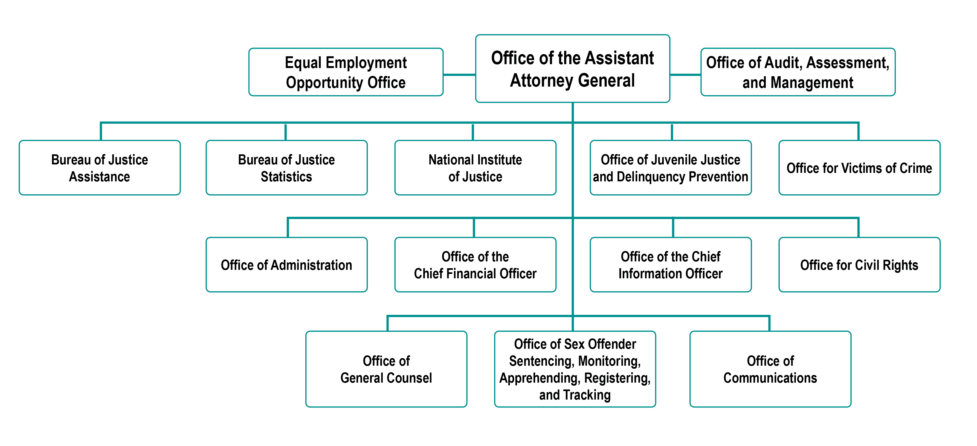
Office of Justice Programs

Slide 7
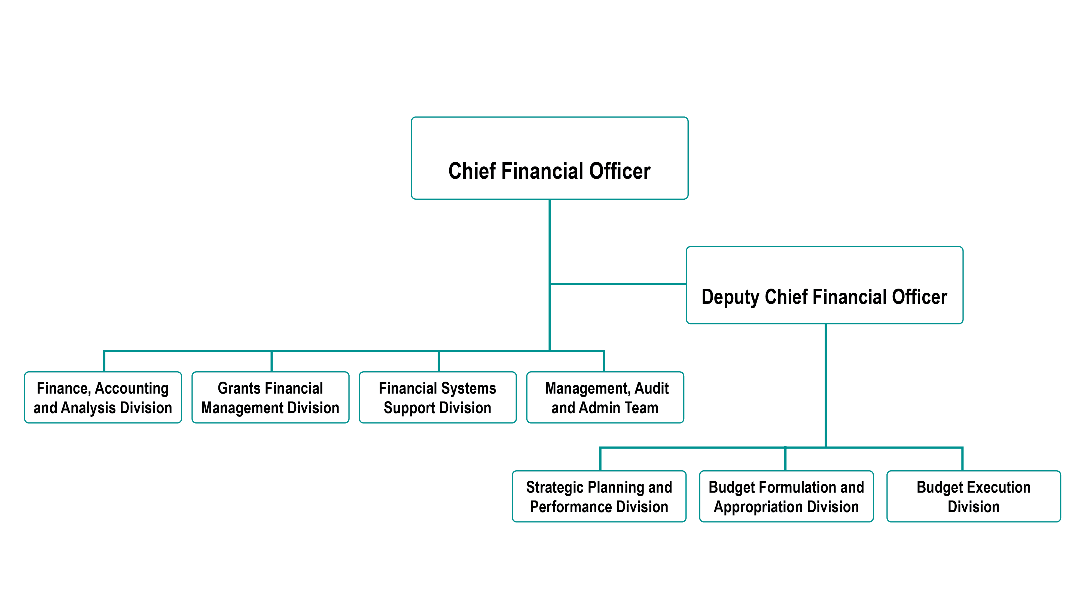
Office of the Chief Financial Officer
Rachel Johnson
Brian Horn

Slide 8
Where Do Federal Grants Come From?

Slide 9

Federal Budget Process
AUTHORIZATION

Slide 10
Federal Budget Process
$
AUTHORIZATION
APPROPRIATION

Slide 11

Federal Budget Process
$
$
AUTHORIZATION
APPORTIONMENT
APPROPRIATION

Slide 12

Federal Budget Process
$
$
$
AUTHORIZATION
APPORTIONMENT
APPROPRIATION
ALLOTMENT

Slide 13

Federal Budget Process
$
$
$
$
AUTHORIZATION
APPORTIONMENT
OBLIGATION
APPROPRIATION
ALLOTMENT

Slide 14

Federal Budget Process
$
$
$
$
$
AUTHORIZATION
APPORTIONMENT
OBLIGATION
APPROPRIATION
ALLOTMENT
EXPENDITURES

Slide 15

Federal Budget Process
$
$
$
$
$
AUTHORIZATION
APPORTIONMENT
OBLIGATION
DISBURSEMENTS
APPROPRIATION
ALLOTMENT
EXPENDITURES

Slide 16
Agency Requirements When Applying for Federal Grant Funds

Slide 17


Financial Management Systems
All recipients are required to:
Establish/maintain auditable accounting records
Accurately account for funds awarded
Funds for each award must be accounted for
separately from other grants and other funding sources
Records shall include Federal, cost sharing, and program income

Slide 18
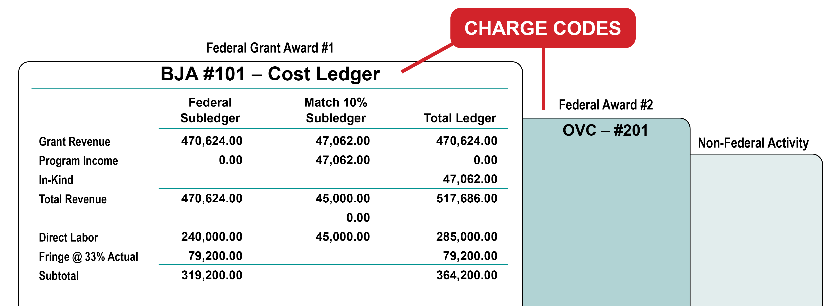
Financial Management Systems
Segregation of Awards and Activities
Separately Funded Federal Awards

Slide 19
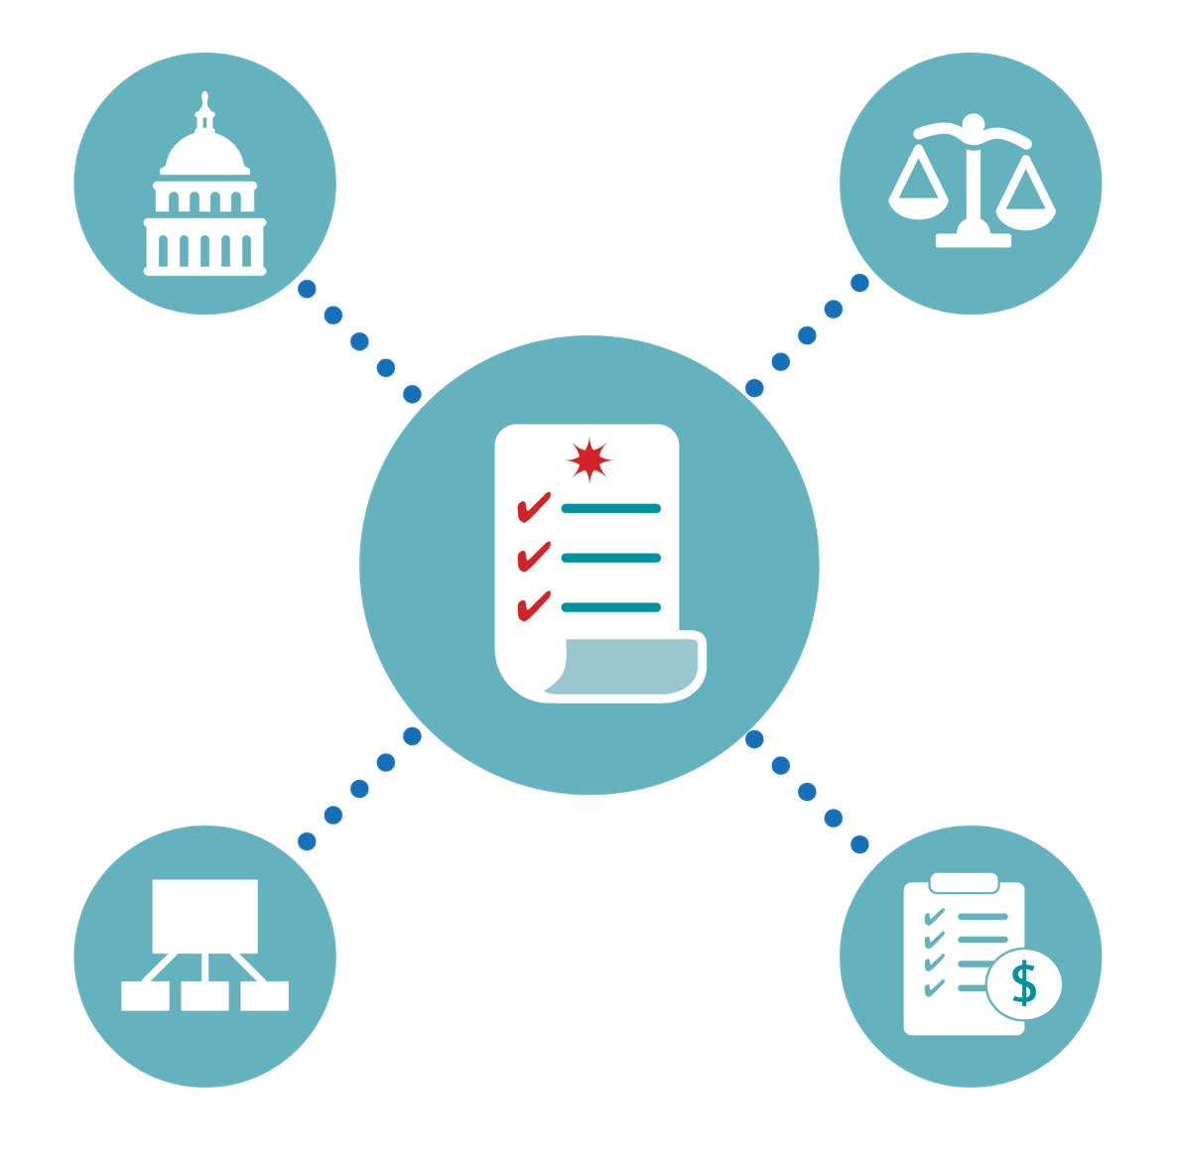
Financial Management Systems
States, Indian Tribes, and recipients or subrecipients must expend/account for grant funds per their own policies and procedures, applicable Federal statutes, regulations, and terms and conditions of the award. (whichever are more restrictive)

Slide 20

Accounting and Internal Controls
Proper stewardship of federal resources is an essential responsibility of the grantee organization.
Grantees must ensure that Federal programs and resources are used efficiently and effectively to achieve desired objectives.

Slide 21

Internal Controls and Segregation of Duties
Strong internal controls allow for effective and efficient operations, reliable financial reporting, and compliance with applicable laws and regulations.
Proper segregation of duties should ensure that no individual has the ability to either conceal or misdirect funds within the agency.

Slide 22
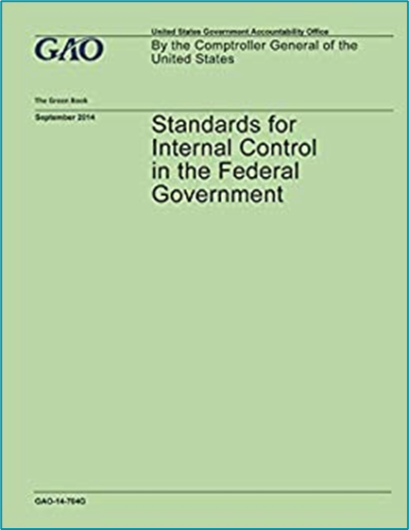
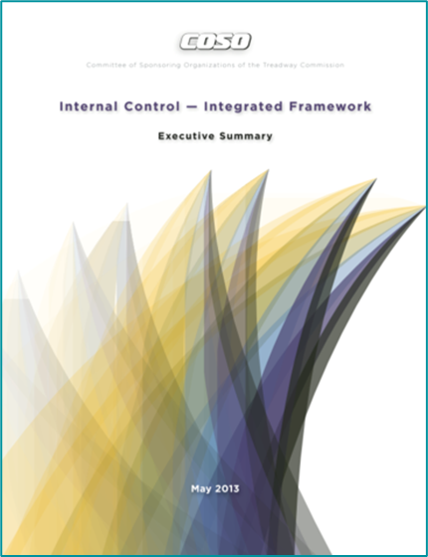
Internal Controls
Standards for Internal Controls in the Federal Government – (Green Book).
Internal Control Integrated Framework / (Committee
of Sponsoring Organizations
of the Treadway
Commission – COSO).

Slide 23



Financial Management Systems
Adequate Accounting System:
Grantee must maintain an adequate system of accounting and internal controls and ensure that an adequate system exists for each of its subrecipients.
- - - - - - -
- - - - - - - - - - - - -
- - -
- - - - - - - -

Slide 24

Financial Management Systems
Adequate Accounting System:
Present and classifies costs,
as required for budgetary and evaluation purposes.
Provides cost and property control to ensure optimal use of funds.
Controls funds/resources to assure conformance with general or special conditions.

Slide 25

Financial Management Systems
Adequate Accounting System:
Meets requirements for periodic reporting.
Provides financial data for planning, control, measurement, and evaluation of direct and indirect costs.

Slide 26
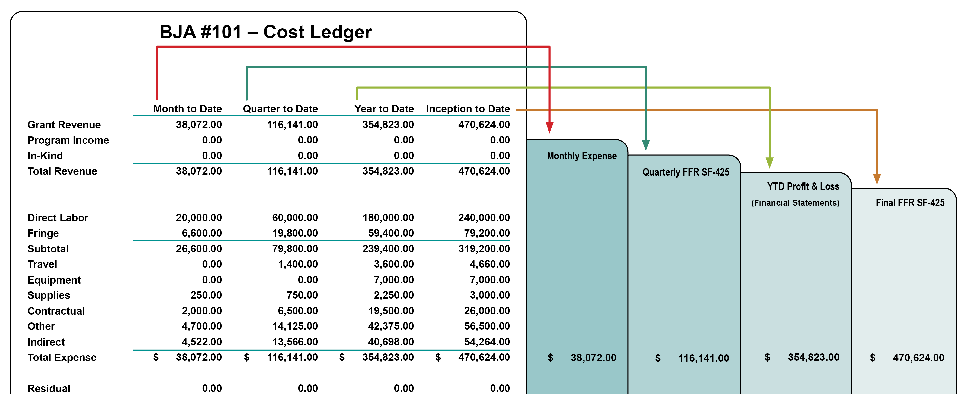
Financial Management Systems
Requirements of Periodic Reports

Slide 27




Financial Management Systems
IN SUMMARY
Record and Report on:
- - - - - - - - - - - - - -
RECEIPT
OBLIGATION
EXPENDITURES
of Grant Funds

Slide 28
Applicable Laws and Regulations Affecting Federal Grant Funds

Slide 29




Order of Precedence
1 AUTHORIZING LEGISLATION
  Congress
2 FEDERAL AGENCY REGULATION
  Code of Federal Regulation (CFR)
3 TERMS AND CONDITIONS OF THE AWARD
  Grant Award Document
4 FEDERAL AGENCY POLICIES
  DOJ Grants Financial Guide

Slide 30
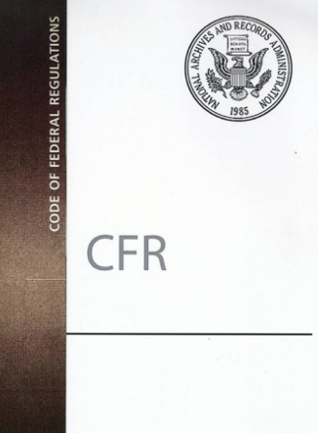
Code of Federal Regulations
The Code of Federal Regulations (CFR)
is the codification of the general and permanent rules published in the Federal Register by the executive departments and agencies of the Federal Government.

Slide 31
Grants Awarded prior to December 26, 2014
APPLIES TO
OMB
DOJ
Non-Profit Organizations
2 CFR, Part 215
OMB A-110
28 CFR 70
Administrative
Requirements
State & Local Units of Government
OMB A-102
28 CFR 66
Educational Institutions
2 CFR, Part 220 (OMB A-21)
Included as reference in CFR
Cost Principles
State & Local Units of Government
2 CFR, Part 225 (OMB A-87)
Non-Profit Organizations
2 CFR, Part 230 (OMB A-122)
Educational Institutions
Included as reference in CFR
Audit Requirements
Non-Profit Organizations
OMB A-133
State & Local Units of Government

Slide 32
Grants Awarded on or After December 26, 2014
APPLIES TO
OMB
Administrative
Requirements
State & Local Units of Government
OMB 2 CFR Part 200 Uniform Administrative Requirements, Cost Principles and Audit Requirements for Federal Awards
Cost Principles
Non/For-Profit Organizations
Audit Requirements
Educational Institutions

Slide 33


BREAK TIME

Slide 34

















15 Minutes
Notes:
34
34

Slide 35




Government-wide Common Rules
Common Rules:
Committee of Federal agency representatives
“Uniform” requirements
Signed by
Federal agencies
Limited
exceptions
granted by OMB

Slide 36

Government-wide Common Rules
1 2 CFR Part 200
2 Suspension & Debarment (S&D)
3 Drug-free Workplace (DFW)
4 Lobbying

Slide 37





Lobbying Restrictions
Applicable to:
State & Local Units of Government
Non-Profit Organizations
Indian Tribes and Tribal Organizations
Commercial Entities
Individuals
(direct or indirect)

Slide 38
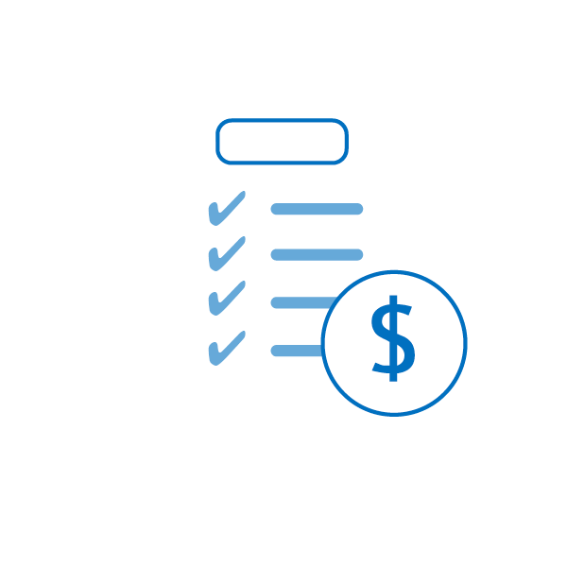
Code of Federal Regulations (2 CFR/Part – 200)
Uniform Administrative Requirements, Cost Principles
and Audit Requirements for Federal Awards
Standards for Costs Requires:
Allowable
Necessary to the performance of a project
Reasonable
Allocable to the project and consistently treated
Non-profitable
Claimed against only one award, and
Permissible under State & Federal laws and regulations.

Slide 39

Classification of Costs
Direct Costs:
Costs identified specifically with an activity
Salaries and wages (including holidays, sick leave, etc.) for direct labor employees
Other employee fringe benefits allocable
to direct labor employees
Consultant services contracted to
accomplish specific project objectives
Travel of direct labor employees
Materials/supplies purchased directly
for use on a specific project

Slide 40
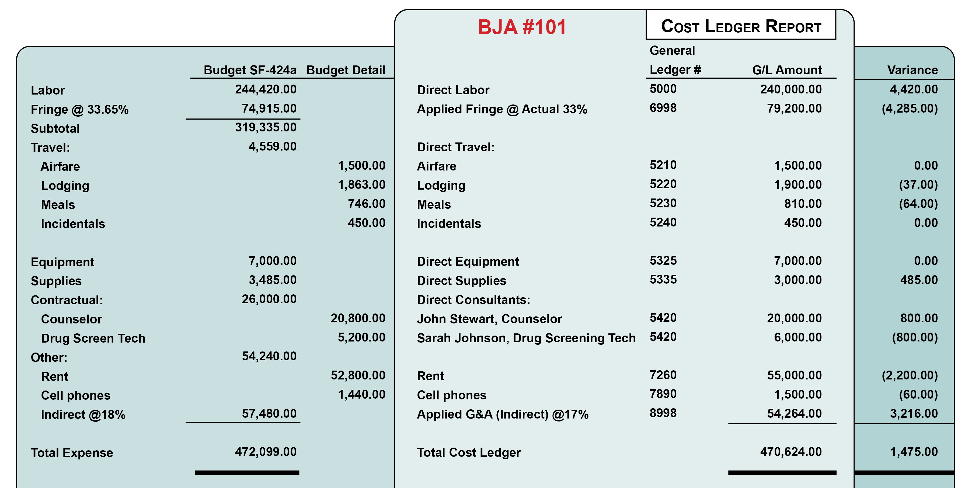
Classification of Costs

Slide 41

Classification of Costs
Indirect costs generally are not readily identifiable with a particular grant or contract such as:
Maintenance of buildings
Telephone expense
Supplies
Depreciation
Rental expense

Slide 42


Classification of Costs
Indirect Costs Rates:
Provisional indirect costs rates adjusted
to actual (retroactive adjustment)
Predetermined rates (not normally
subject to adjustment)
Fixed rates (with roll or carry forward
adjustment in future period)
Implements cognizant Federal
agency concept

Slide 43
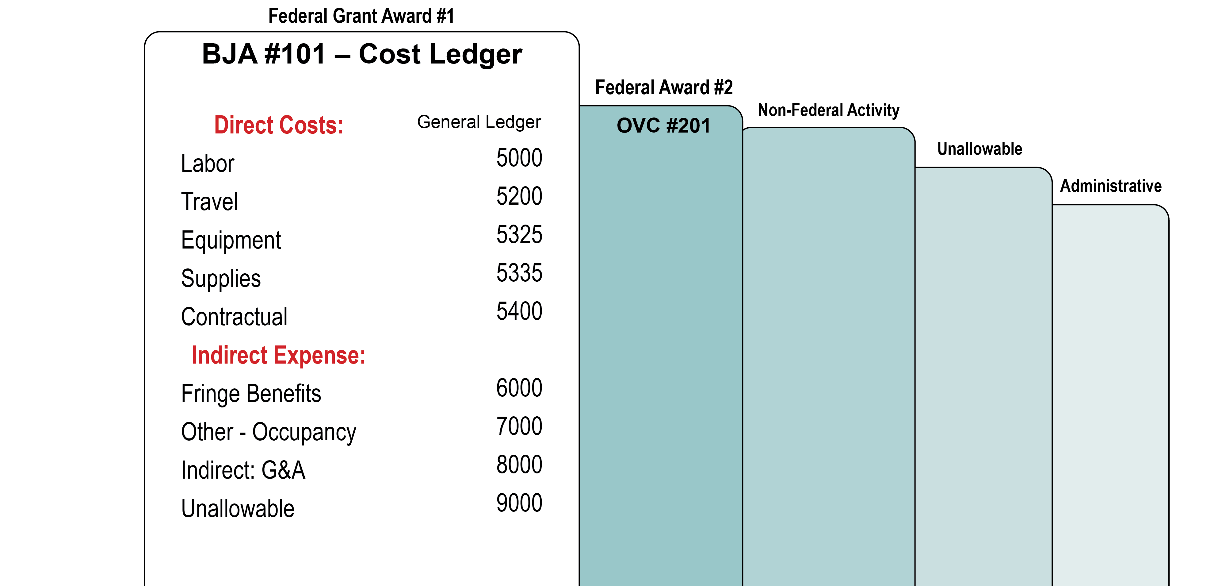
Classification of Costs

Slide 44

Classification of Costs
De Minimis Rate:
Any non-Federal entity that does not have a negotiated indirect cost rate may elect to charge a de minimis rate of up to 15% of modified total direct costs (MTDC)
Rate may be used indefinitely or until entity elect to negotiate for a rate
Costs must be consistently charged
as either indirect or direct – (not both)
Subrecipients use the same guidelines
as recipients.

Slide 45

Code of Federal Regulation Standards for Costs
The regulation DOES NOT:
Supersede limitation imposed by law
Dictate extent of Federal funds
Provide additional Federal funds for indirect costs
Dictate how a government should use funds
Relieve State & local governments of stewardship responsibilities for Federal funds

Slide 46

Selective Items of Cost
Accounting
Advertising
Alcoholic Beverages
Audit Services
Bad Debts
Contingencies
Contributions & Donations
Entertainment
Fines/Penalties
Fund Raising
Rental Costs

Slide 47


Supplanting
DOJ funds must be used to supplement existing funds for program activities and may not replace (supplant) non-federal funds that have been appropriated for the same purpose.

Slide 48
Program Requirements
Applicable to Some Federal Grants

Slide 49
Cost Sharing (Match) Requirements

Slide 50


Cash vs. In-kind Cost Sharing
vs.

Slide 51
How to Calculate Cost Sharing
Award Amount
% of Federal Share
=
Adjusted Project Cost
Adjusted Project Cost
x
Recipient’s Share
=
Required Match
Ex: Federal Amount = $80,000 with 80/20 Match
$80,000 = $100,000 Adjusted Project Cost
80%
$100,000 x 20% = $20,000 Required Match

Slide 52
Procurement

Slide 53


Procurement Procedures and General Guidance
States and Indian Tribes must follow the same policies and procedures it uses for procurements with non-Federal funds.
All other recipients and subrecipients must follow 2 CFR 200.318 – 200.327.
Documentation is very important!
Contract files must establish an audit trail.
Documentation should be sufficient enough
to stand on its own.
- - - - - - - - - - - - - - - - - - - -
- -
- -
- -
- - -

Slide 54
General Guidance and Competition
2 CFR 200.319 requires all procurement transactions be conducted in a manner that provides full and open competition.
Examples of situations that may restrict competition include, but are not limited to:
  Unreasonable requirements
  Unnecessary experience
  Conflicts of interest
  Specifying only a “brand name” product
Bidders’ lists should be continually updated.
Newspaper/other advertising of contract requirement is very important.

Slide 55

Sole Source Contract
Federal awarding agency’s approval of sole source is required for procurements over $250K.
Use when:
The item or service is available only from a single source.
A true public exigency or emergency exists.
After competitive solicitation, competition is considered inadequate.
A for-profit entity not eligible to be a direct recipient may not be awarded a sole source contract.

Slide 56
Sole Source Justification/Sample Outline
Paragraph | Content
1 | Brief description of program and what product or service is being contracted for:
2 | Explanation of why it is necessary to contract non-competitively, to include: Organizational expertise Management Knowledge of the program Responsiveness Expertise of personnel

Slide 57
Sole Source Justification/Sample Outline
Paragraph | Content
3 | Description of and the results of any market survey or research conducted. If no survey or research conducted, explain why not.
4 | Statement of when contractual coverage is required and if dates are not met, what impact on the program. Example: how long it would take another contractor to reach the same level of competence (equate in $$).

Slide 58
Noncompetitive Procurement Justification (Sole Source) Sample Outline
Paragraph | Content
5 | Other points to “sell the case.”
6 | A declaration that this action is in the “best interest” of the grantor agency and/or the Federal government.
7 Note: | Conflict of Interest review. Time constraints will not be considered a factor if the grantee has not sought competitive bids in a timely manner thereby creating a time constraint situation.

Slide 59

Contracting Dos & Don’ts
DOs
DON’Ts
Compete
Prepare IFB/RFP
Maintain bidders list
Conduct interviews
Obtain prior approval
Make documentation available
Place unreasonable requirements
Require unnecessary experience
Engage in noncompetitive pricing
Engage in organizational conflicts of interest
Require unreasonable timeframe
Require only “brand name” products

Slide 60



List of Parties
Excluded From Federal Procurement or Non-Procurement Programs
Frequently Asked Questions:
Electronic List of Parties
https://www.sam.gov/
Federal Service Desk:
1-866-606-8220

Slide 61
Pre-award Exercise

Slide 62
Pre-award Exercise
1. Strong internal controls can ensure effective and efficient operations, reliable financial reporting, and compliance with applicable laws and regulations.
  True
  False

Slide 63
Pre-award Exercise
2. An adequate accounting system:
  Meets requirements for periodic reporting.
  Provides financial data for planning, control, measurement, and evaluation of direct and indirect costs.
  Presents and classifies costs, as required for budgetary and evaluation purposes.
  All of the above
  None of the above

Slide 64
Pre-award Exercise
3. Per 2 CFR/Part 200 (Uniform Administrative Requirements, Cost Principles, and Audit Requirements) accounting, advertising, rental costs, and audit services:
  are allowable costs
  are unallowable costs
  can be allowable costs

Slide 65
Pre-award Exercise
4. OJP funding can be used to purchase food and/or beverages
for any meeting, conference, training or other event.
  True
  False

Slide 66
Pre-award Exercise
5. The value of something received or provided that does not have a cost associated with it.
  Cash match
  In-kind match

Slide 67
Pre-award Exercise
6. Which of the following is first in the order of precedence?
  Terms and Conditions of the Award
  Authorizing Legislation
  Federal Agency Regulation
  Federal Agency Policies

Slide 68
Pre-award Exercise
7. Indirect costs are:
  costs identified specifically with an activity
  costs not readily identifiable with a particular grant or contract
  costs that generally include employee fringe benefits allocable to direct labor employees

Slide 69
Pre-award Exercise
Under Government wide common rules, Indian Tribal Governments are exempt from lobbying.
  True
  False

Slide 70
Pre-award Exercise
9. To deliberately reduce State or local funds because of the existence of Federal funds.
  Indirect Costs
  Supplanting
  Supplement

Slide 71
Pre-award Exercise
Federal awarding agency’s approval of sole source is required for procurements over
  $ 20,000
  $ 250,000
  $ 50,000

Slide 72


U.S. Department of Justice

Slide 73
Break Out Sessions
Break Out Sessions – Place holder

Slide 74
Application Process

Slide 75


Application Review
Unique Entity Identifier (UEI)
  Universal identifier for Federal recipients and their direct subrecipients.
  System for Award Management (SAM)
  Federal Service Desk
  https://www.sam.gov

Slide 76

Financial Integrity
Type of Applicant
Financial Management and Internal Controls Questionnaire – (All OJP applicants)
Grantee Audits
Applicants Federal Debt
Accuracy of Taxpayer ID

Slide 77

High Risk Grantees
Have a history of unsatisfactory performance
Are not financially stable
Have a management system which does not meet the management standards set forth in 2 CFR Part 200.302 (Financial Management)
Have not conformed to the terms and conditions of previous awards
Have open Single Audit or Office of Inspector General (OIG) audit report recommendations
Have significant non-compliance issues
Are otherwise not responsible (e.g., open site visit,
requests for information from DOJ program manager, etc.)

Slide 78
Budget Process

Slide 79










Budget Categories
PERSONNEL
FRINGE BENEFITS
TRAVEL
EQUIPMENT
SUPPLIES
CONSTRUCTION
SUBAWARDS
PROCUREMENT
OTHER
INDIRECT

Slide 80

Budget Review
Personnel Category
Position – (i.e.,) grant coordinator
Title – (i.e.,) director, sheriff, secretary
Percentage of time – (i.e.,) 50%, 100%
Compensation – (i.e., show annual) $60,000
Increases – (i.e.,) raise, cost of living allowance (COLA)
COST MUST BE NECESSARY, REASONABLE, ALLOWABLE, AND ALLOCABLE

Slide 81
Budget Review
Personnel Category
Only the salaries of direct employees should be in the personnel category
Non-employee salaries should be in procurement contracts category
Excessive annual salary limits require a signed waiver (DOJ Financial Guide Pg. 60)
  For 2025, the maximum salary limit is 110% of the SES salary: $225,700 x 110% = $248,270.
COST MUST BE NECESSARY, REASONABLE, ALLOWABLE, AND ALLOCABLE

Slide 82
Budget Review
Personnel Category
John Smith, Project Director ($60,000 x 100% x 1yr) $60,000
Peter Mayes, Program Manager ($45,000 x 100% x 1yr) 45,000
Mary Jones, Assistant Solicitor ($32,000 x 50% x 1yr) 16,000
$121,000
Cost of living increase on second year
John Smith, Project Director ($60,000 x 2%) $1,200
Peter Mayes, Program Manager ($45,000 x 2%) 900
Mary Jones, Assistant Solicitor ($16,000 x 2%) 320
$2,420
COST MUST BE NECESSARY, REASONABLE, ALLOWABLE, AND ALLOCABLE

Slide 83
Budget Review

Slide 84
Budget Review

Slide 85
Budget Review
Fringe Benefits Category
What’s included – (i.e., FICA, health, retirement, workman’s comp)
Unallowable – (i.e., excessive fringe for executives)
Fringe benefits should be calculated on the actual salary of personnel versus the total costs (unless they are the same)
Fringe benefits should be itemized
COST MUST BE NECESSARY, REASONABLE, ALLOWABLE, AND ALLOCABLE

Slide 86
Budget Review
Fringe Benefits Category
FICA 6.75%
Retirement 9.20%
Workman’s Comp 3.70%
Health Insurance 11.0%
Fringe Benefit Rate 30.65%
The fringe benefit for each staff member is estimated at 30.65% of the salaries which is the current cost of fringe benefits for current full-time employees of the Third Judicial Circuit.
John Smith, Project Director (30.65% x $60,000) $18,390
Peter Mayes, Program Manager (30.65% x $45,000) $13,793
Mary Jones, Assistant Solicitor (30.65% x $16,000) $ 4,904
Total Fringe $37,087
COST MUST BE NECESSARY, REASONABLE, ALLOWABLE, AND ALLOCABLE

Slide 87
Budget Review

Slide 88
Budget Review
Travel Category
Travel Policy
Computation – number of travelers x cost
Purpose – grant/program requirements
Per Diem – use agency policy and, if no policy, must follow Federal Travel Regulations
Transportation – air, taxi (show each separately)
Other – parking, tolls, baggage fees
Local Travel – mileage, use agency policy and,
if no policy, must follow Federal policy
COST MUST BE NECESSARY, REASONABLE, ALLOWABLE, AND ALLOCABLE

Slide 89
Budget Review
Travel Category
Registration/Conference fees should be in the “Other Category”
Please include applicable taxes and fees with lodging rates
If using Air travel, include a line item for baggage fees
If the lodging rate per night is more than the GSA rate, the grantees need a justification and state travel policy used
COST MUST BE NECESSARY, REASONABLE, ALLOWABLE, AND ALLOCABLE

Slide 90
Budget Review

Slide 91
Budget Review
Lodging Rates at Per Diem
All OJP funded contracts for events that include 30 or more participants (both Federal and non-Federal) lodging costs for any number of attendees requiring lodging must not exceed Federal per diem rate for lodging.
Conferences that include less than 30 people are exempt from this requirement.
The web-site address for obtaining the current rates is https://www.gsa.gov
DOJ Grants Financial Guide provides further clarification of this
requirement at https://www.ojp.gov/funding/financialguidedoj/overview
COST MUST BE NECESSARY, REASONABLE, ALLOWABLE, AND ALLOCABLE

Slide 92
Budget Review
Equipment Category
Policy – Recipients should follow their own capitalization policy for equipment.
If no policy exists, must follow Federal policy
Unit & cost – (i.e., 1 computer @ $2,000)
Purpose – (i.e., grant/program requirement)
COST MUST BE NECESSARY, REASONABLE, ALLOWABLE, AND ALLOCABLE

Slide 93
Budget Review
Equipment Category
Federal Definition – useful life of more than one year with a fair market value (FMV) of $10,000 or more.
Disposition – when equipment is no longer needed for criminal justice purposes, and its FMV is less than $10,000, the equipment can be retained with no further obligation to the awarding agency.
If the FMV is $10,000 or more, the equipment can be retained
or sold; however, the proceeds (Federal participation)
must be returned to the awarding agency.
COST MUST BE NECESSARY, REASONABLE, ALLOWABLE, AND ALLOCABLE

Slide 94
Budget Review
Equipment Category
Items that do not fit in the guidelines for capitalization, should be in the Supplies category
Rented or leased equipment should be in the Procurements Contracts category
COST MUST BE NECESSARY, REASONABLE, ALLOWABLE, AND ALLOCABLE

Slide 95
Budget Review

Slide 96
Budget Review
Supplies Category
Major types – (i.e., office, training, postage)
Project benefits – (i.e., how supplies will support efforts)
Supplies should be itemized in detail
Miscellaneous expense needs to be itemized
Cell phone service and software should be in the “Other” category
COST MUST BE NECESSARY, REASONABLE, ALLOWABLE, AND ALLOCABLE

Slide 97
Budget Review

Slide 98
Budget Review
Construction Category
As a rule, construction costs are generally not allowable.
Consult with the program office before budgeting funds in this category.
COST MUST BE NECESSARY, REASONABLE, ALLOWABLE, AND ALLOCABLE

Slide 99
Budget Review

Slide 100
Budget Review
Subaward (Subgrants) Category
A description of the activities to be carried out by subrecipients.
Describe the purpose of the subaward (subgrant)
Contracts or consultants that are not considered as subaward should be under procurement contracts category
Grantees must ensure correct calculation when using the de minimis rate
  It should be calculated on the first $50,000 and not $50,000 per year for the subaward category
COST MUST BE NECESSARY, REASONABLE, ALLOWABLE, AND ALLOCABLE

Slide 101
Budget Review

Slide 102
Budget Review
Procurement/Contracts Category
Procurement for goods or services
Consultant rates – (i.e., $650 threshold)
Sole Source – over $250K
Procurement Standards—General Guidance for Open Competition (Uniform Guidance at 2 C.F.R. § 200.317 through 2 C.F.R. § 200.327)
Please describe services being provided
Indicate whether the applicant’s formal written procurement policy or federal acquisition regulations is followed
COST MUST BE NECESSARY, REASONABLE, ALLOWABLE, AND ALLOCABLE

Slide 103
Budget Review

Slide 104
Budget Review

Slide 105
Budget Review
Other Category
Major types – (i.e., rent, utilities)
Basis – (i.e., 1200 sq ft @ $22 per sq ft)
Please list out each item type
Examples of Other: registration fees, rent, software, etc
COST MUST BE NECESSARY, REASONABLE, ALLOWABLE, AND ALLOCABLE

Slide 106
Budget Review

Slide 107
Budget Review
Indirect Costs Category
Approved rate – (i.e., by cognizant Federal agency)
Current negotiated agreement – (i.e., provisional, fixed, final)
De Minimis rate – must specify in application the amount to be claimed
Grantee should calculate indirect costs on federal share only
The correct indirect cost base should be used
COST MUST BE NECESSARY, REASONABLE, ALLOWABLE, AND ALLOCABLE

Slide 108
Budget Review

Slide 109

Budget Summary
Budget Categories Amount
Personnel $121,000
Fringe Benefits $37,087
Travel $4,715
Equipment $7,000
Supplies $1,395
Construction $15,000
Subawards (Subgrants) $295,000
Procurement Contracts $68,105
Other Costs $54,240
Total Direct Costs $603,542
Indirect Costs $28,891
Total Project Costs $632,433

Slide 110
Budget Exercise
For the Budget Exercise- Please refer to the zip file you received by email.

Slide 111

Top Ten Reasons Budgets Don’t Clear
1 The budget detail narrative amounts and descriptions
do not match the budget line item
2 Costs are allocated to the wrong category (i.e. fringe benefits in
personnel; registration in travel; contracts listed in other, etc.)
3 The required match percentage has not been met
or source identified, and/or the match is calculated incorrectly
4 Unallowable costs are included in the budget detail
5 Incomplete Budget – missing budget narrative

Slide 112
Top Ten Reasons Budgets Don’t Clear
6 IDC rate used in computation is calculated incorrectly
7 Prior budget did not clear, or pending budget modification not approved (applies to supplemental awards)
8 Fringe Benefits Base is different from the calculated salaries in
Personnel category
9 Responses to the initial budget financial review memo were
insufficient
10 Total Project Costs do not equal the Federal Funds and Match
amount

Slide 113
To Be Continued …

