Slide 1
CONFERENCE COST SUBMSSION, APPROVAL, AND REPORTING REQUIREMENTS
Office of the
Chief Financial Officer
Office of Justice Programs

Slide 2
Conference Policy

Slide 3
Conference Policy
Purpose for DOJ 1405.03 Policy
Provides guidance on planning, approving, attending and reporting conferences. In addition, it implements the requirements of the Office of Management and Budget (OMB) memorandum M-11-35, titled Eliminating Excess Conference Spending and Promoting Efficiency in Government, dated September 21, 2011, OMB Memorandum M-12-12, Promoting Efficient Spending to Support Agency Operations, dated May 11, 2012, and OMB Memorandum M-17-08, dated November 25, 2016 amending M-12-12 which remind agencies that they must operate with the utmost efficiency and eliminate unnecessary or wasteful spending.

Slide 4
Conference Policy
Reason for Policy
To ensure stewardship over Federal funds.
Make sure the Department’s core missions are supported.

Slide 5
Conference Policy
Conference Definition as defined by DOJ 1405.03 policy and Federal Travel Regulations (FTR)
A conference defined broadly can be:
Meetings;
Retreats;
Seminars;
Symposiums; or
Training activities.

Slide 6
Conference Policy
Conference Definition (Cont)
Some typical characteristics of a conference are:
Designated participants and/or registration,
A published substantive agenda, and
Scheduled speakers or a discussion panel.

Slide 7
Conference Policy
Conference Guidelines
Recipients should ensure the most cost effective options are considered when planning to conduct a training such as:
Webinars;
Acquiring the lowest cost locations and venues;
Minimizing travel costs; and
Ensuring all conference costs are necessary business expenses.

Slide 8
Conference Policy
Conference Guidelines (Cont)
Cooperative agreement recipients and Contractors must receive OJP or DOJ’s written prior approval for each event held with DOJ funds that meets the definition of a conference.
In absence of approval from OJP or DOJ, recipients must cancel the event.

Slide 9
Conference Policy
Conference Guidelines (Cont)
Timing of Requests for Approval
Event Parameters | Date Due from Grantee to OJP
$100K or less, and not exceeding any cost thresholds * | 90 calendar days **
Over $100K, or exceeding any one cost threshold * * conference space, audio-visual equipment/services, logistical conference planner, programmatic conference planner | 120 calendar days ** ** in advance of the earliest: start date of the conference, deadline to sign contracts, or obligation of funds for conference costs (except for minimal costs required to assemble and submit approval request)

Slide 10
Conference Policy
Conference Guidelines (Cont)
All cooperative agreement and contract recipients must complete and submit the Conference & Event Submission Form to OJP for prior approval.
Each submission must contain all the applicable information (i.e., start and end dates, conference planner, M&IE).

Slide 11
Conference Policy
Does this Conference Require Approval?
1. Is the cost of the event greater than $20,000?
2. Are there meeting room costs?
3. Are audio visual costs greater than $31.25 per attendee or more than $1,250 in total?
4. Are there any food and beverage costs?
5. Did the request for the meeting come from multiple jurisdictions or agencies?
6. Are there trinkets being purchased?
7. Is there a formal published agenda?
8. Are formal discussion or presentation panels planned?
9. Are there logistical planning costs beyond incidental internal administrative costs necessary to arrange travel and lodging for a small number of individuals?
If any question is answered "yes", the event must be submitted for prior approval. If all answers are "no", the event does not require prior approval.

Slide 12
Conference Policy
Conference Guidelines (Cont)
The recipient must provide adequate justifications where required by the form.
All supporting documentation should be embedded within the supporting documentation spreadsheet.

Slide 13
Conference Policy
Justifications – Tie to OJP mission- Bureaus/program offices must ensure strong, clear, and concise justifications grounded in the mission and with a policy perspective - explaining the purpose and how the event advances the mission of OJP/DOJ.
Before | After
This conference was designed to disseminate research information and generate dialog about how scientific evidence can improve policy and practice for crime and justice. | Pursuant to NIJ’s authorizing statute, over 1,100 members of the academic community together with state, local and tribal criminal justice professionals participated in this conference, disseminating research, data and information and generating important dialogues about how scientific evidence can improve policy and practice for crime and justice. The 2023 Conference focused on ways policymakers and practitioners can use scientific methods and evidence-based practices to save criminal justice system funds. The conference featured seven breakout session tracks, including corrections, courts and sentencing, forensic science, policing and public safety, shaping the future of criminal justice, justice technology, and violence and victimization. The conference has provided an annual forum for the dissemination of research and evidence to the criminal justice community.

Slide 14
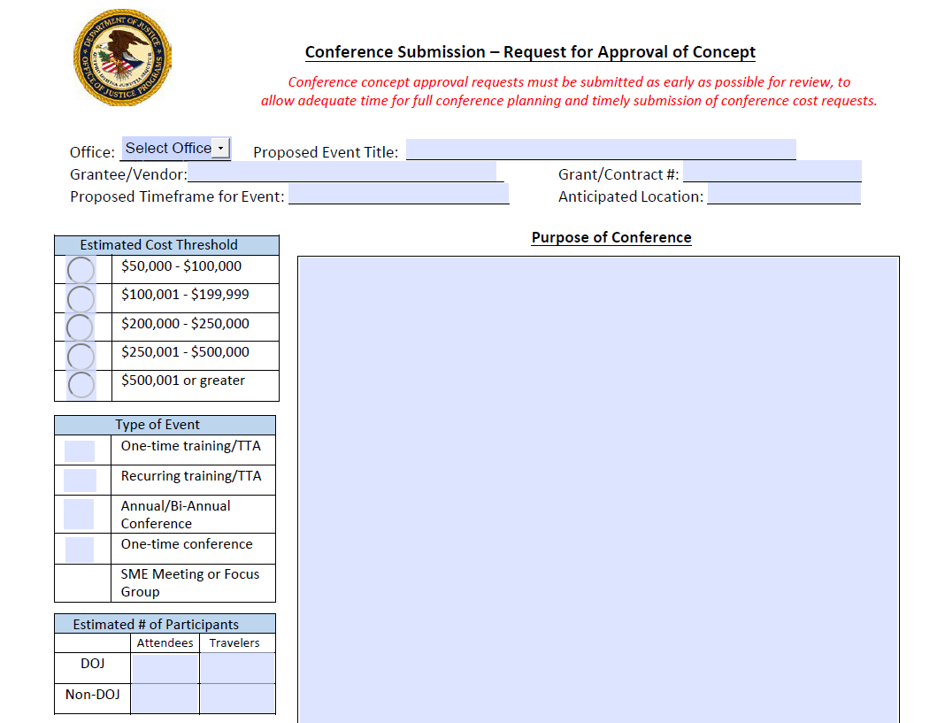
Conference Policy
(Concept Approval Form – For Events over $100k)
For OJP Conferences anticipated to exceed $100,000, offices must complete and submit a Conference Concept Approval Form(CCF) to obtain OJP AAG concurrence on the conference concept before initiating, planning, and submitting a conference cost request for approval. Once the CCF has been reviewed and concurrence has been obtained from the OAAG, full conference planning may begin. A copy of the signed CCF must be included with the supporting documentation when submitting the Conference Request to OJP's designated conference email box.

Slide 15
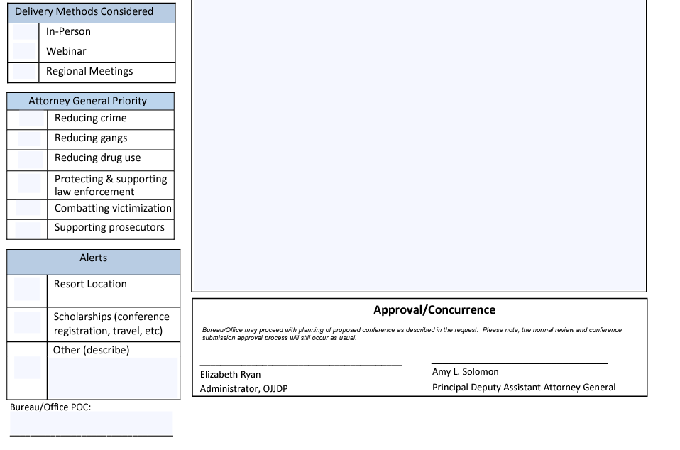
Conference Policy
(Concept Approval Form – Cont’d)

Slide 16
Conference Policy
The review and approval of the budget and budget narrative during the application process that includes funds and details of conferences is not a review or approval of those conference costs. This is also noted in the Financial Clearance Memo: Conference costs (when applicable) require prior approval. The below award condition is applied to the awards.

Slide 17
Conference Cost Process – Responsibilities and Timelines

Slide 18
Conference Cost Process
OJP Review: Responsibilities and Timeline
Performed By: | Action: | Business Days
Cooperative Agreement Recipient/Contractor | Submit to designated OJP email box | *
OCFO Conference Team | Review for basic minimum requirements | 3
Program Office | Review for accuracy, completion and quality | 7
OCFO | OCFO analysts | 14
OAAG | Review/approve and return to OCFO for final processing (policy advisor 2 days; DAAG O&M 1 days; AAG 3 days) | 6
OCFO - CFO | Submit conferences over $250k to JMD (after OAAG approval) | 2
Place holder –Flow Chart for Process

Slide 19
Conference Cost Process
OJP Review: Responsibilities and Timeline
The amount of time required to adequately complete the Conference & Events Submission Form will vary depending on the complexity of the proposed event.
There is no “expedited review process.” Every effort is made to review all events as quickly as possible.
Each conference request is unique in reference to how the event will accomplish OJP’s/COPS Office’s mission (meeting, conference, webinar, etc.). The key to any conference/event moving through the review process will depend on whether the package is complete. A complete package contains a detailed cost analysis and sufficient justification to support all categories within the package.
Note: Regardless of the size of any event, the supporting justification should be sufficient to support the agency’s mission for conducting the event.

Slide 20
Conference Submission
Types of Submissions
The three main types of submissions are:
Regular/Standard Request
Blanket Request – same conference in different locations taking place in the same fiscal year.
Combination Request – (done by conference cost team) – more than one grantee using DOJ funds to conduct conference.

Slide 21
Conference Submission
Cost Categories
Conference Meeting Space including rooms for break-out sessions (Threshold)
Audio-Visual Equipment and Services (Threshold)
Printing and Distribution
Meals
Refreshments
Meals and Incidental Expenses (M&IE)
Lodging
Transportation (common carrier)
Local Transportation (rental car, taxi, POV)
Logistical Planner (Threshold)
Programmatic Planner (Threshold)
External Trainers/Instructors/Presenters/ Facilitators
Other Costs – Identified Individually
Indirect Costs

Slide 22
Conference Submission
Conference/Meeting Space –
Facilities used to hold a conference, includes breakout rooms.
Federal facilities or no-cost facilities should be used if available
Non-federal facilities maybe used:
If a federal facility is not available
If federal facility is more costly
Or if the federal facility does not meet the requirements of the event.
The threshold for meeting room and AV combined is $31.25 per attendee per day not to exceed total cost of $25,000 (this includes indirect cost.)

Slide 23
Conference Submission
Conference/Meeting Space – (Cont’d)
Cooperative Agreement recipients and federal procurement contractors should compare three or more facilities in a location even if there is a “no cost” site selected.
Despite the multiple meetings offered within the larger event, DOJ/OJP/COPS Office considers and approves this type of event as a single event.

Slide 24
Conference Submission
A/V Equipment & Services
Audio-Visual services needed for the conference.
Includes monitors, microphones, flip charts, speaker systems, etc.
If a hotel is being used, then AV should be included in the hotel contract.
The threshold for meeting room and AV combined is 31.25 per attendee per day not to exceed total cost of $25,000 (this includes indirect cost.)

Slide 25
Conference Submission
Printing and Distribution
This cost includes all printing and postage costs required for training materials.
Every effort should be made to provide conference materials to participants electronically or via print-on-demand services/options.
Printed materials should maximize paper usage (printing on both sides) and minimize higher cost options (color printing) where possible.

Slide 26
Conference Submission
M&IE & Lodging
Meals and incidental expenses is designed to cover the daily cost of food and other incidental expenses while on travel for work.
Portion of per diem paid by the Department.
Should include costs for trainers, instructors, presenters, facilitators as well as attendees.
If meals are provided, the meal must be deducted from the claimed M&IE.
Federal MI&E per diem rates can be found at www.GSA.gov.
If taxes are included in the lodging rate, it should be added into the submission form.

Slide 27
Conference Submission
M&IE & Lodging (Cont’d)
According to the DOJ Financial Guide: All contracts under an award funded by OJP awards for events that include 30 or more participants (both Federal and non-Federal) must ensure that lodging costs for any number of attendees do not exceed the prevailing Federal per diem rate for lodging. If the lodging rate is not the Federal per diem rate or less, none of the lodging costs associated with the event are allowable costs to the award.

Slide 28
Conference Submission
Transportation
Common Carrier Transportation for commuting to conference for all participants that require transportation.
Total transportation cost to/from conference location (airplane, train, etc.), not including any local transportation cost paid for by Department of Justice funds.
This should include baggage fees as well.
DOJ attendee travel must be accounted for if paid with by DOJ funds. This section would normally be completed by program office. Grantees should work with the program office regarding costs to include.

Slide 29
Conference Submission
Local Transportation
Local Transportation Expenses associated with the conference for participants including, airport parking fees, rental car, mileage, etc.
Any local transportation cost paid for by Department of Justice funds.

Slide 30
Conference Submission
Logistical Planner
Logistical planner performs the logistical planning necessary to hold a conference, i.e., recommending venues, advertising, securing rooms, handling registration, making travel reservations etc.
Logistical planners can be internal staff or external contractors.
Logistical planner costs should be tracked separately in the cooperative recipients accounting records.
The threshold for logistical planner is $62.50 per attendee not to exceed $11,000. Includes direct and indirect costs.
Logistical planner hours must be broken down by tasks.
Logistical planning includes time spent on tasks such as venue selection, ordering and setting up of audio-video equipment, securing hotel rooms, processing registrations, onsite support during the event, and other non-programmatic functions.

Slide 31
Conference Submission
Programmatic Planner
Programmatic planner develops the conference agenda, content, and written materials. They may identify subject matter experts and conference participants.
Programmatic planners can be internal staff or external contractors.
Programmatic planner costs should be tracked separately in the cooperative recipients accounting records.
The threshold for logistical planner is $250 per attendee not to exceed $43,750. Includes direct and indirect costs.
Programmatic planner hours must be broken out by tasks.
Programmatic planning includes time spent on activities such as developing the conference content and agenda, identifying and recruiting subject matter experts, and preparing written materials.
Note: Time spent working on a conference by staff or contractors can be classified as either Logistical planning time or Programmatic planning time.

Slide 32
Conference Submission
Conference Facilitator
The facilitator acts in the role as the trainer, moderator, speaker, instructor etc. for the conference.
Conference facilitators can be internal staff or external contractors.
Costs should include prep time preparing for speaking.

Slide 33
Conference Submission
Other Costs
Other costs must be identified individually.
These costs must be itemized on the Conference & Events Submission form.

Slide 34
Conference Submission
Indirect Cost
Indirect costs associated with the direct costs necessary to plan and hold a conference must be included in all conference reporting.
The indirect cost rate is in accordance with the negotiated indirect cost agreements.
A current agreement (covering conference period) must be attached as supporting documentation.

Slide 35
Conference (Other)
Food and Beverage
Lunch “On Your Own” should be addressed on the agenda.
Complimentary food and beverages may be accepted if offered to everyone. You are not required to reduce your M&IE by the value of the food and beverage if offered to all customers as noted in this example.
The inclusion of food and beverage costs will delay the review process and these costs are not likely to be approved. The only exception is when the location of the conference does not allow attendees to obtain food or beverages on their own, or when this restriction would greatly disrupt the conference schedule. If you believe your event qualifies for such a rare exception, please contact your program manager to discuss it before completing and submitting your form.

Slide 36
Conference
Changes after Approval
After receiving notification of approval from DOJ/OJP/COPS Office, all subsequent changes prior to the start day of the event should be sent to either the OJP or COPS Office Conference Costs email address, as appropriate.
Example: If an event was approved by OJP/COPS Office on 9/1/20XX for an event scheduled for 12/15/20XX, the recipient/ federal procurement contractor should notify OJP/ COPS Office as soon as possible of any changes in attendees (preferably 30 days or more in advance). This scenario holds true for changes to start and end date, location, and any other cost-related category.

Slide 37
Post Reporting

Slide 38
Conference Post Reporting
Reporting Requirements
All conference costs for events held by cooperative agreement recipients or federal procurement contractors costing over $20,000, or where more than 50% of attendees are DOJ employees, must be reported within 45 calendar days after the last day of the event.
Explanation of variances greater than 10% and $1,000.
If the actual costs are $20,000 or less, cooperative agreement recipients should file the report with the actual costs and notify the program manager or OJP point of contact that a report is not required.

Slide 39
Conference Post Reporting
Reporting Requirements (Cont’d)
Post event reports must contain actual costs. These costs should include logistical and programmatic planner staff time spent on these activities and any contracted planner costs.

Slide 40
Conference Cost Findings

Slide 41
Conference Cost Findings
Top Ten Conference Cost Findings
Breakdown of Programmatic and Logistical Planning Hours by Task.
Strong Justification on Line 14 on the Submission Form and Enhanced Justification on separate sheet if needed.
Lunch “On Your Own” should be addressed on the agenda.
Leaving columns and items blank on the submission form.
Attachments should be embedded in the supporting documents.
Do not upload revised versions of the conference submission form.
Indirect cost rate agreement must be current for the period of the conference.
Detailed breakdown in the printing category.
Lodging rates should address taxes.
Transportation category should address baggage fees.

Slide 42
Conference Cost Reminders

Slide 43
Conference Cost Reminders
Conference Concept Approval form is required for OJP Conferences expected to exceed $100,000.
When notifying the grantees of their approval status, please attach a copy of the grantee’s original submission form that was sent with the OCFO Approval email, if the event >=$20K.
Before submitting a conference, please ensure that there is a strong, clear, and concise justification that ties to DOJ/OJP’s mission.
Always download the most recent version of the submission form from the DOJ financial guide to complete as opposed to overwriting an older version. This will cause a delay in processing.
: As a general rule, please explain how you derived every cost that you include in the conference submission form. The form can be challenging to complete and there are lines where it is not possible to add descriptive narrative. Please include your explanations and specific cost breakdowns in a separate tab, or in a separate document that is submitted with the form. In addition, please include the cooperative agreement or federal procurement contract number on the form.

Slide 44
Conference Cost Reminders
Avoid Delays:
Do not attempt to alter the submission form. The altering of the submission form will cause a delay and it will be returned to the grantee.
If additional space is needed, please include a separate attachment with your explanations and specific cost breakdowns and submit it with the form.
Do not leave spaces blank in the submission form. Instead, state that DOJ funds are not covering any items in this category or costs in this category are covered by private funds.
If there is no current grant in place, contact your program manager to see if a project period extension is warranted.
Remember the conference cost submission form is an estimate of costs . Attendance and costs should be based on historical data of the previous or similar event. Any changes in the estimate can be noted in the post report after approval along with a justification.

Slide 45
Resources

Slide 46
Conference Submissions
Designated Email Boxes
Conference request for prior approval:
BJA: BJAConferencereport@usdoj.gov All other OJP Bureaus and Offices: OJPConferencecosts@ojp.usdoj.gov
Conference post reporting:
OJPConferenceCostReporting@ojp.usdoj.gov

Slide 47
Policy Guidance
DOJ Grants Financial Guide
Federal Travel Regulation
OJP Conference Cost Reporting Policy and Guidance Documents
Resources
Conference Cost Webinar Recording
Conference Cost PowerPoint
Conference & Events Submission Instructions
Conference & Events Submission Instructions – Blanket Request
Conference & Events Submission Form
Conference & Events Submission Job Aid
Conference & Events Submission FAQs
DOJ Grants Financial Guide
Federal Meeting Facilities | GSA
Food and Beverage Policy
OJP Conference Certification Program

Slide 48
Questions

