Slide 1
Indirect Cost
Direct Cost, Indirect Cost, and Cost Objectives
Indirect Cost Allocation
Types of Direct Cost Bases
Types of Indirect Cost Rates
Cognizant Agency
Indirect Cost Negotiation Process
Indirect Cost Budget
2024 OMB’s Uniform Guidance Updates
Frequently Asked Questions

Slide 2
Direct Cost, Indirect Cost, & Cost Objective

Slide 3
Types of Costs
Total Costs
Direct
Administrative
Program
Indirect
Administrative
Program
Notes:
Let's start by showing the two different types of costs. Not all administrative costs are indirect costs.

Slide 4
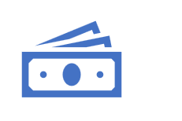
Direct Cost & Indirect Cost
Direct Costs
Easily identified with a specific cost objective
Specific to a particular cost objective
Indirect Costs
Not readily assignable to cost objective
Benefits more than one cost objective
Direct Salaries, Travel Equipment, Materials
Accounting Services, Utilities, Rent

Slide 5
Cost Objective
Cost Objective
Activity
Award
Division
Contract
Work Unit
Function
Program
Cost Objective
Can be a program, an award, a division, a function, an activity, or a work unit against which costs are allocated to measure the cost processes, products, jobs, etc.
Notes:
Understanding Cost objectives is key to know the difference between Direct vs Indirect.

Slide 6
Test Your Knowledge
All administrative costs are indirect costs.
True
False

Slide 7
Test Your Knowledge: Identify Costs as Direct or Indirect
The salary paid to the CEO of an organization.
Indirect Cost.
Travel expenses of a staff to train victims of human trafficking.
Direct Cost
Fringe benefits paid to the Accountant who process invoices.
Indirect Cost
Testing kits purchased for a program funded by OVC.
Direct Cost

Slide 8
Indirect Cost Allocation

Slide 9
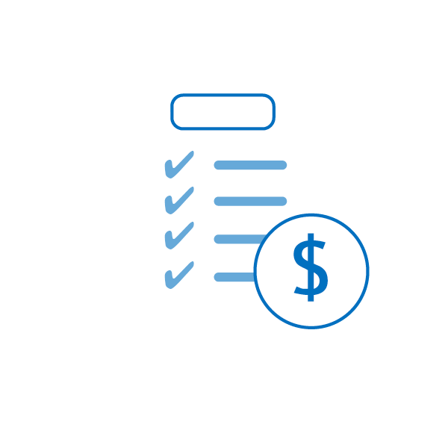
Indirect Cost Allocation
Central Service Cost Allocation Plan: the documentation identifying, accumulating, and allocating or developing billing rates based on the allowable costs of services provided by a governmental unit on a centralized basis to its department and agencies. (2 CFR Part 200.9)
Indirect Cost Rate: is a rate used to allocate indirect costs to each cost objective.

Slide 10
Statewide Cost Allocation Plans (SWCAP)
Mechanism for the state to identify, summarize, and allocate statewide indirect costs
Allows state to charge cost of central services to Federal awards
Should submit annual SWCAP to U.S. Department of Health and Human Services

Slide 11
Indirect Cost Rate (ICR)
ICR is a mechanism for determining fairly and conveniently the proportions of indirect costs each program should bear.
ICR is used to recover indirect costs from a federal grant.
Indirect Cost Pool
Direct Cost Base
Indirect Cost Rate
÷
=
Notes:
A method used to determine what proportion of indirect costs each program should pay

Slide 12
Indirect Cost Rate Example
Indirect Cost Pool = $20,000
Direct Cost Base = $100,000
Indirect Cost Rate = 20%

Slide 13
Generally Unallowable Costs
Lobbying Costs
Alcoholic beverages
Bad debt or allowances for doubtful accounts
Entertainment costs
Fundraising costs
Fines and Penalties
Loss on Federal or non-Federal projects
Provisions for contingencies
Interest
Charitable contributions

Slide 14
Test Your Knowledge
Indirect cost rate provides a basis for:
Charging the Legislature
Billing the federal government for those costs that indirectly benefit the federal project
Recouping all non-federal entity costs regardless of impact on the federal grant program
Indirectly charging the federal for property costs
Notes:
B

Slide 15
Types of Direct Cost Bases

Slide 16
Types of Indirect Cost Base
Modified Total Direct Costs (MTDC)
Direct Salaries & Wages
Direct Salaries & Wages plus Fringe Benefits

Slide 17
Types of Direct Cost Bases
INDIRECT COST RATE CALCULATION
Indirect Costs |  | $ 75,000
Direct Costs
Salaries & Wages |  | $ 200,000
Fringe Benefits |  | $ 50,000
Total Direct Costs |  | $ 250,000
Indirect Costs: $75,000 Salaries & Wages Base: $200,000 | = | 37.5% Salaries & Wages Base
Indirect Costs: $75,000 Total Salaries & Wages Plus Fringe Benefits: $250,000 | = | 30% Salaries & Wages Plus Fringe Benefits
Total Direct Salaries and Wages includes only direct salaries.
Direct Salaries and Wages plus Fringe Benefits: Includes direct salaries and fringe benefits.

Slide 18
Types of Direct Cost Bases (Cont.)
Modified Total Direct Cost (MTDC) : includes direct salaries and wages, applicable fringe benefits, materials and supplies, services, travel, and up to the first $50,000 of each subaward regardless of the performance period.​

Slide 19
Modified Total Direct Cost (MTDC) Base
Excludes
Equipment
Capital Expenditures
Includes
Direct Salaries and Wages
Participant Support Costs
Tuition Charges
Rental of Space
Each Subaward in excess of $50k
Applicable Fringe Benefits
Materials and Supplies
Services
Travel
Up to the first $50k of each Subaward

Slide 20
Test Your Knowledge: Calculate MTDC Base for Year 1
Budget Type | Year 1 | Year 2
Personnel | $100,000 | $100,000
Fringe Benefits | $25,000 | $25,000
Travel | $10,000 | $10,000
Equipment | $25,000 | $15,000
Supply | $8,000 | $8,000
Subawards – Subrecipient A | $65,000 | $65,000
Subawards – Subrecipient B | $40,000 | $40,000
Other - Rent | $24,000 | $24,000
Other - Tuition | $10,000 | $5,000
Total Direct Cost (TDC) | $307,000 | $292,000
MTDC Year 1 Calculation
Total Direct Cost $307,000
Exclusions:
Equipment ($25,000)
Subaward to A ($15,000)
Subaward to B $0
Rent ($24,000)
Tuition ($10,000)
Year 1: MTDC $233,000
De Minimis ICR 15%
Indirect Cost $34,950

Slide 21
Test Your Knowledge: Calculate MTDC Base for Year 2
Budget Type | Year 1 | Year 2
Personnel | $100,000 | $100,000
Fringe Benefits | $25,000 | $25,000
Travel | $10,000 | $10,000
Equipment | $25,000 | $15,000
Supply | $8,000 | $8,000
Subawards – Subrecipient A | $65,000 | $65,000
Subawards – Subrecipient B | $40,000 | $40,000
Other - Rent | $24,000 | $24,000
Other - Tuition | $10,000 | $5,000
Total Direct Cost (TDC) | $307,000 | $292,000
MTDC Year 2 Calculation
Total Direct Cost $292,000
Exclusions:
Equipment ($15,000)
Subaward to A ($65,000)
Subaward to B ($30,000)
Rent ($24,000)
Tuition ($5,000)
Year 1: MTDC $153,000
De Minimis ICR 15%
Indirect Cost $22,950

Slide 22
Types of Indirect Cost Rates

Slide 23
Types of Indirect Cost Rates
Negotiated
Final: Based on actual cost and not subject to adjustment.
Non-Negotiated
De Minimis: Up to 15% of Modified Total Direct Costs (MTDC).
Provisional: Temporary rate until final indirect cost rate approval.
Fixed Carry-Forward Rate (For States only):The difference between estimated and actual costs is carried forward as an adjustment to the rate computation of a subsequent period.

Slide 24
De Minimis Rate
Organizations that do not have a negotiated indirect cost rate with a cognizant agency may elect to use the 15% De Minimis rate.
The Modified Total Direct Cost Base is used for De Minimis rate.
If MTDC = $100,000
Indirect Cost using De Minimis rate = 15% x $100,000

Slide 25
Fixed Carried-forward Rate
The actual financial data from two years ago is used to calculate the Fixed carried-forward rate.
Example
FY 2022 Fixed Rate
FY 2020 Financial Data
FY 2023 Fixed Rate
FY 2021 Financial Data
FY 2024 Fixed Rate
FY 2022 Financial Data

Slide 26
Fixed Carried-forward Rate Calculation
Information needed to calculate FY 2024 Fixed Rate
FY 2022 Actual Direct Cost
FY 2022 Actual Indirect Cost
Carry forward adjustment
FY 2022 Cost Allocated from SWCAP
FY 2022 Negotiated Indirect cost Rate
Carry Forward Adjustment is the difference between:
The actual indirect cost pool for FY 22 (FY22 Indirect cost + SWCAP)
FY 22 Indirect cost charged using negotiated rate ( FY 22 Negotiated rate X Actual Direct Cost)

Slide 27
Fixed Carried-forward Rate Calculation (Cont.)
Rate per negotiation (FY) 2022: 16.96%
Actual Direct Expenditure | 4,341,731,758
Department Indirect Costs | 710,630,728
SWCAP | 289,615,842
Carry-Forward | -0-
Total Pool | 1,000,246,570
Carry-Forward Adjustment Calculation
Rate x Actual Direct Costs (16.96% x $4,341,731,758) | 736,357,706
Should have recovered (Actual indirect costs for FY 20) | 1,000,246,570
Under (+)/ Over (-) Recovery | 263,888,864
Rate per negotiation (FY) 2024: 29.12%
a) Direct cost base | 4,341,731,758
Department Indirect costs | 710,630,728
SWCAP | 289,615,842
Carry forward | 263,888,864
Total Pool | 1,264,135,434

Slide 28
Test Your Knowledge
Which one of the following is NOT an indirect cost rate type?
Final
Variable
Provisional
Fixed/Carry-Forward
Notes:
B

Slide 29
Cognizant Agency

Slide 30
What is a Cognizant Agency?
Cognizant agency is the Federal Agency responsible for reviewing, negotiating, and approving cost allocation plans or indirect cost rate proposals developed under 2 CFR Part 200.414.
The Agency that provides the most federal direct funding (excluding pass-throughs & other local funding) to a grantee is the cognizant federal agency.
Notes:
One of the first step in indirect cost negotiation is identifying your cognizant agency.

Slide 31
Cognizant Federal Agency (Cont.)
Cognizant agency, typically will not be changed for 5 years for States and 3 years non-profits.
The Cognizant agency negotiates indirect cost on behalf of other federal agencies.
The rate should be accepted by all Federal awarding agencies.

Slide 32
Test Your Knowledge: Cognizant Agency Determination
ABC ‘s Grant Funding for FY 2023
ABC company doesn’t have a negotiated indirect cost rate and wants to apply for a negotiated indirect cost rate. ABC needs to determine its cognizant federal agency to submit its proposal. Based on its FY23 Grant Funding, who is the cognizant Federal agency for ABC Company?
Federal Agency | Pass-through awards | Direct Awards
Department of Health & Human Services | 5,000,000 | 3,000,000
Department of Education | 2,000,000 | 4,000,000
Department of Justice | 1,000,000 | 5,000,000
Notes:
DOJ

Slide 33
Test Your Knowledge
Once the cognizant agency approves an indirect cost rate proposal, the indirect cost rate will NOT be subject to audit.
True
False

Slide 34
OJP/DOJ’s Indirect Cost Negotiation Process

Slide 35
OJP’s Indirect Cost Negotiation Process
Grantee Submits Indirect Cost Proposal
OJP sends Confirmation email for Receipt
OJP Reviews and approves
OJP sends out agreement to grantee for signature
Grantee signs and returns agreement
OJP sends final signed agreement

Slide 36
Indirect Cost Rate Proposal Submission
Indirect Cost Proposals and all required documents can be submitted to OJP’s OCFO Indirect Cost Email address OCFOindirectcost@usdoj.gov
After submitting the proposal, grantees need to make sure:
To receive a receipt notification email from OJP.
To respond timely to OJP’s requests for any missing documents, questions, or concerns.
Notes:
On average it takes about 90 days to complete

Slide 37
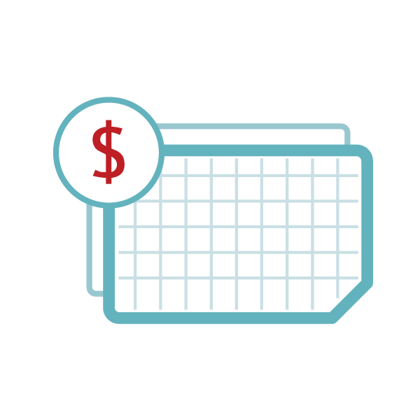
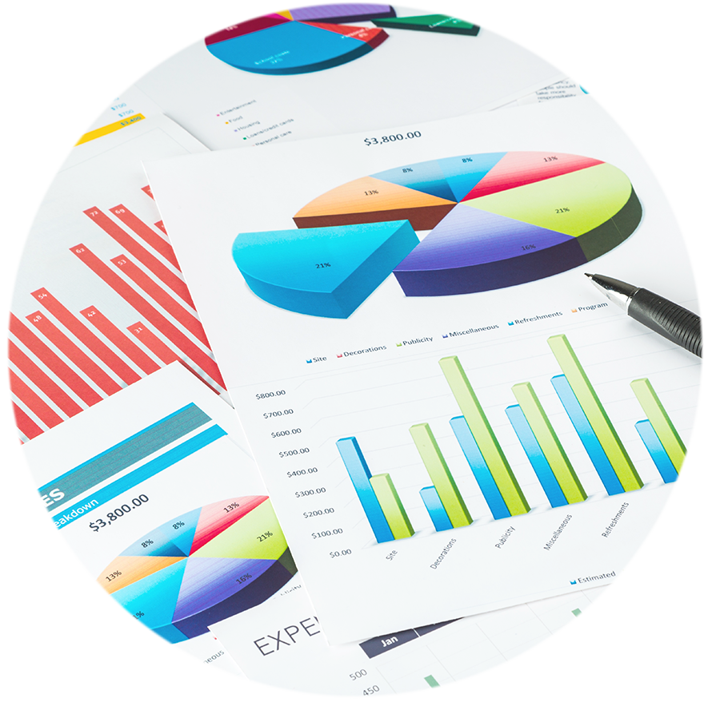
What are the Submission Requirements?
Indirect Cost Rate Proposal must be:
Developed and submitted within six months after the close of the entity’s fiscal year.
within
6
MONTHS
after FY
- - - - - - - - -
- -
- -
- - -

Slide 38
Indirect Cost Rate Proposal Required Documents
Indirect Cost Rate Proposal
Indirect Cost Rate Certification
Audited Financial Statements
List of Grant Funding or SEFA
Organizational Chart (First time)
Statewide Cost Allocation Plan (State Governments)
Cost Policy Statement

Slide 39
Indirect Cost Rate Proposal Required Documents (Cont.)
Itemized Direct and Indirect Cost Pool
List of subawards > $50k
Personnel Cost Worksheet (For Non & For- Profit)
Fixed Plus Carry Forward Calculation (State Governments)
Copy of last negotiated rate, if applicable

Slide 40
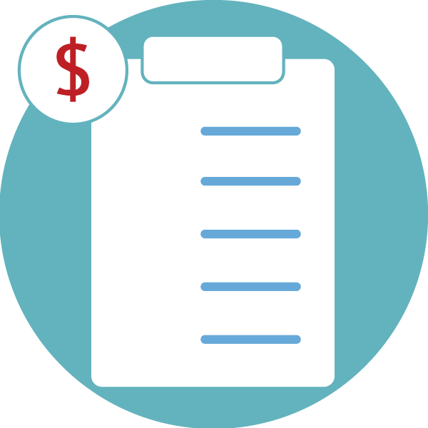
Grantee’s Responsibilities
Grantees are responsible for ensuring that indirect costs are:
Allowable, reasonable, and necessary
Treated consistently
In compliance with generally accepted accounting principles
Allocable to the Federal program
Proportional to benefit received
Adequately documented

Slide 41
Negotiated Rate Extension
One-time extension of a current negotiated rate for a period up to 4 years.
Subject to approval from cognizant agency
OJP Specific: A request for a one-time extension of a current negotiated rate may be approved for a period of one year.

Slide 42
Test Your Knowledge
How much time, from the end of the award recipient’s fiscal year, does a grant recipient have to submit a current indirect cost rate proposal?
Twelve months
Two months
Six months
None of the above

Slide 43
Indirect Cost Budget

Slide 44
Indirect Cost Budget
For indirect cost budget you need:
Indirect cost rate
Negotiated Indirect Cost Rate or
De Minimis rate
Direct Cost Base
Indirect Cost using De Minimis = 15% x $100,000
If MTDC =$100,000
Notes:
2cfr200.306

Slide 45
Indirect Cost Budget (Cont.)
Direct Cost Base excludes non-federal amount.
Example:
Total direct cost = $100,000
Total Federal share = $80,000
Total Match = $20,000
If a grantee has a negotiated rate of 20%, the grantee can include an indirect cost budget up to $16,000 ($80,000 X 20%)
If a grantee has no negotiated indirect cost rate and elected to use De Minimis rate, the grantee can charge indirect cost budget up to $12,000 ($80,000 X 15%)
Notes:
2cfr200.306

Slide 46
Indirect Cost Budget (Cont.)
Indirect Cost as a Match
Grantee can charge unrecovered indirect cost as a match, if the grantee has a federally approved indirect cost rate.
Since De Minimis rate is not a federally negotiated rate, grantee cannot charge De Minimis as a match.

Slide 47
Indirect Cost Budget (Cont.)
Example: XYZ’s MTDC = $100,000
If XYZ has a Federally approved indirect cost rate of 20%
XYZ can include up to $20,000 in the indirect cost budget as a match, or as a federal share, or split it between a match and federal share.
If XYZ elects to use de minimis
XYZ can only include up to $15,000 in the indirect cost budget as a federal share only.

Slide 48
Indirect Cost Budget (Cont.)
The budget narrative should:
Specify the type of indirect cost rate used
Show how the direct cost base is calculated
Example : ABC company currently does not have a federally negotiated indirect cost rate and elects to use De Minimis rate of 15%. The MTDC base for Year 1 excludes subaward in excess of $50k and equipment budgets from the total direct cost.

Slide 49
Indirect Cost Budget Reminders
Indirect Cost Budget Reminders
Attach current negotiated indirect cost rate agreement in JustGrants, if a negotiated rate used.
Claim indirect cost on federal share only.
Initiate Budget Modification GAM for any dollar increase or decrease from the budget.

Slide 50
2024 OMB’s Uniform Guidance Updates

Slide 51
2024 Uniform Guidance Updates
Increased Subaward threshold for calculating indirect from $25,000 to $50,000.
Increased Single Audit and Major Program threshold from $750,000 to $1,000,000
Increased De Minimis indirect rate from 10% to 15%
Equipment: Increased threshold from $5k to $10k.
Notes:
More to come

Slide 52
Frequently Asked Questions

Slide 53
Frequently Asked Questions.
Q- If a non-Federal entity’s last negotiated indirect cost rate was 9 percent MTDC, and the rate has since expired, can the organization elect to use the De Minimis rate going forward?
A - Yes. Grantee must apply across the board for all federal grants.
Q- Does a non-Federal entity using the De Minimis rate need to provide documentation to substantiate its costs?
A - No. The De Minimis rate was designed to reduce burden for small non-Federal entities.

Slide 54
Frequently Asked Questions (Cont.)
Q- If the subaward is made up of several individual funding agreements, does each individual subaward require including up to $50,000 in the MTDC base?
A - The allowance of $50,000 is for one time during the period of performance of each individual subaward.
Q- Can an award recipient, that does not have a final indirect cost rate, closeout the award using provisional rates?
A – Yes.

Slide 55
Frequently Asked Questions (Cont.)
Q- When is a Budget modification GAM (Grant Award Modification) required for a change in indirect cost budget?
A – A GAM for a budget modification must be initiated if there is any dollar increase or decrease to the indirect cost category of an approved budget.
Q. Can an award recipient claim indirect costs at a rate lower than on the approved negotiated agreement?
A. Yes, the award recipient can charge indirect cost up to the approved negotiated rate.

Slide 56
Questions

