Slide 2


Overview of Webinar
This webinar is designed to provide guidance to new recipients or individuals recently assigned the responsibility of financial administration of federal grant programs.
Completion of this webinar does not satisfy the training requirement for the grant award administrator and financial manager of an award.
Given COVID-19 circumstances, OJP has decided to discontinue the in-person training at 810 7th Street, until further notice.
We encourage recipients to access the DOJ Grants Financial Management Online Training at https://onlinegfmt.training.ojp.gov.
- -
- - - -

Slide 3
Topics of Discussion
TOPICS SLIDE #
Laws and Regulations Affecting Federal Grant Funds 5
Agency Requirements 7
Internal Controls 14
Standards for Costs 18
Types of Costs 20
Grant Award Modification 26
Reporting Requirements 29
2 CFR Part 200/Subpart F 31

Slide 4
Points to Remember for
Successful Financial Management

Slide 5
Laws and Regulations
Affecting Federal Grant Funds

Slide 6




Order of Precedence
1
AUTHORIZING LEGISLATION
  Congress
FEDERAL AGENCY REGULATION
  Code of Federal Regulation (CFR)
TERMS AND CONDITIONS OF THE AWARD
  Grant Award Document
FEDERAL AGENCY POLICIES
  DOJ Grants Financial Guide
2
3
4

Slide 7
Agency Requirements
Financial Management Systems

Slide 8


Financial Management Systems
All recipients are required to:
Establish/maintain auditable accounting records
Accurately account for funds awarded
Funds for each award must be accounted for
separately from other grants and other funding sources
Records shall include Federal, matching, and program income

Slide 9
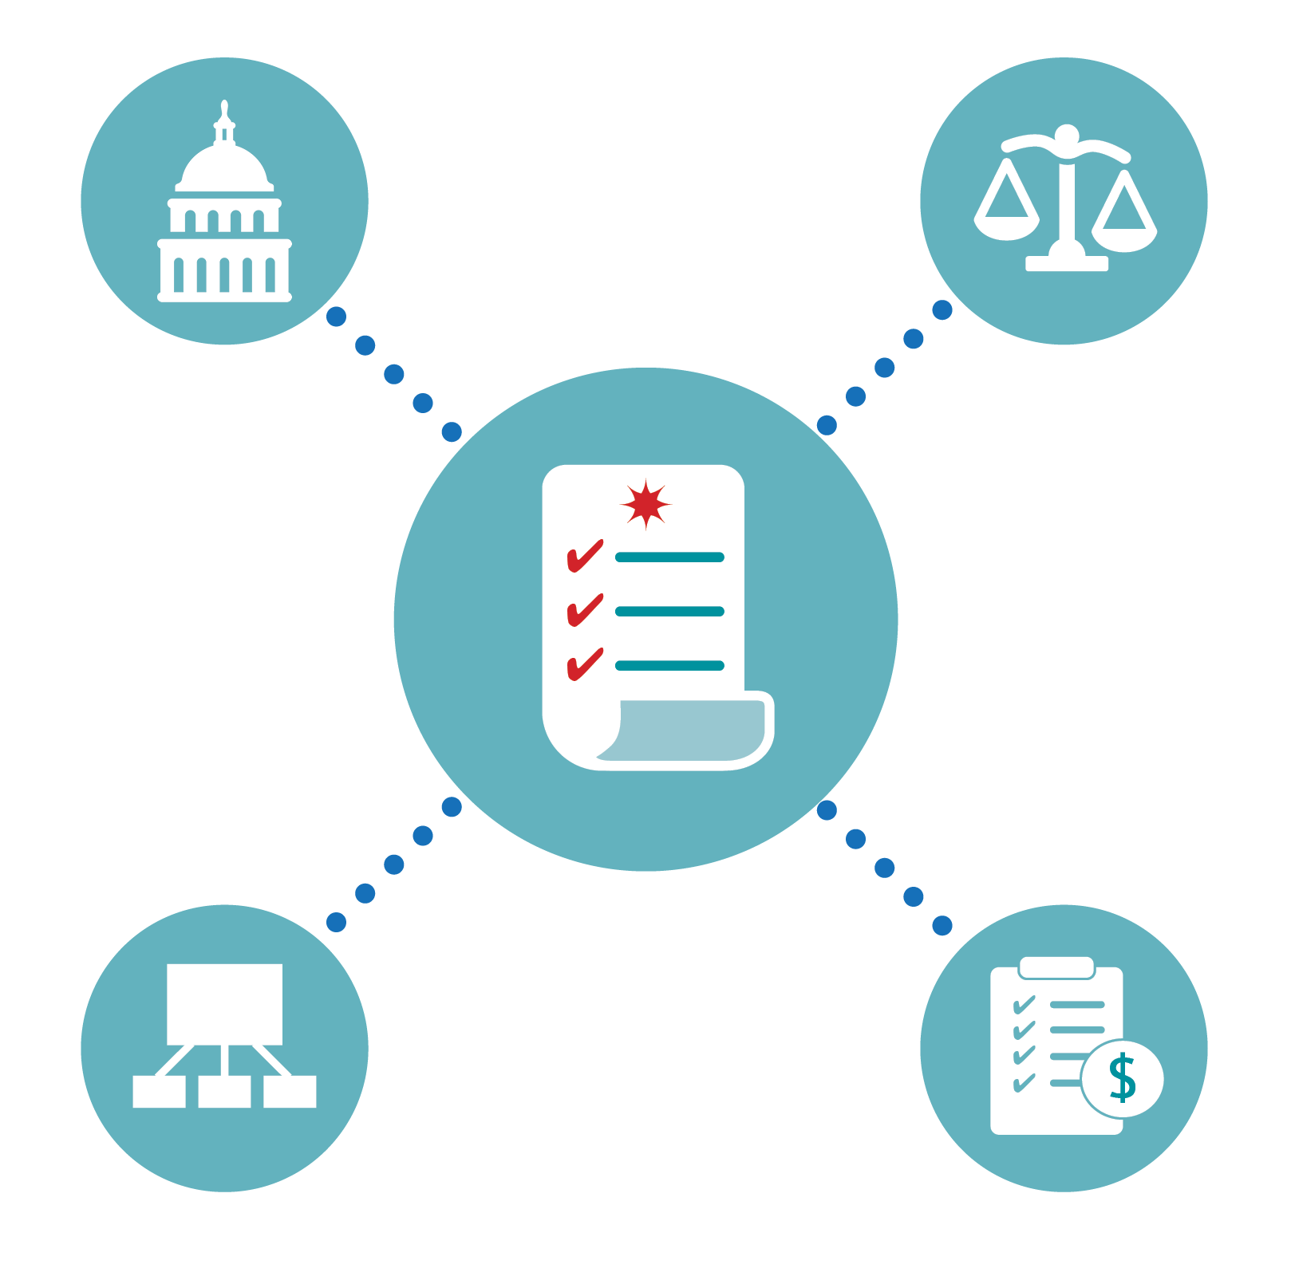
Financial Management Systems
States and other non-Federal entities must expend/account for grant funds per their own policies and procedures, applicable Federal statutes, regulations, and terms and conditions of the award. (whichever are more restrictive)

Slide 10

Financial Management Systems
Accounting and Internal Controls:
Proper stewardship of federal resources is an essential responsibility of the grantee organization.
Grantees must ensure that Federal programs and resources are used efficiently and effectively to achieve desired objectives.

Slide 11

Financial Management Systems
Adequate Accounting System:
Present and classifies costs,
as required for budgetary and evaluation purposes.
Provides cost and property control to ensure optimal use of funds.
Controls funds/resources to assure conformance with general or special conditions.

Slide 12

Financial Management Systems
Adequate Accounting System:
Meets requirements for periodic reporting.
Provides financial data for planning, control, measurement, and evaluation of direct and indirect costs.

Slide 13



Financial Management Systems
Financial Management Systems must
be able to record and report on the:
- - - - - - - - - - - - - -
RECEIPT
OBLIGATION
EXPENDITURES

Slide 14
Internal Controls

Slide 15






Internal Controls
Vision
Monitor
INTERNAL CONTROLS
Policy &
Procedures
Risk Assessment
Communication

Slide 16

Internal Controls
Internal Controls and Segregation of Duties:
Strong internal controls allow for effective and efficient operations, reliable financial reporting, and compliance with applicable laws and regulations.
Proper segregation of duties should ensure that no individual has the ability to either conceal or misdirect funds within the agency.

Slide 17
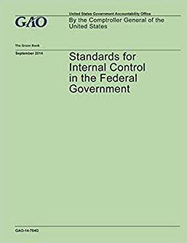
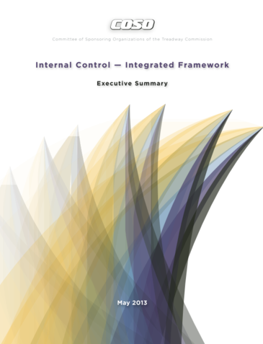
Internal Controls
Non-federal entities are required to implement adequate internal controls to ensure full compliance with all regulations.
Standards for Internal Controls in the Federal Government – (Green Book).
Internal Control Integrated Framework / (Committee
of Sponsoring Organizations
of the Treadway
Commission – COSO).

Slide 18
Standards for Costs

Slide 19
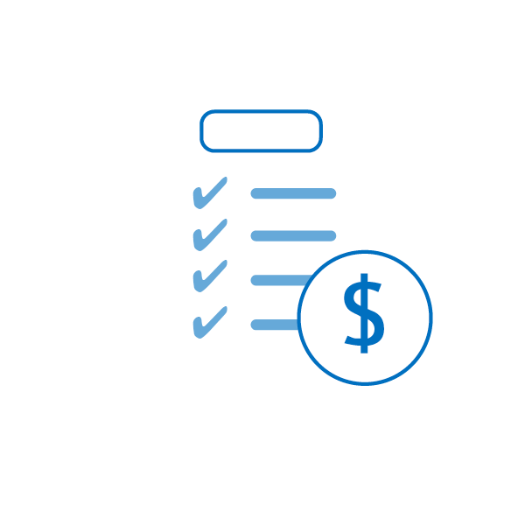
Standards for Costs
Standards for Costs Requires:
Allowable
Necessary to the performance of a project
Reasonable
Allocable to the project and consistently treated
Non-profitable
Claimed against only one award, and
Permissible under State & Federal laws and regulations.
Lobbying Restrictions

Slide 20
Types of Costs
Allowable
Unallowable
Unauthorized
Unsupported
Unreasonable

Slide 21

Allowable Costs
Costs that are necessary, reasonable, allocable, not prohibited under State/local laws or regulations. Costs must conform to any limitations set forth in Federal laws and comply with the terms and conditions of the Federal award, and claimed against only one award.
Allowable Costs

Slide 22
Unallowable Costs
Costs not allowed under Federal programs include, but are not limited to lobbying, land acquisition, fund raising, entertainment, contingencies, and alcoholic beverages.

Slide 23
Unauthorized Costs
Costs are not authorized when there is no consent from the awarding agency to incur costs, not included in the approved budget, or occurs before or after the grant award period.

Slide 24
Unsupported Costs
Costs which do not contain adequate documentation to support work performed or costs charged to the Federal award.
?
?
?
?
?

Slide 25
Unreasonable Costs
Costs deemed excessive or unreasonable when its nature and amount exceeds that which would be incurred by a prudent person when the decision was made.
!
!
!
!
!

Slide 26
Grants Award Modification (GAM)
Notes:
A Grant Adjustment Notice (GAN) is used to request project changes and/or corrections to any programmatic, administrative, or financial change associated with a grant award. All GANs must be requested electronically by System (GMS),

Slide 27

Grant Award Modification (GAM)
The purpose of a Grant Award Modification (GAM) is to update/modify key facts or details about the award.
There are three types of award changes that can be performed in the GAM system:
  Financial;
  Project Period Extension; and
  Programmatic.

Slide 28
Grant Award Modification (GAM)
Financial GAMs have four subtypes:
  Budget Modification;
  Budget Reduction;
  Sole Source Approval; and
  Budget Clearance (Financial Grants Management Initiator only).
Project Period Extension GAM is used to extend the length of the funded award.
Programmatic GAMs have two subtypes:
  Programmatic Costs; and
  Scope Change.

Slide 29
Reporting Requirements

Slide 30
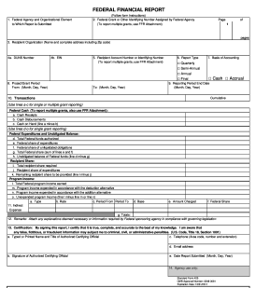



Reporting Requirements
Federal Financial Report (SF–425)
Submitted Quarterly
Progress Reports – Programmatic Reports Submitted Annually, Semi-annually or Quarterly

Slide 31
2 CFR Part 200/Subpart F
Audit of non-Federal Entities
Expending Federal Awards

Slide 32
Audit Requirements
2 CFR
Subpart F applicable
to all
non-federal entities
Thresholds $750K
or more expended during
the FY –
Single Audit required
Audit Report due nine (9) months after end of FY
Submit
online to Federal Audit Clearinghouse
(FAC)
$15,000
or more in questioned costs must
be included
in the Single
Audit report
Due
9 Months after end
of FY
Submit online to FAC
$15K
Questioned Costs
2 CFR Subpart F
$750K
Thresholds
Notes:
2 CFR Subpart F applicable to all non-federal entities
Thresholds $750K or more expended during the FY - Single Audit required
Audit Report - due nine (9) months after end of FY
Submit online to Federal Audit Clearinghouse (FAC)
$15,000 or more in questioned costs must be included in the Single Audit report

Slide 33
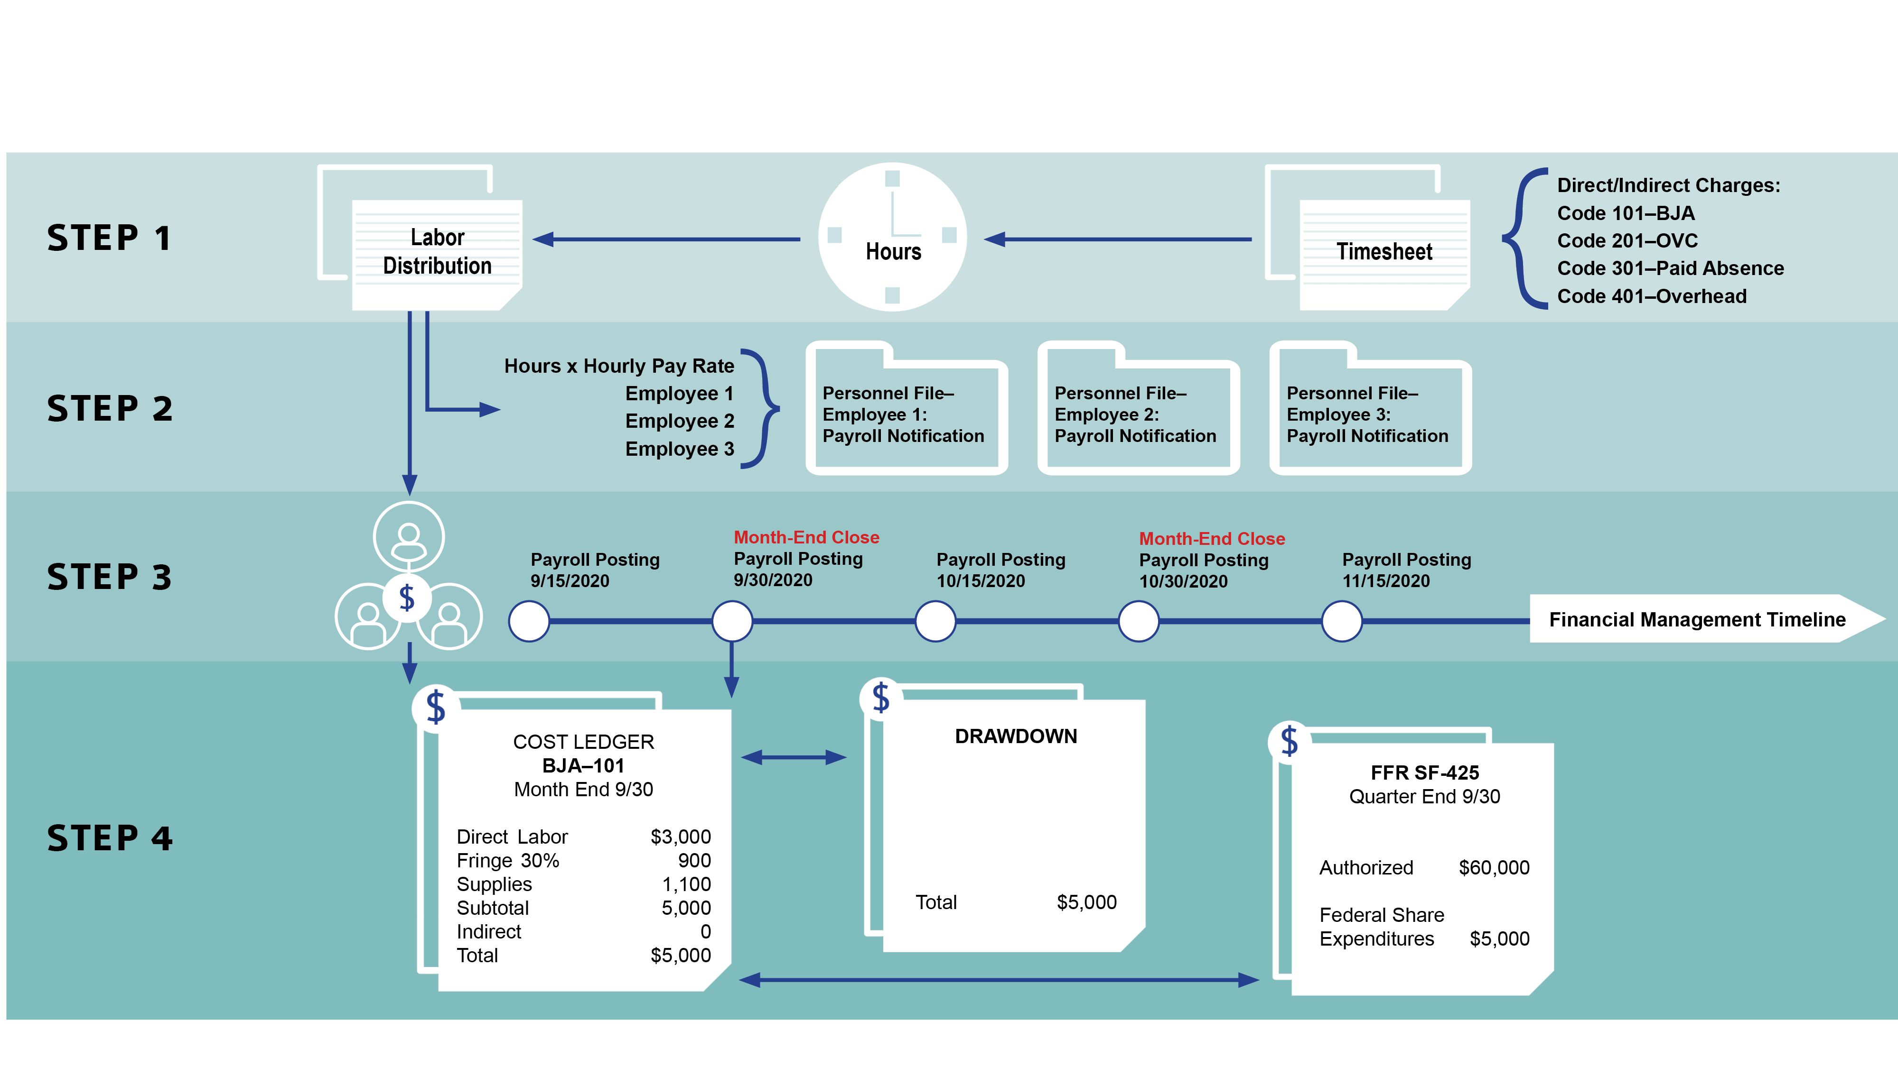
Audit Trail

Slide 34

Single Audit
Federal Audit Clearinghouse (FAC) Requirement
  All grant recipients to submit online via Internet Data Entry System (IDES):
form
SF SAC
Single Audit Report package
IF AUDIT REPORT IS DELINQUENT, FUNDS MAY BE WITHHELD.

Slide 35



Single Audit
To use the online system:
http://harvester.census.gov/facdissem/Main.
  Questions about submission can be addressed to:
  Phone #: 800-253-0696
  Email: govs.fac.ides@census.gov
IF AUDIT REPORT IS DELINQUENT, FUNDS MAY BE WITHHELD.

Slide 36


Resolution of Audit Reports
Office of Audit, Assessment, and Management
Establish working file for the audit report.
Review and analyze the audit report.
If there are any findings, a letter must be generated to the audited recipient. This letter should include a request for a Corrective Action Plan (CAP).

Slide 37
Resolution of Audit Reports
The corrective action plan (CAP) should include:
Description of each finding.
Specific steps to implement the recommendation.
Timetable for performance of each corrective action.
Description of monitoring to be performed.

Slide 38

Top 10 Audit Findings (FY 2021)
Procedures not documented or need improvement.
Financial and program reports not accurate.
Special conditions not met by grantee.
Questioned costs - unsupported.
Questioned costs – unallowable.
1
2
3
4
5

Slide 39
Top 10 Audit Findings (FY 2021)
6
Drawdowns not adequately supported.
Matching funds not provided and/or inadequately supported.
Procurement not supported – (e.g., RFPs, Bids, etc.).
Suspension and Debarment – (verification not performed).
Accounting system inadequate or not effectively utilized.
7
8
9
10

Slide 40


Getting Through the Financial Maze
When in Doubt…
?
Call the Awarding Agency

Slide 41

Questions & Answers
?
?
?
?
?
?

